Slide 1
Who’s Who of World War II
Chapter 24

Slide 2
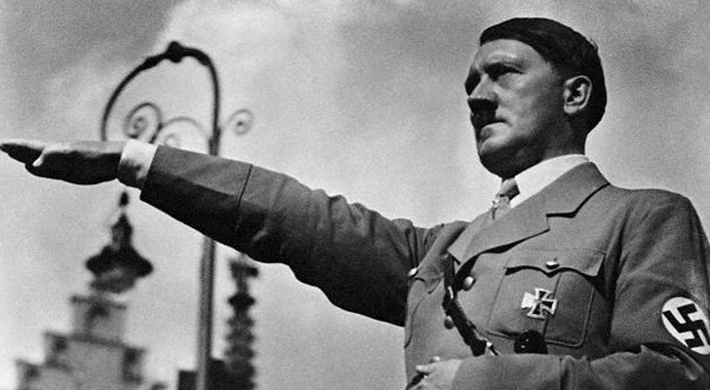
Adolf Hitler
Hitler was a soldier during World War I, but after the war joined the Nazi political party.
Nazi – National Socialist German Worker’s Party

Slide 3
Characteristics and Beliefs of Adolf Hitler
-extreme nationalism and racism
-militaristic expansionism – means making the military larger
-forceful leader
-private property with strong government controls
-anticommunist – means against communism

Slide 4
Hitler was a powerful public speaker and organizer, which helped him become the leader of the Nazi Party.
Hitler’s Goal: to unite all German-speaking people in a great German empire.

Slide 5
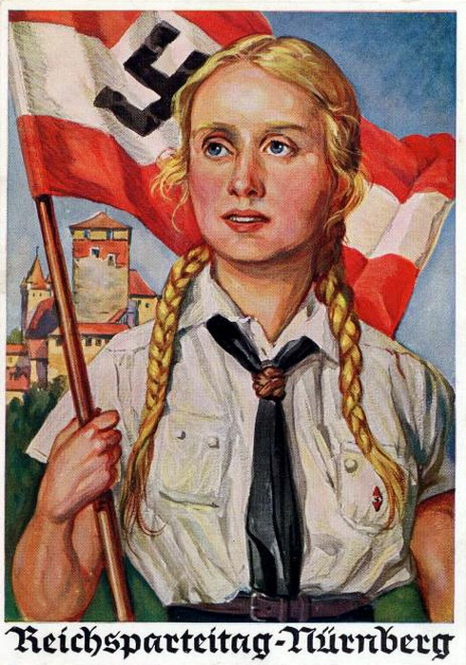
Hitler wanted to create racial purification in Germany, which he considered the “master race,” destined to rule the world.
Hitler thought “inferior races” such as Jews, Slavs, and all nonwhites were only good to serve his Aryan (German) race.
Inferior means less important or not as good as others.

Slide 6
National Expansionism – thought that Germans needed more living space and thought his German Empire was entitled to more land because they were the superior race.

Slide 7
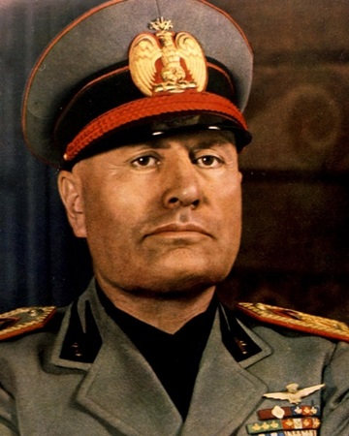
Benito Mussolini (Italy)
Benito Mussolini established a totalitarian government in Italy.
Established means to set up.
Totalitarian – the ruler or a ruling group has complete control of the government.

Slide 8
Mussolini’s government was made possible because massive unemployment and inflation (money losing spending power) caused the people to demand stronger leadership.
Mussolini won support by using the people’s fear of economic failure and communism.

Slide 9
Fascism
Fascist Party – political party that pushed the idea of nationalism and put the needs of the country above the needs of an individual person.
Believes power must be held by a small group that is loyal to fascist beliefs.

Slide 10
Mussolini took power because important government officials, the army, and the police all sided with him, so the king had to appoint him the head of the government.
Mussolini took the title “Il Duce,” meaning the leader.

Slide 11
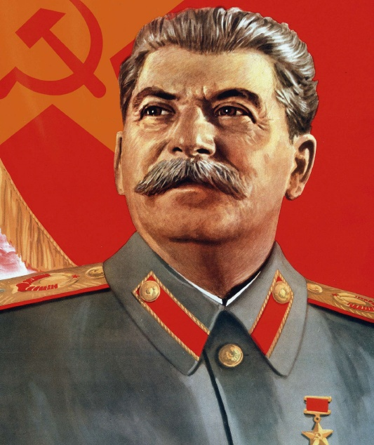
Joseph Stalin (Soviet Union)
Stalin took power of the communist government of the Soviet Union after the death of Vladimir Lenin in 1924.

Slide 12
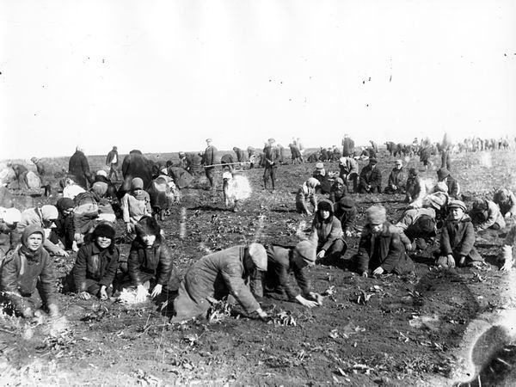
Stalin focused on creating a perfect communist country.
1. He made agricultural and industrial growth the major economic goals of the country.
2. He abolished all privately owned farms and replaced them with collectives.
Collectives – large government owned farms, each worked by hundreds of families.

Slide 13
Stalin started a set of 5-year plans: meant to direct industrialization.
Stalin kept control over the people by eliminating anyone who threatened his power, even his most faithful supporters.

Slide 14
History estimates that Stalin is responsible for the deaths of 8-13 million people.
By 1939, Stalin had established a totalitarian government that maintained complete control over its citizens. Individuals had no rights and the government ends all opposition.

Slide 15
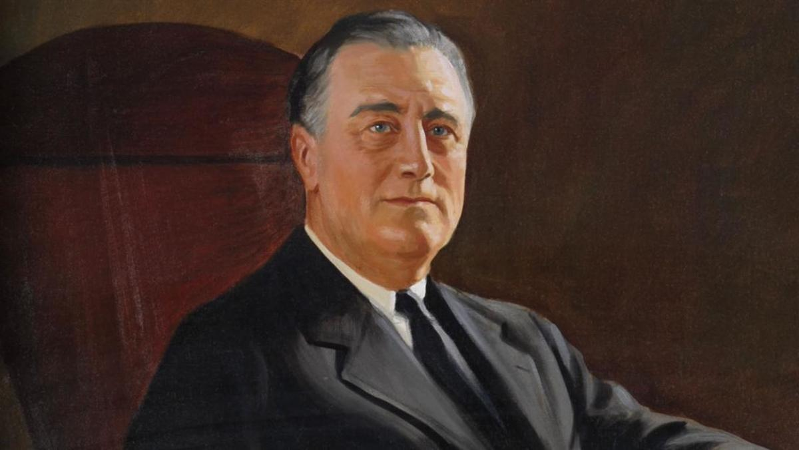
Franklin Delano Roosevelt
President of the United States from 1933-1945. The only U.S. President to serve more than two terms in office.
President Roosevelt is known as the President that led America through the Great Depression and got us through World War II.

