Slide 1
ELA, Week 34
Content Objectives
I can analyze Unit 6’s essential question (EQ): “How Can We Balance Everyone’s Rights?” by reading and discussing the historical texts: The Declaration of Independence and Sentiments (623-626).
Language Objectives
I can write to explain details about the unit and its focus on rights and responsibilities by reading and analyzing the texts and relating them back to the unit’s EQ and to my own life.

Slide 2
Declaration of Independence, Monday, 05/05/20
1) What is the Declaration of Independence is saying? Everyone is born with the right to life, liberty, and the pursuit of happiness. We have different laws from the U.K. and we deserve to be treated with these rights. The people are upset that the government is not treating them fairly.
2) How is the Declaration of Independence convincing its readers of what it is saying? The writers quote evidence of their problems.

Slide 3
Declaration Questions, 05/06/20
Inference/Implicit: Why did the authors of the Declaration of Sentiments base their document on the Declaration of Independence?
In my opinion writers the Declaration of Independence wrote the same words because it included rights and laws to follow. The Sentiments writers think that these laws should apply to women as well. They recognize that the Declaration of Independence has strong rhetoric.

Slide 4
Declaration Questions, 05/06/20
2. Vocabulary: What is an example of oppression given by the authors of the Declaration of Independence? What is an example of oppression in the Declaration of Sentiments? Explain why each is an example of oppression.
The colonists were under control of the British. We know this, because the document mentions Great Britain, and refers to it as “He” (King George). In the Sentiments article, men had more power than women. They say they cannot vote.

Slide 5
Declaration Questions, 05/06/20
3. Relate Arguments: How are the two declarations similar? How are they different? Use the authors’ claims, reasons, and evidence from both texts to explain your responses.
One way they are similar is that they both fight for human rights.
One way they are different is they are fighting for men’s equality and then women’s equality.

Slide 6
Declaration Questions, 05/06/20
4. Form Generalizations: What generalizations can you make about how the authors of the two declarations had been treated? Use evidence from each text to support your response. What do you think life was like for these two groups of people?
I think that the women experienced sexism. they always stayed at home, and stuck to their “roles” at the time.
I believe this because on page 625 “all colleges are closed against her,” meaning women.

Slide 7
“4th of July” Speech, 05/06/20
Read the speech from page 630-633 called, “What to the Slave Is the Fourth of July?” by Frederick Douglass.
As you read the story, write down notes and questions in your notebook.
You must have 10 bullet points of notes, and you must write 5 questions that you have. Your questions can be about vocabulary, ideas, history, connections to today etc.

Slide 8
“4th of July” Speech, 05/07/20
Write a paragraph (5-8 sentences) in your notebook answering the following question:
What is your opinion about Frederick Douglass’ speech about the Fourth of July? Do you agree with him? Do you disagree with him? Are there parts that you agree/disagree with? Does he use good rhetoric (logos, pathos, ethos)? Does he make strong arguments? Explain your ideas and use at least one example (with page #) from the text.

Slide 9
What is Rhetoric?
Rhetoric is the persuasive way that we speak, write, and make arguments. It uses:
Logos: when you use logic/evidence to make your points
Pathos: when you use emotions/feelings to make your points
Ethos: when you use credibility/trust to make your points

Slide 10
Unit 6 Assignment, 05/08/20
For reference, these are the texts we have read in Unit 6:
“Too Young to Drive?” (p.562-569)
“Piracy Bites” (p.584-592)
“Long Walk to Freedom” by Nelson Mandela (p. 608-620)
“The Declaration of Independence and Sentiments” (p.623-625)
“What to the Slave is the Fourth of July?” by Frederick Douglass (p.630-633)

Slide 11
Unit 6 Assignment, 05/08/20
Write a paragraph (5-8 sentences) in your notebook answering the following question:
Which text from Unit 6 was your favorite? What did you like about it? Can you relate to the text in some way? How does the text you have chosen attempt to answer the EQ: “How can we balance everyone’s rights?” Make sure to quote one line from the text (with page #) somewhere in your written response.

Slide 12
Make-up Assignment for Missing Work
I understand that access to technology and other resources has not been equal for all of you. For those reasons, I also understand it is possible that you missed our Zoom meetings for Week 31/32/33 and the notebook assignments. If you did not turn in the notebook vocabulary and assignments from Week 31/32/33, I am offering students an opportunity to replace those grades with an alternative assignment. If you already did the work for Week 31/32/33, you do not have to do this assignment, but you may do it if you want extra credit.
Last week (Week 33) we finished Nelson Mandela’s autobiography, “Long Walk to Freedom.” For 20 points, write a one-page, double-spaced, 12-point font, Times New Roman essay explaining the following points:
Why is Nelson’s Mandela’s fight to end Apartheid so important to the people of South Africa?
How is Mandela’s story about standing up for equal rights relevant to the current struggles and problems that we are experiencing in our own modern age today? You can talk about racism, segregation, COVID-19, the differences between “rights” and “responsibilities,” etc.
This assignment will be due by next Friday morning (May 8th). No exceptions.

Slide 13
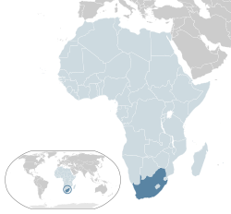
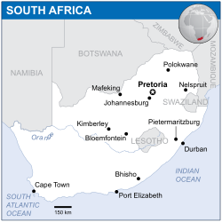
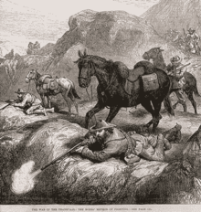
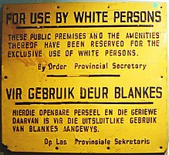
South Africa History
Around 300 CE, South Africa was settled by the native Bantu-speaking peoples.
However, In the 1650s, South Africa was colonized by the Dutch (Netherlands).
Those who became farmers on the frontier were called the Boers, who adapted semi-nomadic lifestyles.
These two groups fought for a long time, until the country was taken over by Great Britain in the 1800s.
After the Boer Wars in the early 1900s, the country eventually gained independence.
Unfortunately, those left in charge began “Apartheid” in 1948, a system of racial segregation and violence.

Slide 14
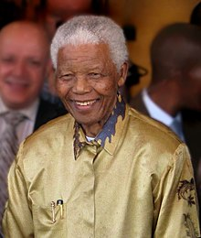
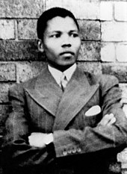
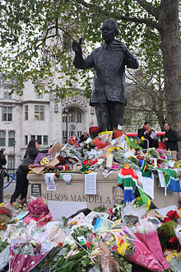
Nelson Mandela
Born 1918 – Died 2013
Mandela was born near Umtata, a city in Eastern South Africa.
As a young man, he joined the African National Congress, a group who fought against the unfair rules of Apartheid.
Initially, he viewed peaceful protest as the correct way to fight back, but he later believed that “guerilla sabotage” (destroying things like power plants, military buildings, and telephone lines when civilians were not present) was the only way to stop oppression.
For this reason, he is still a heroic and controversial figure.
He was jailed in 1962, but he was later released from prison in 1990 and elected President of South Africa in 1994.

Slide 15
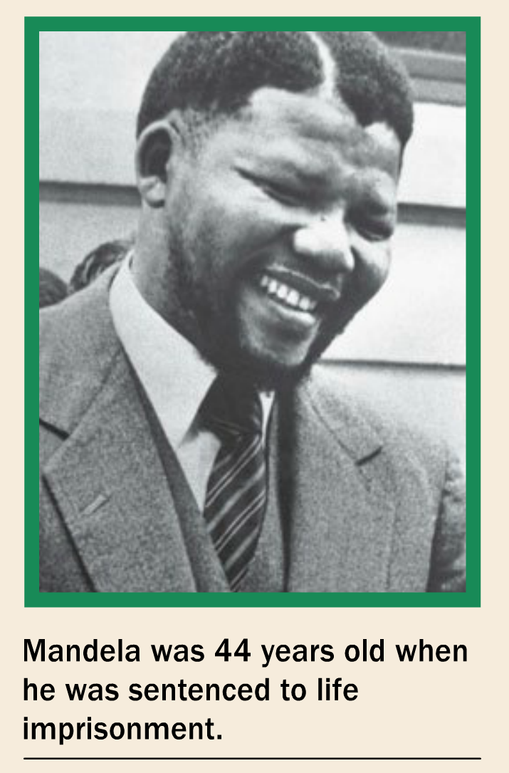
“Long Walk to Freedom” Notes
Setting: Mandela makes his inauguration speech in Pretoria, South Africa.
Mandela protested the unfair rules of Apartheid/segregation.
South Africa is called the Rainbow Nation.
Mandela honors the past by giving credit to all those African leaders and protestors who came before him.
(p.614-617) Mandela says that he, and all South Africans, should feel like they are born free.
He says that every person is born with a responsibility to take care of their family and their community.
When he is in prison, he comes to believe that “the chains on any one of (his) people were the chains on all of them.”
He wants to liberate both the oppressed and the oppressor from prejudice.

Slide 16
“Long Walk to Freedom,” 04/27/20
Do you agree/disagree with the following quotes? Write a paragraph for one of them and explain your answers.
“Courage is not the absence of fear, but the triumph over it” (613).
“People must learn to hate, and if they can learn to hate, they can be taught to love, for love comes more naturally to the human heart than its opposite” (614).

Slide 17
“Long Walk to Freedom,” 04/29/20
In your own words, explain “Apartheid.”
Who was Nelson Mandela, and why do we talk about him today as both a heroic and a controversial figure?
Why is South Africa called the rainbow nation?
What was the African National Congress (ANC)?
Why does Mandela say he is “the sum of all those African patriots” (612) who came before him?
What are the “twin obligations” (614) that every person is born with? Why does Mandela believe this?
What is the revelation that Mandela learns when he is in prison? (616-617).

