Slide 1
ELA, Week 32-33
Content Objectives
I can analyze Unit 6’s essential question: “How Can We Balance Everyone’s Rights?” by reading and discussing the autobiography “Long Walk to Freedom” by Nelson Mandela (p.608-615).
Language Objectives
I can write to explain details about the unit and its focus on rights and responsibilities by reading and analyzing the informative text and relating it back to the unit’s essential question and to my own life.

Slide 2
Week 32, Key Vocabulary (p.606)
apathetic (adjective): when you have no interest in something
distinction (noun): the main difference between two or more things
emancipation (noun): freedom from enslavement
exploitation (noun): the act of using people in a selfish way
inclination (noun): when you have a liking for something
liberate (verb): to set someone or something free
motivate (verb): to encourage someone to do or achieve something
oppression (noun): when you feel like you are being treated unfairly and that you have no rights
Compound: For, And, Nor, But, Or, Yet, So (FANBOYS)
Complex: after, before, whenever, while, when, until, because, since, if, unless, although, even though

Slide 3
Week 32, Sentences (p.606)
apathetic (adjective): The girl was very apathetic towards Sarah’s composition.
distinction (noun): There is a distinction between nouns and pronouns.
emancipation (noun): Abraham Lincoln signed the emancipation proclamation to free slaves.
exploitation (noun): This was very unfair exploitation of the poor by the British.
inclination (noun): I have an inclination for…
liberate (verb): Lincoln liberated the slaves.
motivate (verb): I motivate my sisters.
oppression (noun): I felt oppression in school.
Compound: For, And, Nor, But, Or, Yet, So (FANBOYS)
Complex: after, before, whenever, while, when, until, because, since, if, unless, although, even though

Slide 4
Week 32, Sentences (p.606)
apathetic (adjective): He is apathetic about soccer.
distinction (noun): There is a distinction between your homework and your classwork.
emancipation (noun): Abraham Lincoln signed the emancipation proclamation to end slavery.
exploitation (noun): The exploitation of children is bad.
inclination (noun): I have an inclination for soccer.
liberate (verb): Abraham Lincoln liberated the slaves.
motivate (verb): I motivate my sister to do her homework.
oppression (noun): I feel oppression at work.
Compound: For, And, Nor, But, Or, Yet, So (FANBOYS)
Complex: after, before, whenever, while, when, until, because, since, if, unless, although, even though

Slide 5
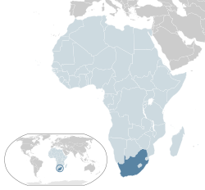
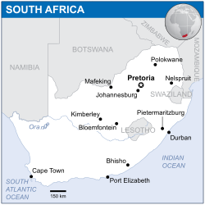
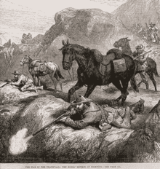
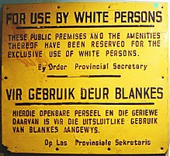
South Africa History
Around 300 CE, South Africa was settled by the native Bantu-speaking peoples.
However, In the 1650s, South Africa was colonized by the Dutch (Netherlands).
Those who became farmers on the frontier were called the Boers, who adapted semi-nomadic lifestyles.
These two groups fought for a long time, until the country was taken over by Great Britain in the 1800s.
After the Boer Wars in the early 1900s, the country eventually gained independence.
Unfortunately, those left in charge began “Apartheid” in 1948, a system of racial segregation and violence.

Slide 6
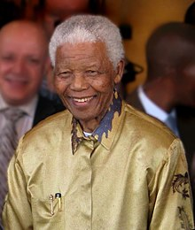
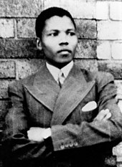
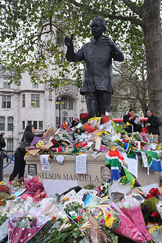
Nelson Mandela
Born 1918 – Died 2013
Mandela was born near Umtata, a city in Eastern South Africa.
As a young man, he joined the African National Congress, a group who fought against the unfair rules of Apartheid.
Initially, he viewed peaceful protest as the correct way to fight back, but he later believed that “guerilla sabotage” (destroying things like power plants, military buildings, and telephone lines when civilians were not present) was the only way to stop oppression.
For this reason, he is still a heroic and controversial figure.
He was jailed in 1962, but he was later released from prison in 1990 and elected President of South Africa in 1994.

Slide 7
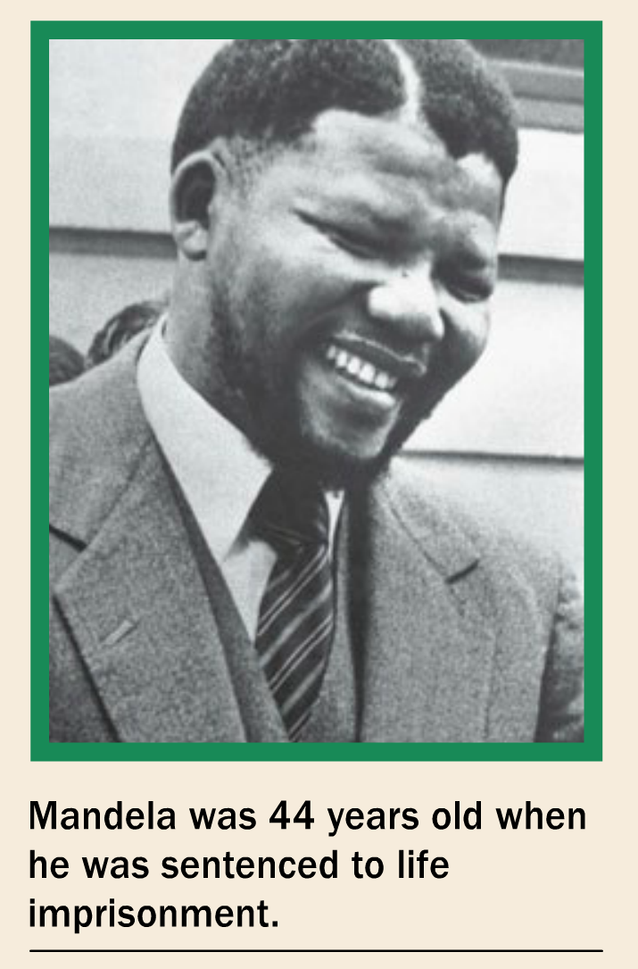
“Long Walk to Freedom” Notes
Setting: Mandela makes his inauguration speech in Pretoria, South Africa.
Mandela protested the unfair rules of Apartheid/segregation.
South Africa is called the Rainbow Nation.
Mandela honors the past by giving credit to all those African leaders and protestors who came before him.
(p.614-617) Mandela says that he, and all South Africans, should feel like they are born free.
He says that every person is born with a responsibility to take care of their family and their community.
When he is in prison, he comes to believe that “the chains on any one of (his) people were the chains on all of them.”
He wants to liberate both the oppressed and the oppressor from prejudice.

Slide 8
“Long Walk to Freedom,” 04/27/20
Do you agree/disagree with the following quotes? Write a paragraph for one of them and explain your answers.
“Courage is not the absence of fear, but the triumph over it” (613).
“People must learn to hate, and if they can learn to hate, they can be taught to love, for love comes more naturally to the human heart than its opposite” (614).

Slide 9
Student Responses
Courage is not the absence of fear doesn’t mean that you have no fear. Someone who can overcome their fears has the courage to face it. You have to decide that there’s other stuff other than being scared. It taught me to face my fears and try my best to overcome it, and victory over the fear.

Slide 10
Student Responses
Yes, I agree with this because courage doesn't mean you're not afraid of something, courage means that you are willing to stand up for something you were afraid of. It also means having the ability to face your fears, and according to Mandela, courage is not the absence of fear. It means fighting and overcoming the fear.

Slide 11
Student Responses
I chose the first quote because I agree with this quote. I have fear with lots of things, and I think I should face them. If I don't face them, they will stay with me. I will not be able to move on if my fears will stay with me. I should face my fear to break it and move on in my life. Everyone should do that. This is very important for everyone and that's why I agree with this quote.

Slide 12
Student Responses
I chose the second quote because everyone needs to always understand what other people feel. If you know what a person feels from hate, you can help that person and many others learn. So what I'm basically saying is to put your feet in someone's shoes. This helps everyone feel positive and the world can come together in peace.

Slide 13
Student Responses
"People must learn to hate, and if they can learn to hate, they can be taught to love, for love comes more naturally to the human heart than its opposite" (614).
A person cannot build on hatred. It is like someone who builds on a swamp.

Slide 14
“Long Walk to Freedom,” 04/29/20
In your own words, explain “Apartheid.”
Who was Nelson Mandela, and why do we talk about him today as both a heroic and a controversial figure?
Why is South Africa called the rainbow nation?
What was the African National Congress (ANC)?
Why does Mandela say he is “the sum of all those African patriots” (612) who came before him?
What are the “twin obligations” (614) that every person is born with? Why does Mandela believe this?
What is the revelation that Mandela learns when he is in prison? (616-617).

