Slide 1
War In Europe
Chapter 24 Section 2

Slide 2
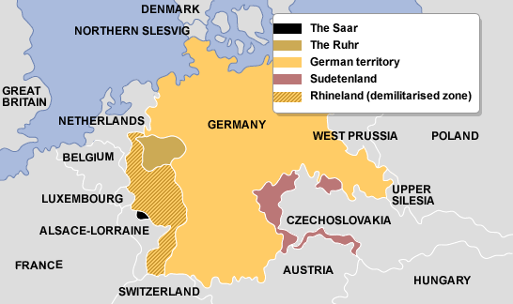
Austria and Czechoslovakia Fall
In 1937, Hitler met with his top military advisers to create a plan to take over the land of Austria and Czechoslovakia.
Austria is a German speaking country and Czechoslovakia had parts of the country that spoke the German language.
His advisers told him that taking these countries by force would cause a war, but he claimed it was a necessary risk.

Slide 3
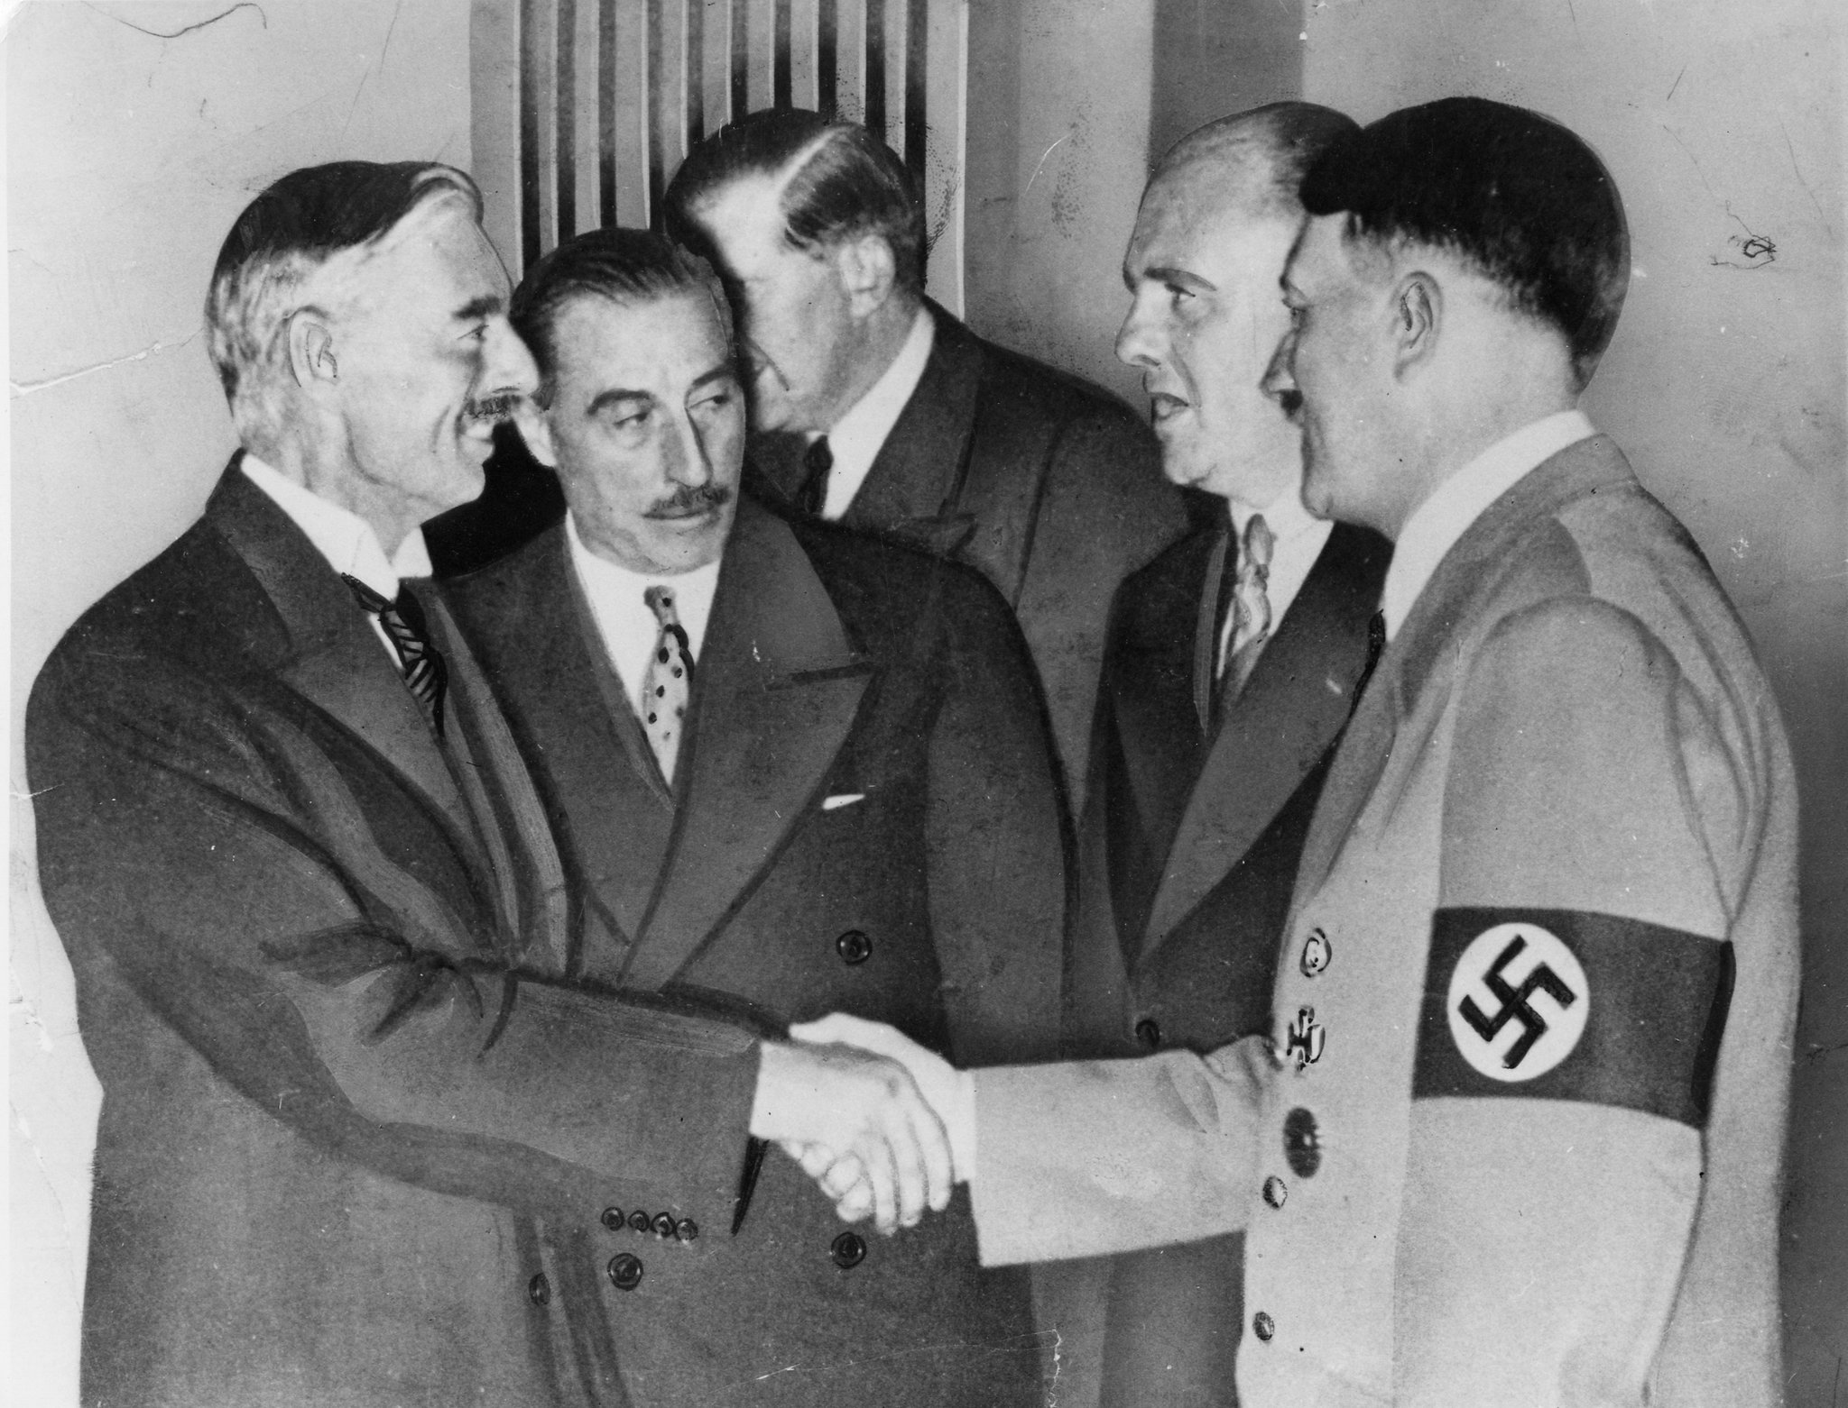
Sudetenland in Czechoslovakia
About 3 million German-speaking people lived in the area of Czechoslovakia called Sudetenland.
Hitler wanted to take over Czechoslovakia to gain more living space for Germans and to gain control of the natural resources found there.
Hitler claimed that the Czechs were abusing the Germans in the Sudetenland and started to send military troops to the Czech border in preparation for the attack.
Even though both France and Great Britain said they would help protect Czechoslovakia, that changed when Hitler invited Edouard Daladier of France and Neville Chamberlain of Great Britain to Munich. He told them that the Sudetenland would be the last place he would invade.

Slide 4
Munich Agreement
Chamberlain and Daladier believed Hitler, mostly because they really wanted to avoid war and this gave them that opportunity.
The three leaders signed the Munich Agreement, which allowed Germany the right to conquer Czechoslovakia without interference from Great Britain or France.

Slide 5
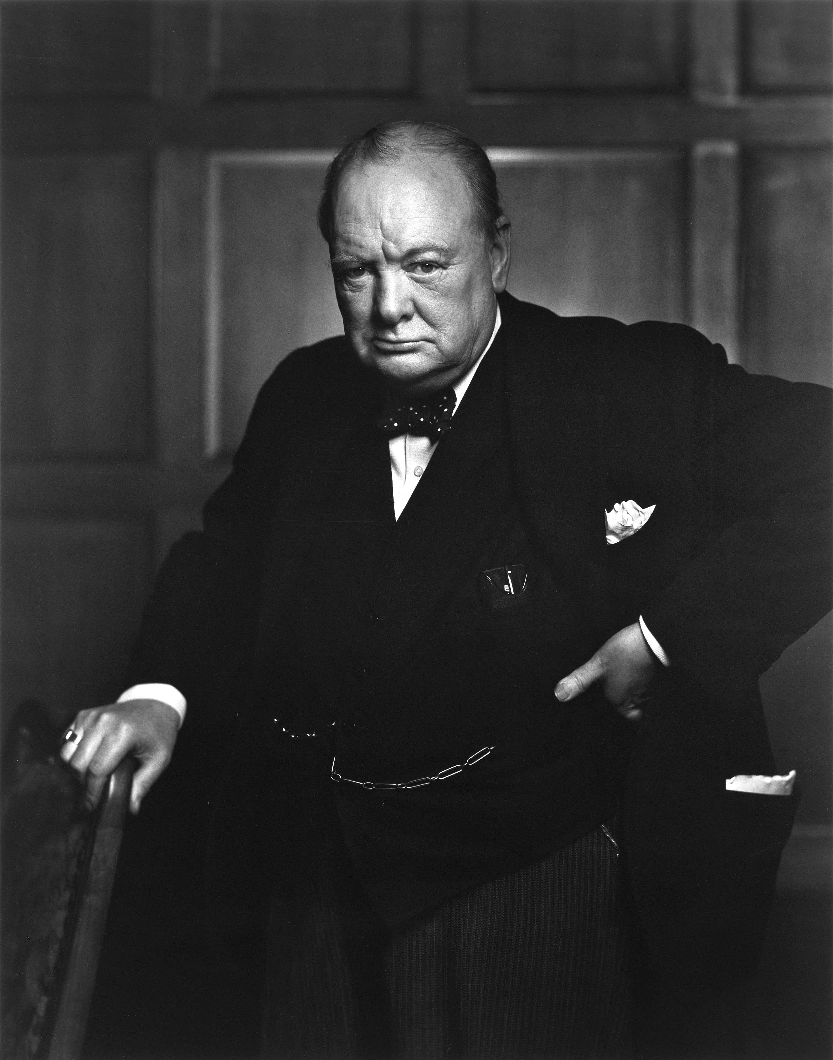
Winston Churchill Disagrees
Winston Churchill, a political opponent of Neville Chamberlain, disagreed with the deal made with Hitler.
He claimed that the signing of the Munich Agreement was just starting a policy of appeasement, and Great Britain should be ashamed of it.
Appeasement – giving up what you believe in to avoid conflict

Slide 6
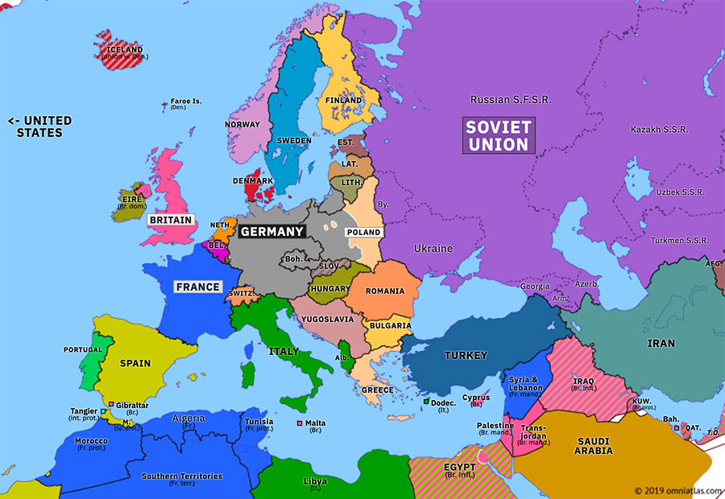
The German Offensive Begins
Even though Hitler had promised that after he took control of Austria and Czechoslovakia, he would stop, he did not follow through on that promise.
After Germany conquered Czechoslovakia, he began plans to attack Poland.

Slide 7
Hitler’s Invasion of Poland
Since Germany also shared a border with Poland, there were some German speakers that lived in areas of Poland.
Hitler used the same excuse as he did with Czechoslovakia, claiming that Germans living in Poland were being treated badly. He used this as his reason to justify invading Poland.
Poland did not believe that Hitler would be foolish and attack Poland, assuming that the attack would anger Stalin of the Soviet Union, since in order to attack Poland, Hitler would be marching his armies up to the border of the Soviet Union.

Slide 8
Another reason that Poland did not think that Hitler would invade was because it would cause France and Great Britain to declare war on Germany in defense of Poland, as they had promised.
If France and Great Britain declared war on Germany, Germany would be forced into fighting a war on two fronts, just like in World War I.
Front – the area at the front of a country’s military attack

Slide 9
Nonaggression Pact
Since attacking Poland was likely to anger Stalin in the Soviet Union, Hitler made an agreement with Stalin.
Hitler and Stalin agreed to divide Poland between their two countries. This would make it so that Hitler could use his army to invade Poland without threatening Stalin in the Soviet Union.
The agreement also said that Hitler promised never to invade the Soviet Union.
He would end up going against this promise too.

Slide 11
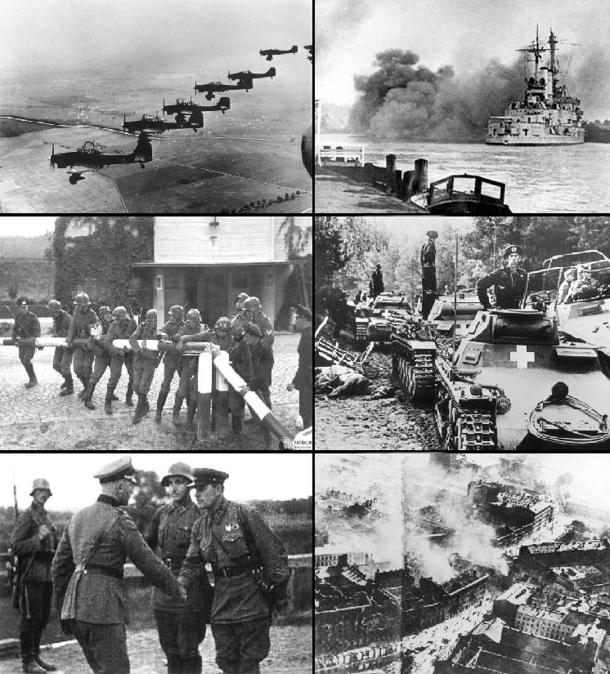
Blitzkrieg
Blitzkrieg – German for lightning war
The blitzkrieg style of attack was an idea that Hitler started when he invaded Poland.
Hitler put all parts of his military, foot soldier, tanks, and planes, and had them all invade Poland at once.
This idea of a quick and sudden invasion caught Poland so off guard that they were completely defeated and under German control in just a few weeks.

Slide 12
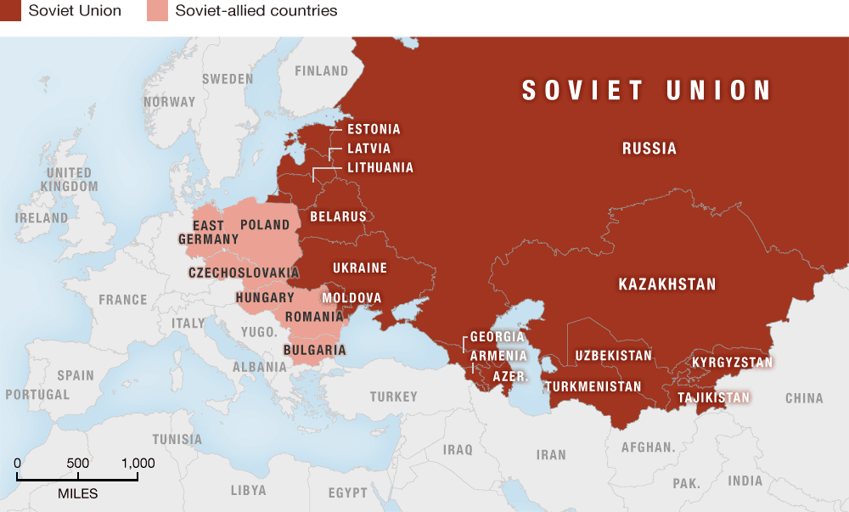
Stalin Starts His Attacks
After Stalin took control of the eastern half of Poland, he kept up his attacks.
Stalin sent his army to take control of the 3 Baltic Countries (Latvia, Lithuania, and Estonia) and then on the conquer Finland.

Slide 13
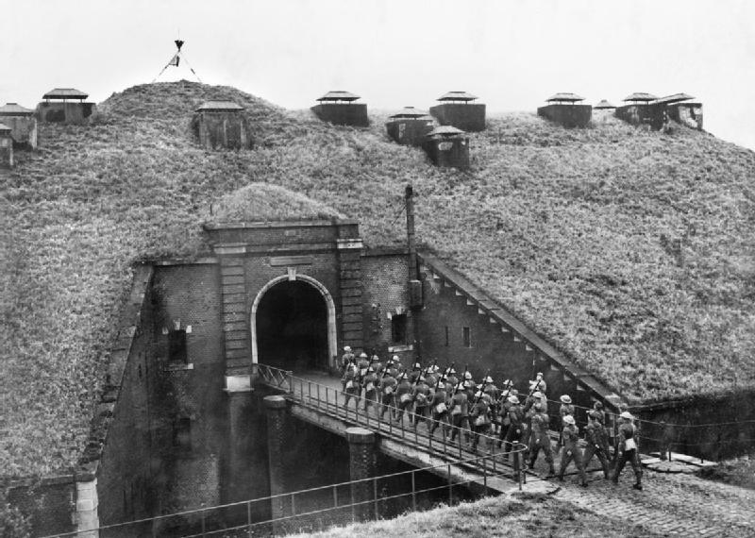
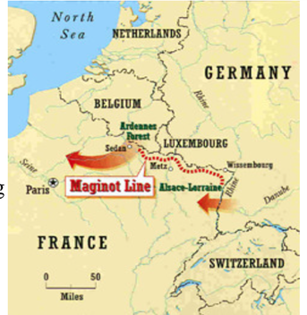
France is Taken Over By Germany
Maginot Line – a line of fortifications along France’s eastern border
To get around the Maginot Line, Hitler sent the German army through the Ardennes Forest in Belgium, which France thought was not going to happen because the forest is too hard to pass an army through. They were wrong.
The German army made it through Belgium and would take control of the French capital of Paris.

Slide 14
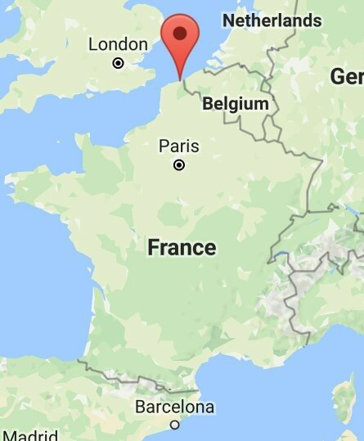
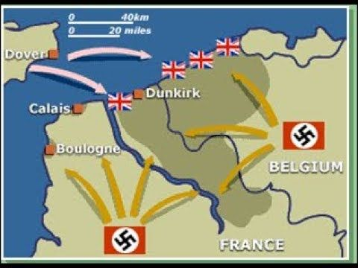
Dunkirk
As the German army moved into France and Belgium, they trapped almost 400,000 British and French soldiers on the beaches of Dunkirk.
The British gathered military and volunteer boats of every size to make dangerous trips across the English Channel between France and England to get the trapped soldiers to safety in England.

Slide 15
Italy Officially Joins the War
In June 1940, Italy invaded France from the south, while Germany was invading France from the north.
France was forced to surrender to Hitler on June 22, 1940, but French General Charles de Gaulle escaped to England and set up a French government in exile, using England as the base.
Charles de Gaulle was set on a future attack to regain control of France from the Germans.

Slide 16
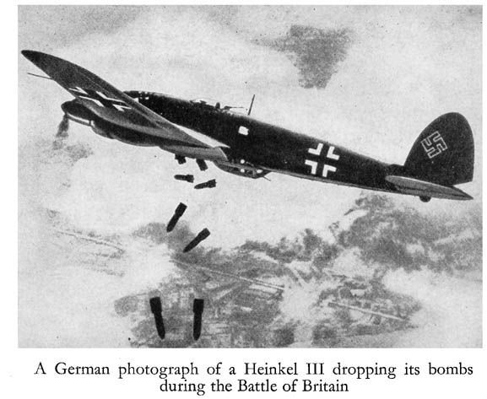
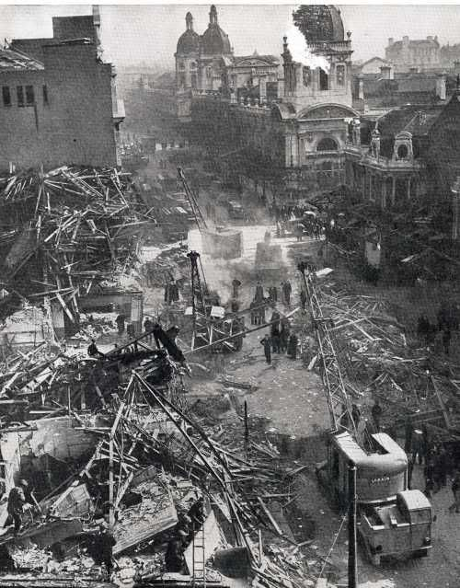
Battle of Britain
In the summer of 1940, the German Luftwaffe (German air force) began bombings over Great Britain, mostly over the city of London.
The goal was to destroy the British air force (RAF) and destroy London, Great Britain’s capital city and government headquarters.
The bombing occurred almost every day for over two months.
In the end, the British air force was able to shoot down enough German planes that Hitler stopped the bombings.
The city of London had been largely damaged though.

Slide 17
Major Countries Involved as of 1940
Allied Powers
Axis Powers
England
France
Germany
Italy
Soviet Union
Japan

