Slide 1
The War for Europe and North Africa
Chapter 25 Section 2

Slide 2
The United States and Britain Join Forces
In a meeting at the White House between President Roosevelt and Prime Minister Winston Churchill, it was decided that the Germany and Italy were the bigger threat to both England and the U.S.
Even though the U.S. would be involving its military with defeating Japan in the Pacific Ocean, its biggest focus would be on the war in Europe.

Slide 3
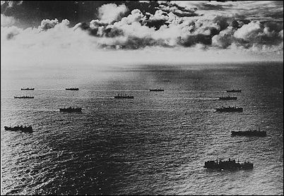
Battle of the Atlantic
Hitler was ordering submarine attacks along the east coast of the United States.
His hope was to destroy American ships before they could deliver food and war materials to Great Britain and the Soviet Union.
In the first four months of 1942, Hitler’s submarines sank 87 ships off the Atlantic coast.
By July, German wolfpacks, destroyed 681 Allied ships.
Wolfpack – group of German submarines that would attack together

Slide 4
Allies Response to the Battle in the Atlantic
In response to the German wolfpack attacks, the U.S. set up convoys of ships to protect its ships and supplies trying to make it to Europe.
Convoy – group of smaller ships escorting the larger supplies ships for protection.
The convoys had boats with sonar for detecting submarines underwater.
Airplanes also flew over the convoys to spot threats from the air.
Due to these convoys, the Allies destroyed German U-Boats (submarines) faster than the Germans could build them.

Slide 5
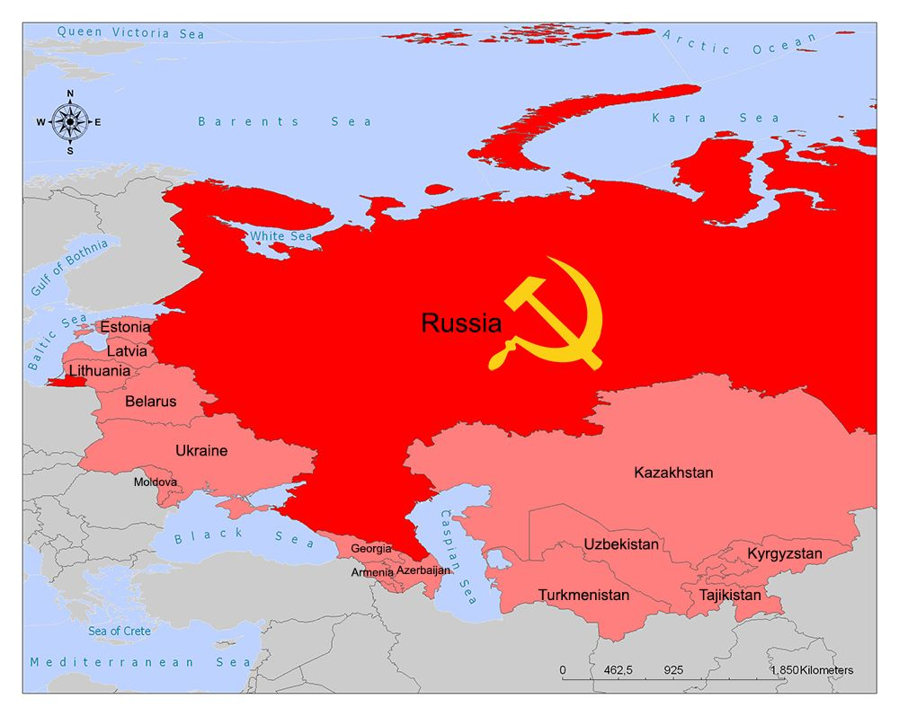
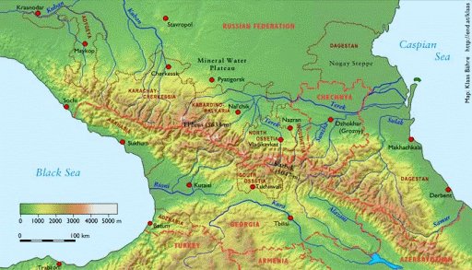
The Battle of Stalingrad
The Germans had been fighting in the Soviet Union since June 1941, but in November the cold of Soviet winter stopped them from advancing just outside the Soviet Union cities of Moscow and Leningrad.
In the summer of 1942, Hitler invaded the southern Soviet Union to try to take control of the oil fields near the Caucasus Mountains.
He also wanted to destroy Stalingrad, a major industrial center for the Soviet Union.

Slide 6
The German army approached Stalingrad in August 1942.
The German air force sent bombing raids over Stalingrad almost every night to help make it easier for the ground troops to take the city.
By September, the Germans controlled most of what was left of Stalingrad, but then another winter started and the Soviets, who were use to the cold winters, started to fight back.
The Soviets circled and surrounded the Germans, trapping them in the city of Stalingrad and cutting them off from any help or supplies.

Slide 7
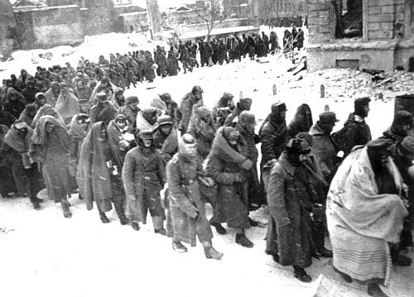
The German commander surrendered on January 31, 1943.
The Soviets lost a total of 1,100,000 soldiers defending Stalingrad, which was more than the U.S. lost during the whole war.
The Battle of Stalingrad was the point in the war that the Soviets started winning and moving its army towards Germany.

Slide 8
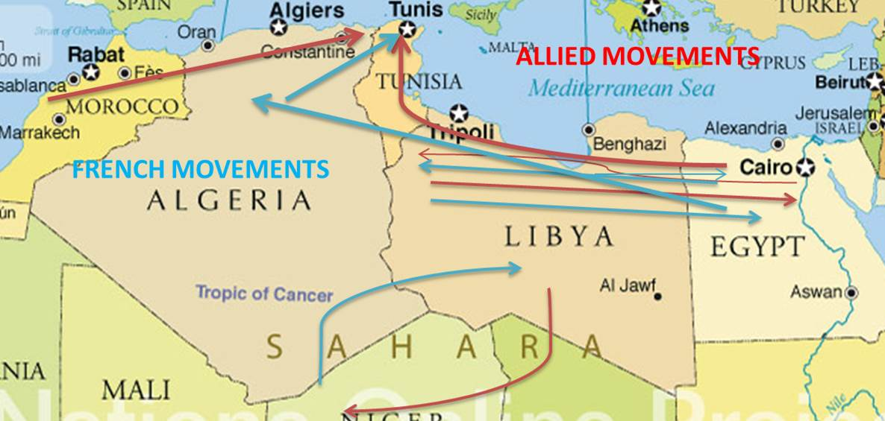
Fighting In North Africa
Allied started “OPERATION TORCH,” which was a mission to invade northern Africa, which was controlled by the Axis Powers.
American General Dwight D. Eisenhower led the American forces.
The American forces started in Casablanca, Morocco and headed east across northern Africa to try to chase out the Axis Powers led by General Erwin Rommel.
The combined American and British forces drove the Axis Powers all the way across North Africa and into Egypt. By May 1943, Rommel and the Axis Powers had been driven out of North Africa.

Slide 9
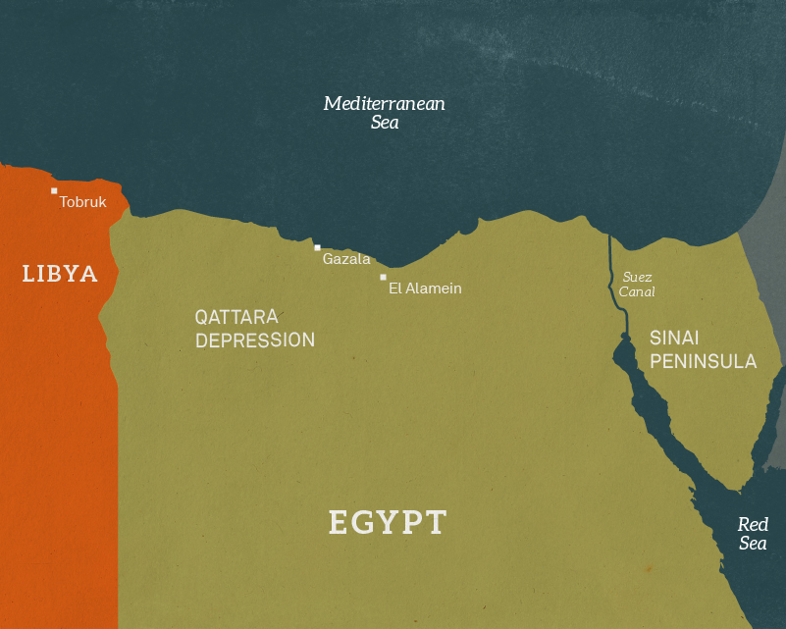
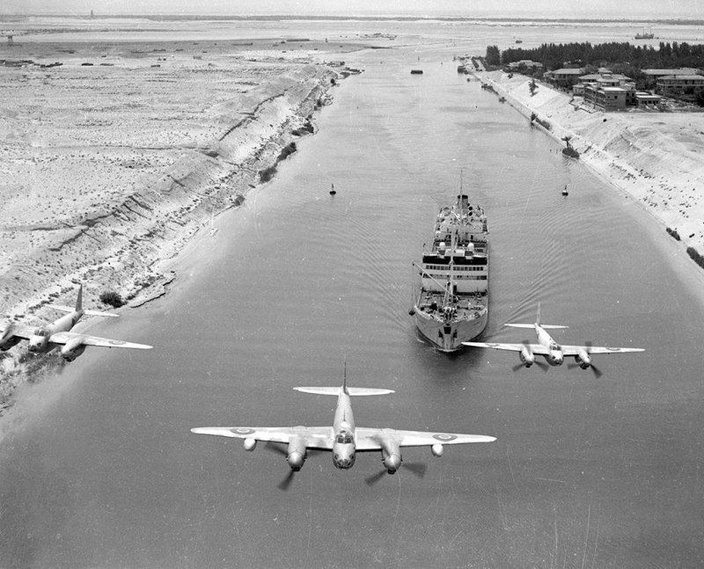
The Goal of the Axis Powers in North Africa
The major push to control North Africa was most importantly a fight to control the Suez Canal.
Suez Canal – the man made waterway that was owned by the British during World War II and was the major water route between the Mediterranean Sea and the Red Sea.

Slide 10
Erwin Romell the “Desert Fox”
Erwin Rommel was nicknamed the Desert Fox because of his
Success in desert warfare, like they were facing in North Africa.

Slide 11
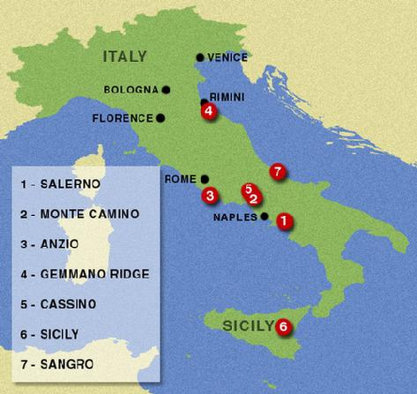
The Invasion of Italy
In the summer of 1943, the combined American and British troops started their push to attack and control Italy.
The first major victory was the Allied takeover of Sicily, and island part of Italy.

Slide 12
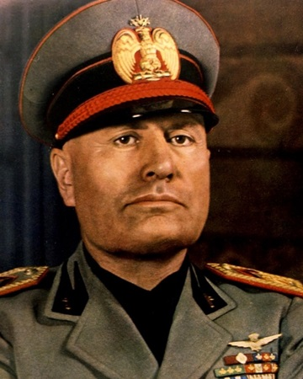
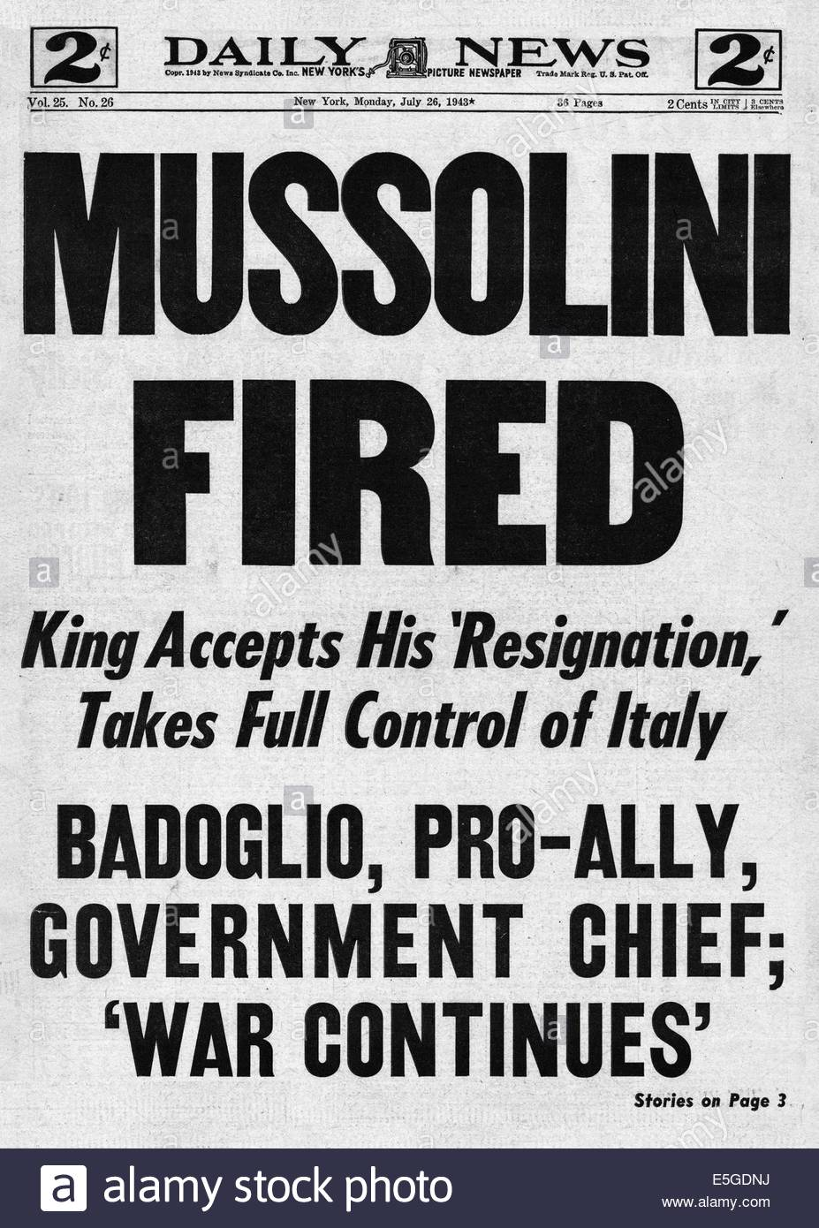
The Fall of Mussolini and Italy
The loss of Sicily caused the Italian government to force Benito Mussolini to give up his position as the dictator of Italy. Mussolini was force to give up his power and arrested by the King.
Mussolini was forced into exile from Italy, but before he made it out of the country, he was captured by angry Italian citizens, tortured and killed along with his family.
The Italians surrendered to the Allied forces.
Italians thought this would be the end of the war for them, but that did not happen.

Slide 13
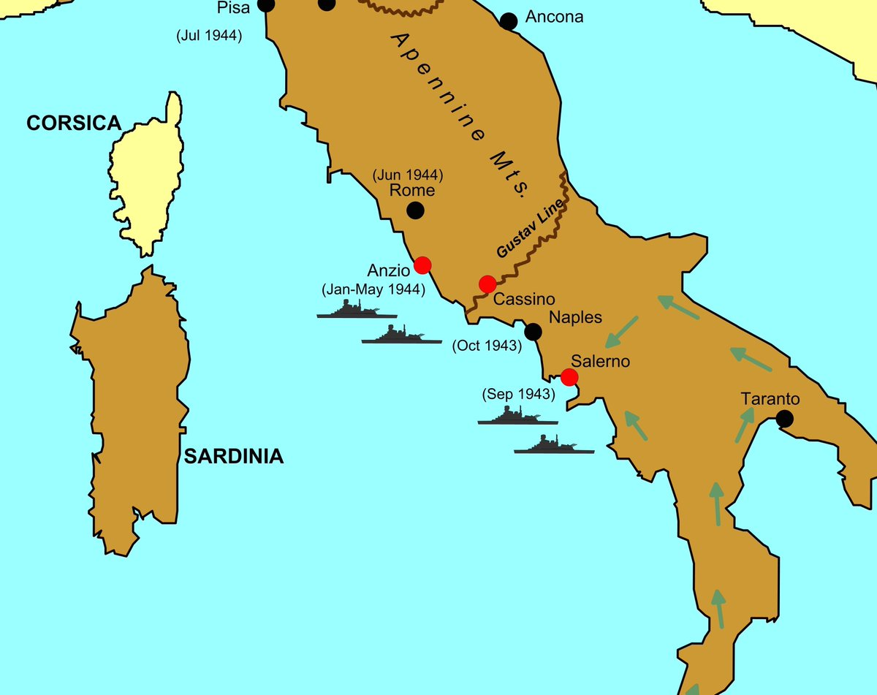
Hitler Tries for Control in Italy
Hitler wanted to stop the Allied Powers in Italy to keep them from making it into Germany.
One of the most hard fought battles in Italy took place in a city called Anzio, just south of Rome. The battle lasted 4 months and was a huge loss in soldiers for both sides.
It took the Allied Powers until 1945 to finally take control of Italy from the Nazis.

Slide 14
Tuskegee Airmen
The Tuskegee Airmen were a group of all black air force pilots that were in segregated groups.
They trained at Tuskegee Air Force Base in Tuskegee, Alabama.
They faced strong discrimination that made them have to prove themselves as pilots much more strongly than any other pilots.
Tuskegee Airmen

Slide 15
The Tuskegee Airmen had its first victory in combat flying battles over Sicily, Italy and destroying an enemy aircraft carrier.
It became one of the most decorated squadrons of the entire war.

Slide 16
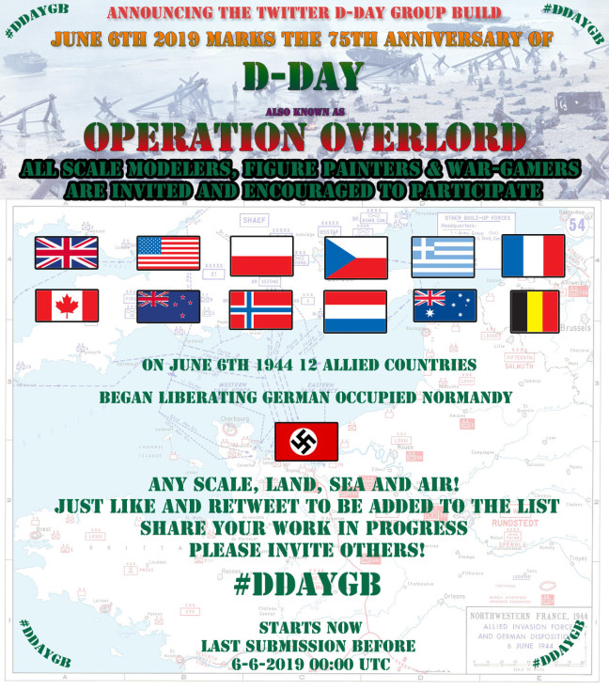
The Allies Liberate Europe
At the same time that the Allied Powers were fighting to take control of Italy from Hitler’s Germany, the Allies were also planning to invade France and free Western Europe from Nazi control.
General Eisenhower was put in command of the largest combined military invasion in history.
Countries Involved in the Invasion to Liberate France: U.S.A., France, Great Britain, Canada, Australia, Norway, Poland, Belgium, Czechoslovakia, Greece, the Netherlands, and New Zealand

Slide 17
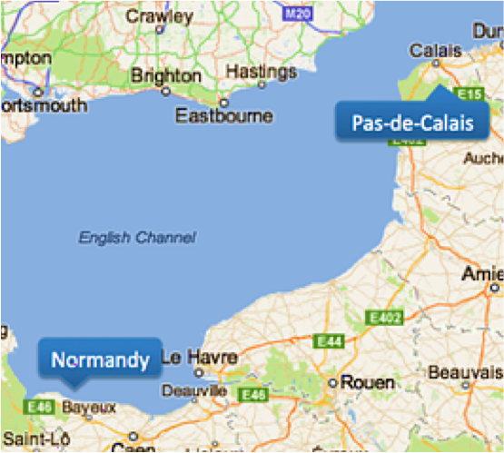
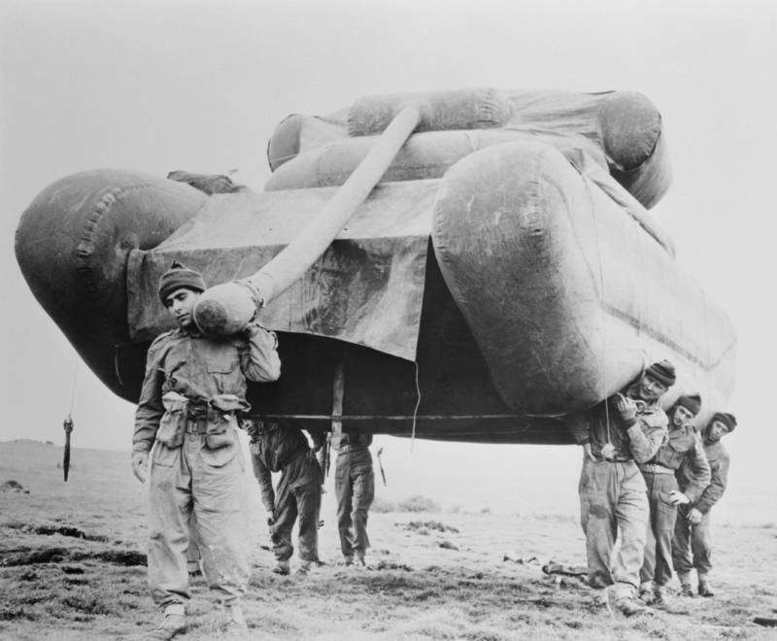
Keeping the Mission Secret
In order to keep the plan a secret and mislead Hitler as to the Allied plans, the Allied Powers set up a fake camp that made it look like they were preparing an invasion from a different place than the real plans.
The fake camp was farther up the eastern coast of England, making it seem like the invasion would come at the closest point that the camp was to France in a place called Calais, which was far east of the real planned invasion area of Normandy, France.

Slide 18
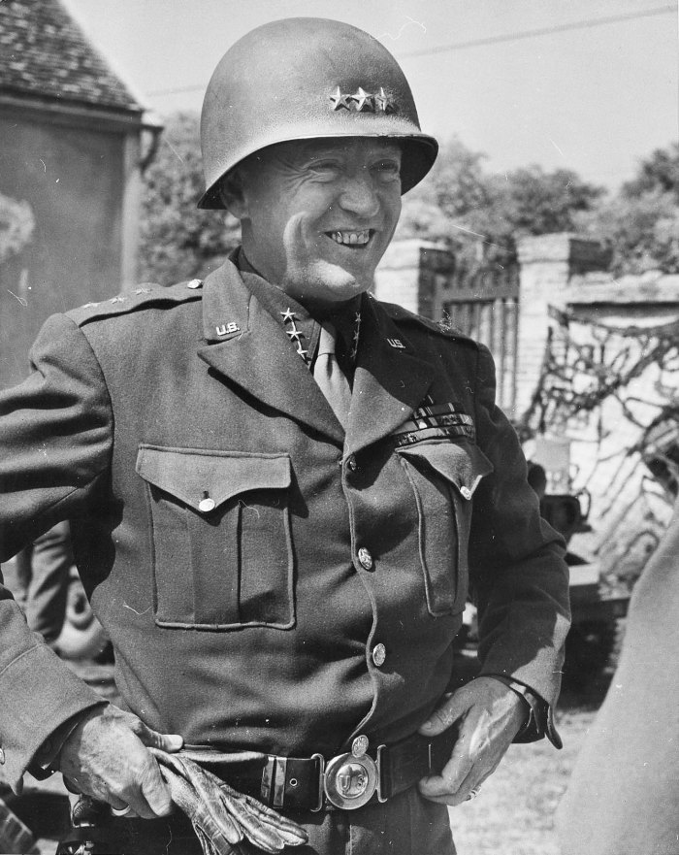
General George Patton
In 1944, the top and most highly respected military field leader
was General George Patton.
Patton was known for his military strategy and tough attitude.
He would have been the leader expected to lead the invasion of Europe, but just before the mission was planned, he was reported to have physically abused one of the soldiers under his command because the soldiers was not meeting his training expectations.
Because of the world would have its attention on the invasion after it happened, the U.S. military did not want to look bad to the public by the story of Patton’s misbehavior getting out in the papers, so he was not chosen to lead the invasion.
Instead, Patton was used as a decoy and put in charge of the false based that was set up to mislead Hitler. Hitler would have been convinced that wherever Patton was based would be the site that the invasion would come from.

Slide 19
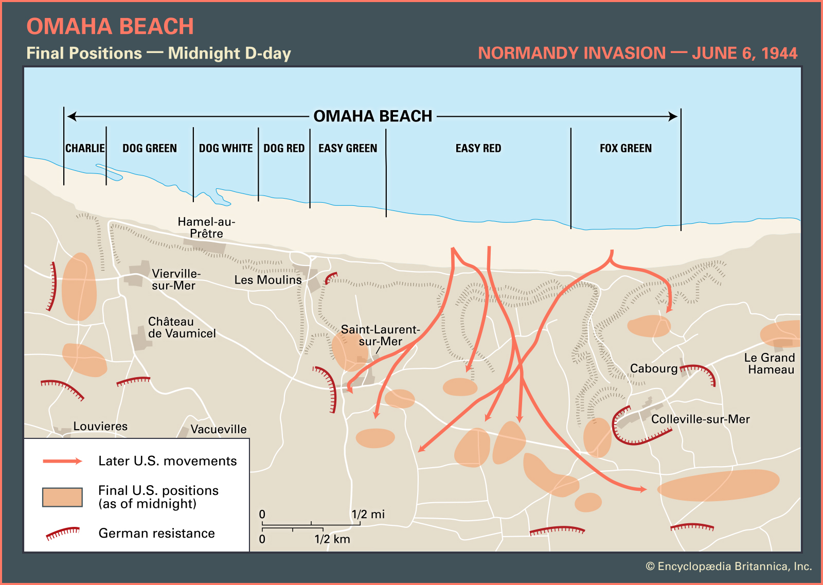
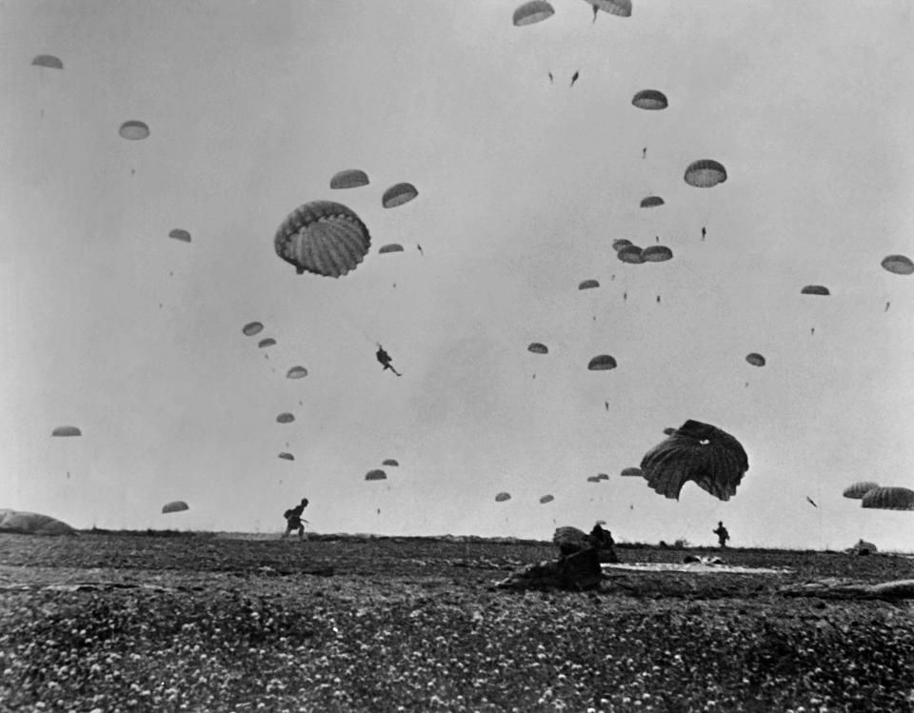
Operation Overlord
On June 6, 1944, the invasion code named “Operation Overlord” began. It became known as D-Day or the 1st day of the invasion.
Three divisions of paratroopers, soldiers who would parachute into an area, landed behind the German military lines to attack from the inland areas, while the rest of the invasion would occur along the coast of France near Normandy.

Slide 20
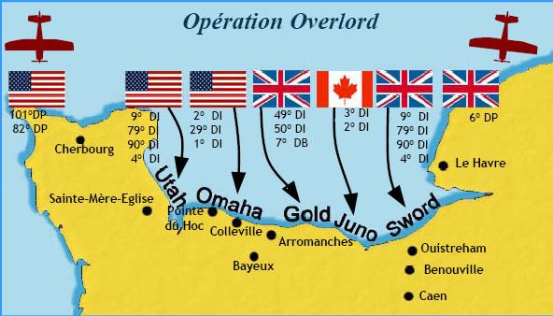
Invasion From the Beach
The Allies fought on the beaches of Normandy, France for 7 days. The surprise attack along the beaches still faced much enemy fire.
The position of the Axis Powers made it very difficult for the Allies to get onto the beaches.
The Axis Powers had the advantage because they were set up along the hills and cliffs that overlooked the beaches.
It was the amount of men and machinery that the Allies had that finally allowed them to take control over the coast of France, even though they took great loss of life to do so.

Slide 21
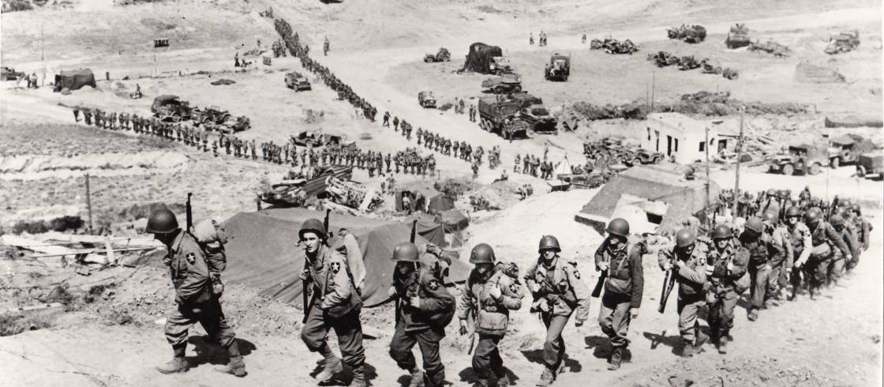
D-Day Troops Face Unthinkable Odds Video
https://www.history.com/topics/world-war-ii/d-day-allied-invasion-at-normandy-video

Slide 22
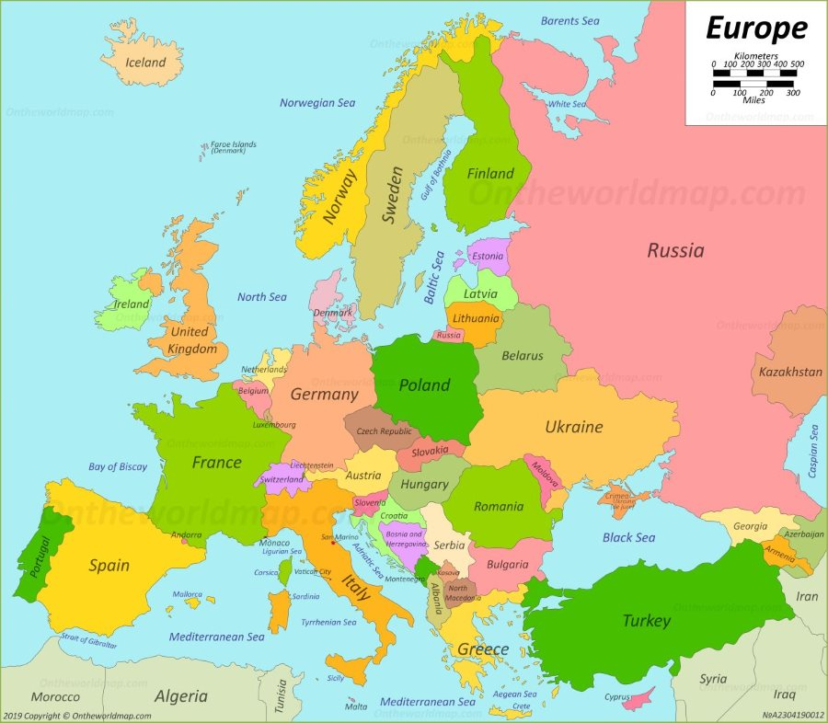
Liberation of Paris, France
In August 1944, General George Patton led his Third Army division into the area around the Seine River on a mission to free the capital city of Paris, France.
By September 1944, the Allied Forces had freed France, Belgium, and Luxembourg from the control of Nazi Germany.

Slide 23
Battle of the Bulge
In December 1944, 8 German tank divisions broke through American lines along an 80 mile section of the front in the Ardennes Forest along the border of Belgium and Germany.
The area of the German breakthrough created a bulge, or bump, in the Allied lines, leading to the battle’s name.
Hitler was trying to stop the Allies from advancing into Germany.

Slide 24
Battle of the Bulge is the Beginning of the End for Germany
Lasting six brutal weeks, from December 16, 1944, to January 25, 1945, the assault, also called the Battle of the Ardennes, took place during frigid weather conditions, with some 30 German divisions attacking battle-fatigued American troops across 85 miles of the densely wooded Ardennes Forest.
As the Germans drove into the Ardennes, the Allied line took on the appearance of a large bulge, giving rise to the battle’s name. The battle proved to be the costliest ever fought by the U.S. Army, which suffered over 100,000 casualties. The formerly serene, wooded region of Ardennes was hacked into chaos by fighting as the Americans dug in against the German Army.
The Allied victory in the Battle of the Bulge allowed the Allied Forces to enter Germany and eventually take Berlin, Germany’s capital.

Slide 25
The Death Of Hitler
On April 15, 1945, the Soviet Army entered Berlin.
Just before the Allied Powers would be able to capture him, Hitler and his new wife, Eva Braun, committed suicide.
Hitler shot himself in the head and his wife took poison. To avoid disgrace, Hitler had ordered his soldiers to burn his body after his death.

Slide 26
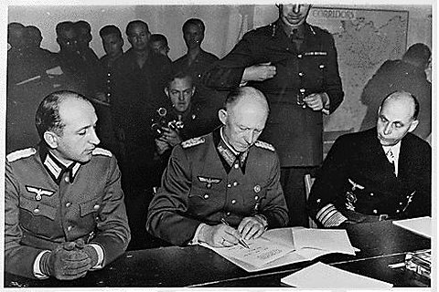
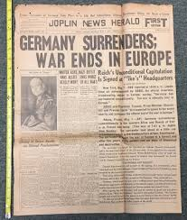
Unconditional Surrender
One week after the death of Hitler, American General Eisenhower accepted the unconditional surrender of the German army and the Nazi government, the Third Reich.
May 8, 1945 became known as V-E Day, which stands for Victory in Europe.

Slide 27
The Death of President Roosevelt
On April 12, 1945, President Franklin Delano Roosevelt had a stroke and died.
He did not live to see the end of the war.
That night, Vice President Harry S. Truman was sworn in as President of the United States.

