Slide 1
The Home Front
Chapter 25 Section 4

Slide 2
Economic Gains
The years during the war were good for working people.
Many jobs were available due to war production and even though not all products were available to families, those families mostly had money to spend.
Average weekly pay went up during the war, helping workers have money to save for the future.
Farmers also had good weather conditions, new machinery, and rising crop prices, in additions to having the government buying a good deal of their crops to send to soldiers.

Slide 3
Women in the Workforce
Over 6 million women entered the workforce for the first time during World War.
1/3 of those women worked in factories making war supplies, which paid higher and included more challenging work than women were doing before the war.
This gave great opportunity for women to take advantage of proving themselves in professions that were previously dominated by men.
Unfortunately, once the war ended, many of the men coming back from the fighting came to reclaim their jobs, and women were replaced.

Slide 4
Population Changes
Population is many places across the U.S. also changed because of World War II.
Many families moved to find work opportunities that were there in factories making war supplies.
Especially common was for African Americans to leave the farms of the south to find work in the more industrial areas in the north and west of the U.S.

Slide 5
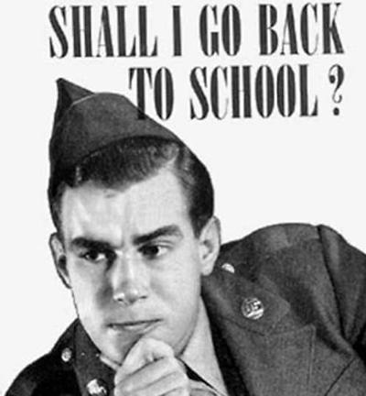
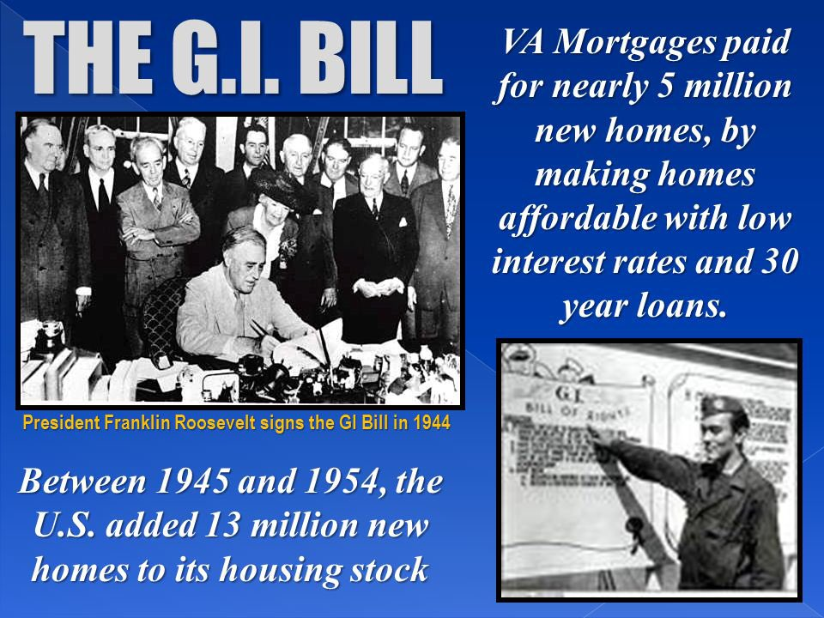
GI Bill of Rights
GI – stands for general issue, which is used to describe a basically trained soldier in the military
To help returning soldiers, Congress passed the Servicemen’s Readjustment Act, more commonly known as the GI Bill of Rights.
The bill provided education and training for military veterans, which was paid for by the government.
This bill helped many soldiers get job training or attend college when they returned home from the war.
It also helped my returning soldiers buy homes or farms when they got back from the war.

Slide 6
Racism and Discrimination
During the years of World War II, the percentage of African Americans that were employed doubled.
African Americans still faced discrimination, with racial tension growing in some large cities.
The worst racial violence happened in Detroit, when a fight between blacks and whites turned into 3 days of city wide riots
In Los Angeles, a riot occurred between Mexican Americans and whites after white sailors claimed to have been attacked and robbed by Mexicans.

Slide 7
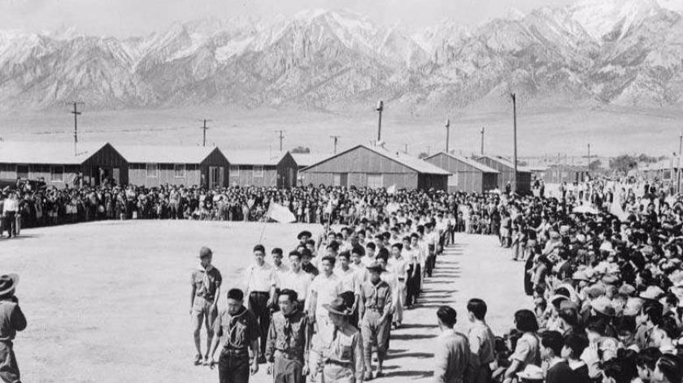
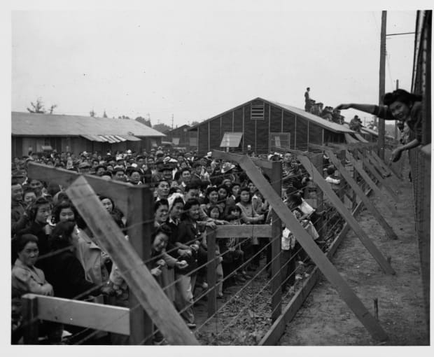
Japanese Internment
When the war began, over 120,000 Japanese Americans lived in the U.S., mostly along the west coast.
The attack on Pearl Harbor by the Japanese left American citizens fearful that more attacks would happen.
This fear led to a lot of prejudice against Japanese Americans.

Slide 8
In early 1942, the War Department asked for complete evacuations of all Japanese Americans from Hawaii.
They eventually ordered the internment, or confinement, of 1,444 Japanese Americans in Hawaii.
As the panic spread, anti-Japanese feelings grew and President Roosevelt signed an order requiring the removal of people of Japanese ancestry from California, Washington, Oregon, and Arizona.
They claimed it was necessary for national security.

Slide 9
The army rounded up 110,000 Japanese Americans and sent them to “relocation centers” which were really prison camps called internment camps.
No Japanese Americans were ever charged with a crime and no evidence of wrong doing was ever found.
Many families lost homes and businesses during their time in the prison camps or had to sell them for much less than they were worth.

Slide 10
Admitting the Wrong
In 1944, in the Supreme Court case of Korematsu v. United States, the court decided that the government’s policy of evacuating Japanese Americans to camps was justified on the basis of “military necessity.”
In 1965, Congress agreed to spend $38 millions to help repay what Japanese Americans had lost, but that was far less than they had really lost.
It was not until 1990, that the government finally acknowledged the wrongs that had been done to the Japanese culture in the United States during World War II.

