Slide 1
The Holocaust
Chapter 24 Section 3

Slide 2
What does Holocaust mean?
Holocaust – the term used to refer to the systematic murder of 6 million Jews by the Nazis between 1933 and 1945. It also included the extermination of Gypsies and Poles. The word means destruction or slaughter.
Gypsy – Also known as Roma, they were a culture group found in eastern Europe.
Poles – People from the country of Poland
Extermination – the killing of a whole group of people

Slide 3
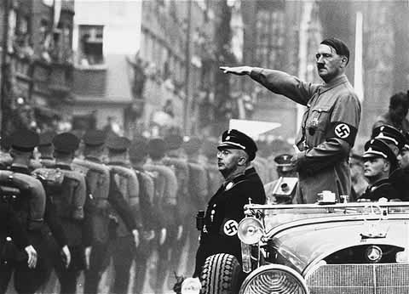
How It All Began……
When Hitler took office as the Chancellor of Germany in 1933, he started several steps to increase persecution of the Jewish people.
Persecution – treat someone or a group badly because of something about them like race, political opinions, or religion.
The first step Hitler took to begin the persecution of the Jews in Germany was to not allow any Jews to have government jobs in Germany.

Slide 4
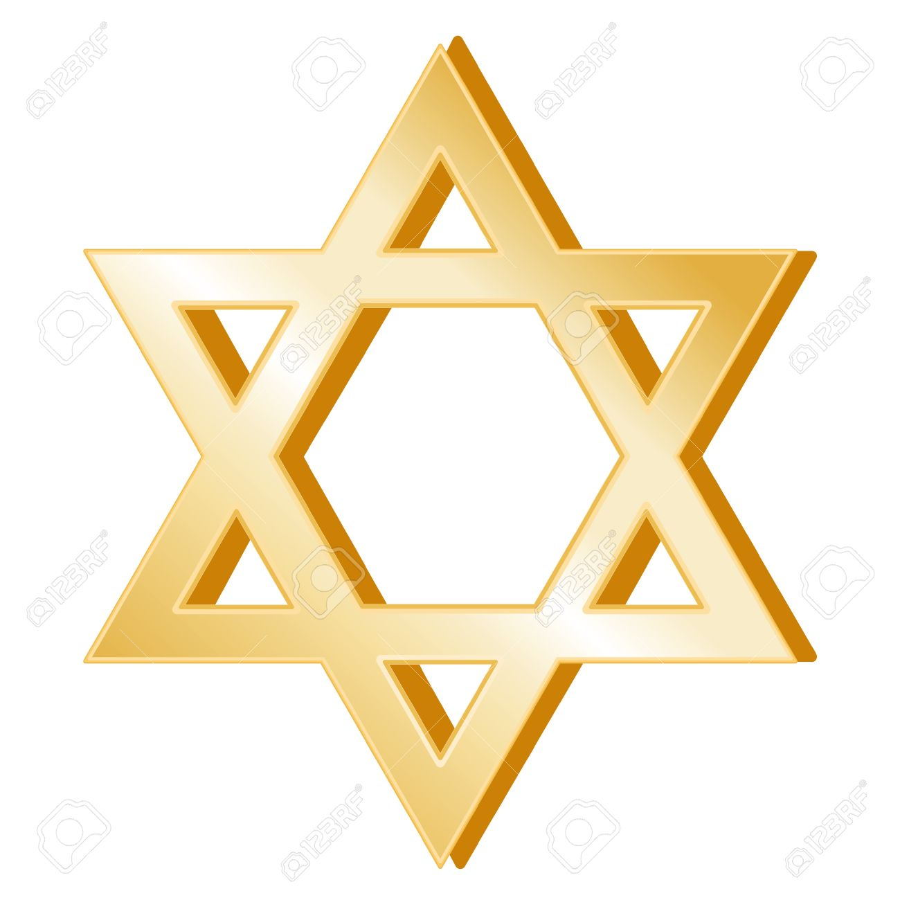
Anti-Semitism – Hatred of the Jews
Anti-Semitism had a long history in European countries.
Europe was traditionally a very Christian society, and Jews were a very small part of the population that did not believe in all of the teachings of Christianity, making them easy targets for persecution throughout time
Anti-Semitism
Film: Anti-Semitism boycott

Slide 5
Since Germany’s failed attempt to dominate Europe in World War I, they had been looking for someone to blame for the failure.
The loss of land, humiliation of Germany in the Treaty of Versailles ending WWI, and the continued poor economy that was made worse by the Great Depression, all made the Germany people in need of a scapegoat to claim was the reason for these problems.
Hitler used his powerful and convincing speaker ability to get the people to support his ideas that the Jews were to blame for all of Germany’s money problems and the loss of World War I.
Scapegoat – an innocent person that is blamed for the problems of others.

Slide 6
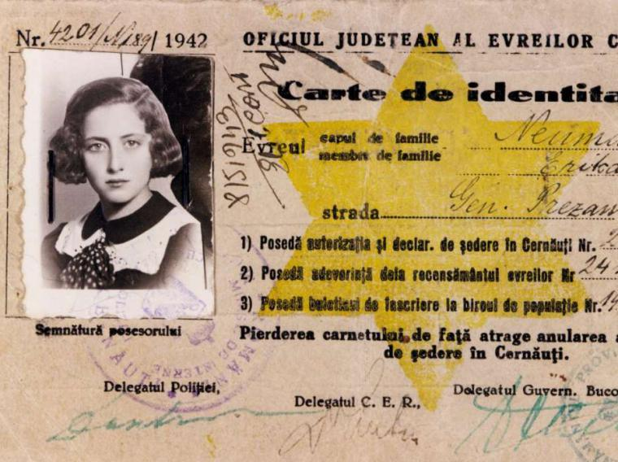
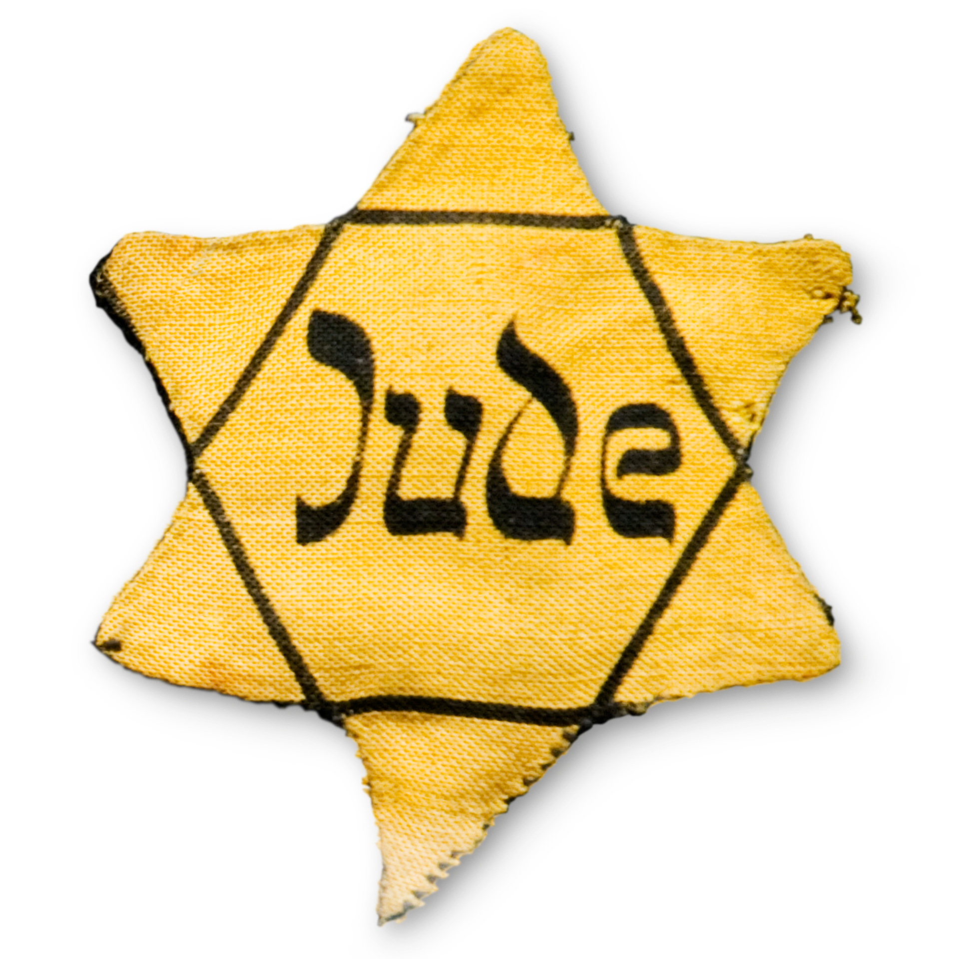
Nuremberg Laws
Nuremberg Laws – a set of laws that were created by the Nazis to limit the rights of Jews and took away Jews citizenship in Germany.
Examples of Nuremberg Laws:
1. Individuals of mixed Jewish and Aryan blood are to be considered Jews under the law.
2. Jews do not have the right to vote.
3. Jews cannot hold public office.
4. Marriage between Jews and non-Jews is illegal.
5. Jews must carry identity cards.
6. Jews must wear the yellow Star of David on their clothing.
Nuremberg Laws: Click for link

Slide 7
Kristallnacht “Night of Broken Glass”
Click for Link: Kristallnacht
November 9-10, 1938 became known as Kristallnacht, which in German means Night of Broken Glass.
On this night, Nazi storm troopers were sent to destroy Jewish places like their homes, businesses, and synagogues.
Synagogue – Jewish place for religious worship
They smashed windows and injured anyone that tried to stop them.
After the event, Jews were blamed for the damage and many were arrested for the crime.

Slide 8
Jewish Refugees
Refugee – person who leaves an area because they fear they will be harmed or to avoid war or danger.
Emigration – when people leave a country to live somewhere else.
Jews trying to leave Germany had trouble finding other countries that would take them in.
Reasons:
1. Some countries had already taken too many Jewish refugees and felt that their country could not handle any more.
2. Fear of starting Anti-Semitic feelings in their countries.
3. People were afraid that the new immigrants would take jobs away from their country’s people.

Slide 10
Hitler’s Final Solution
Final Solution – the Nazi term for the extermination of the Jews in Europe.
Genocide – the systematic extermination of a specific group or population.
Hitler’s goal for Europe was to eliminate all Jews from the population.
His way of doing this would be to round them up and force them into slavery and eventually death.
He also included groups that he considered “undesirable” or unwanted. These were people that he believed would ruin the “purity of the races.”
Ex: Gypsies, handicapped or mentally disabled, Homosexuals, or people of any religious group that due to their religion refused to accept him as the ruling authority of the people, and anyone who challenged him politically.
Final Solution

Slide 11
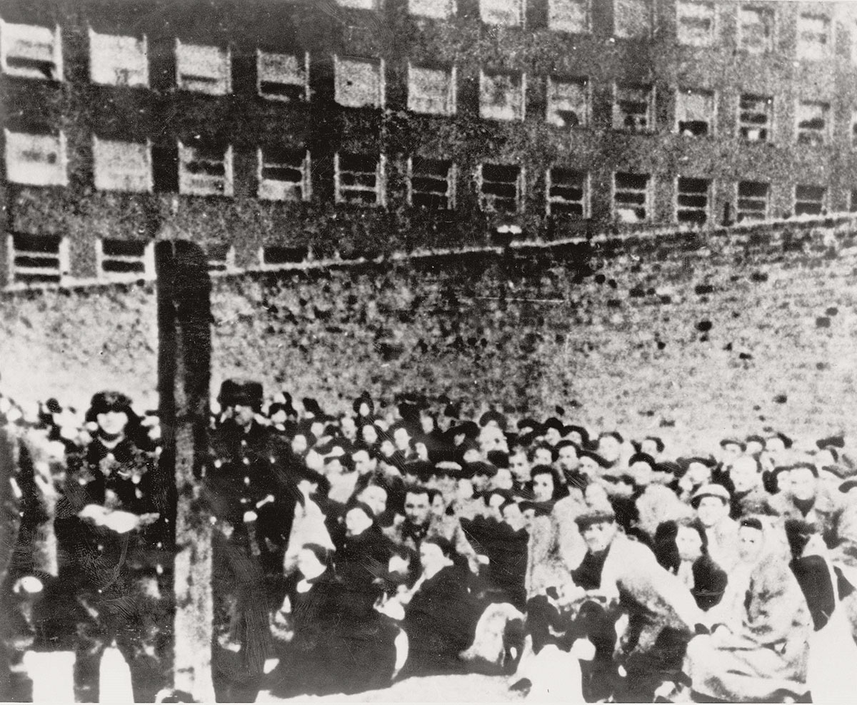
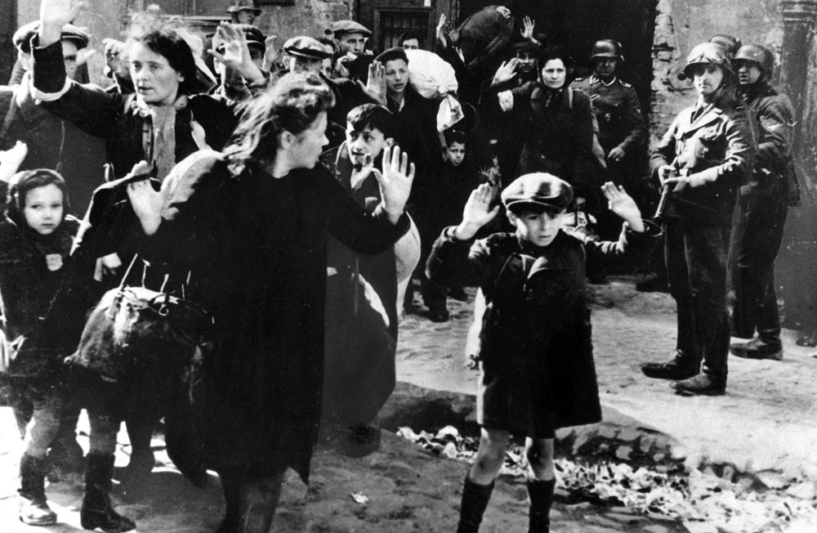
Forced Relocation
As land was taken by the Nazis, Jews were forced to live in small, crowded ghettos. They were often closed off with walls or barbed wire.
Ghetto – A closed off section of a city where Jews were forced to live.
People living in the
ghettos were often
forced to work in
German factories as
slave labor.

Slide 12
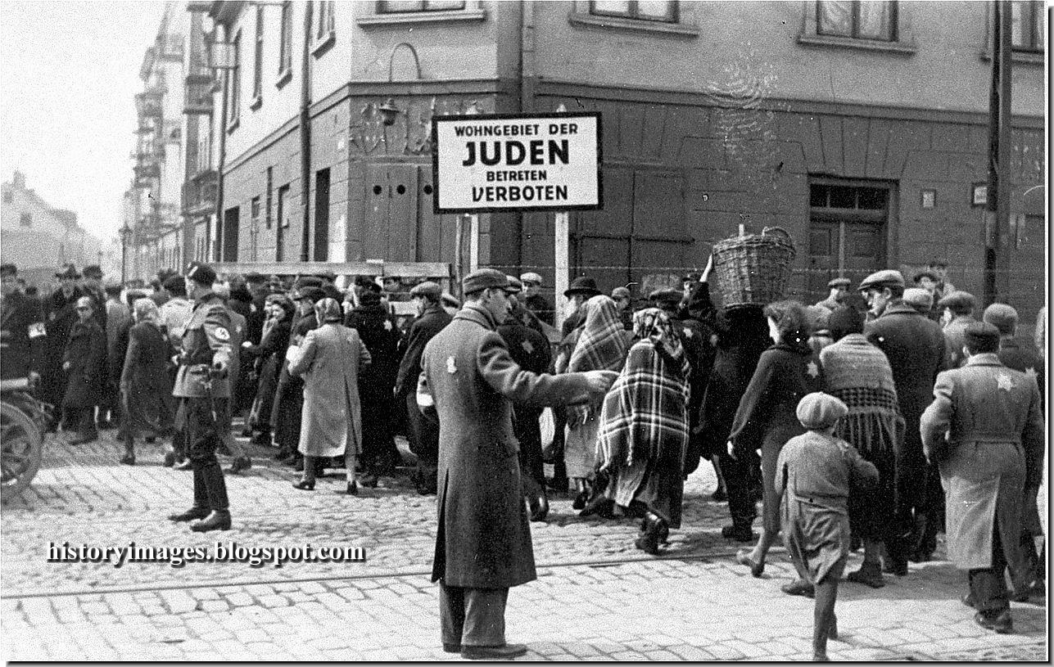
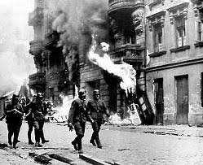
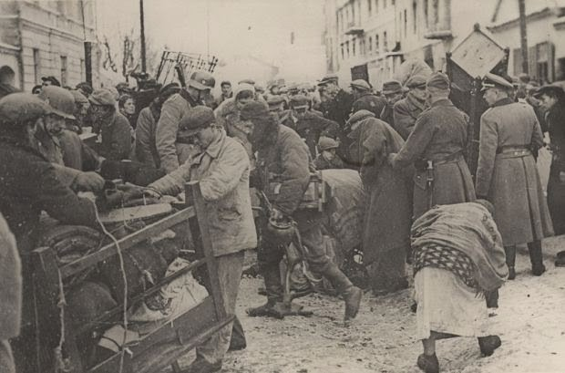
Warsaw Ghetto
One of the most famous and deadly ghettos was the Warsaw Ghetto in Poland.
Warsaw Ghetto
Warsaw Ghetto Uprising

Slide 13
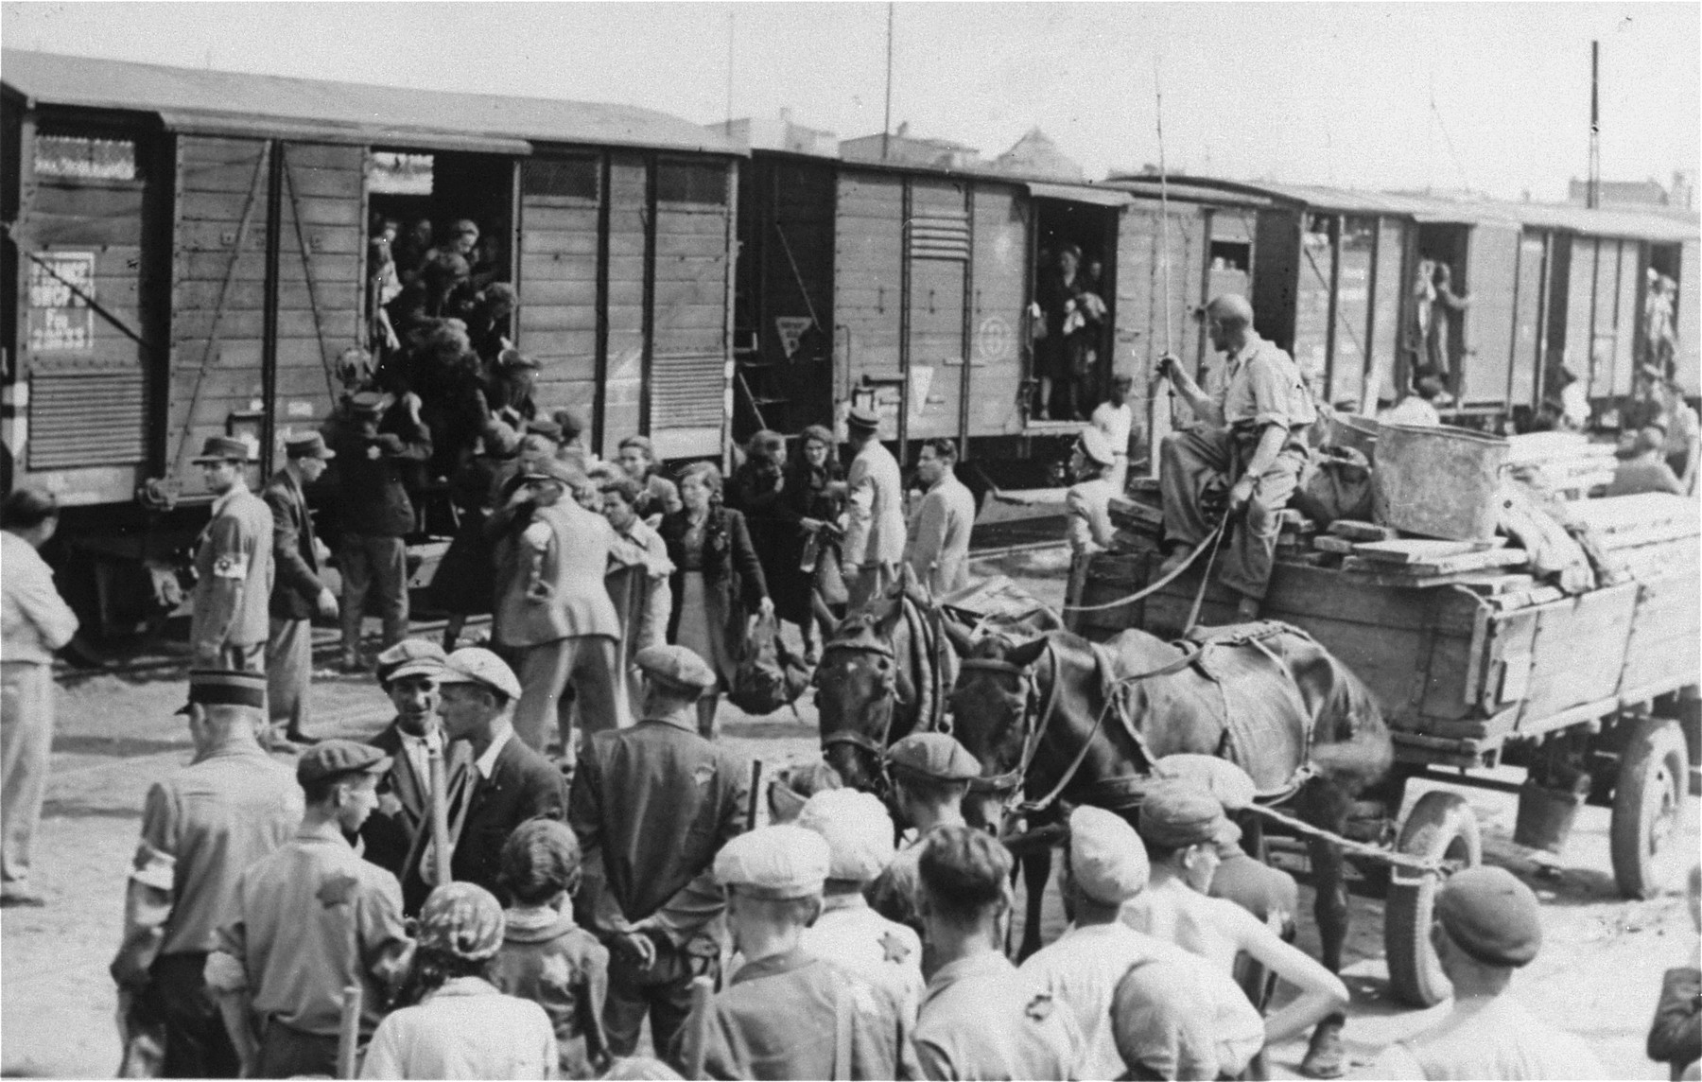
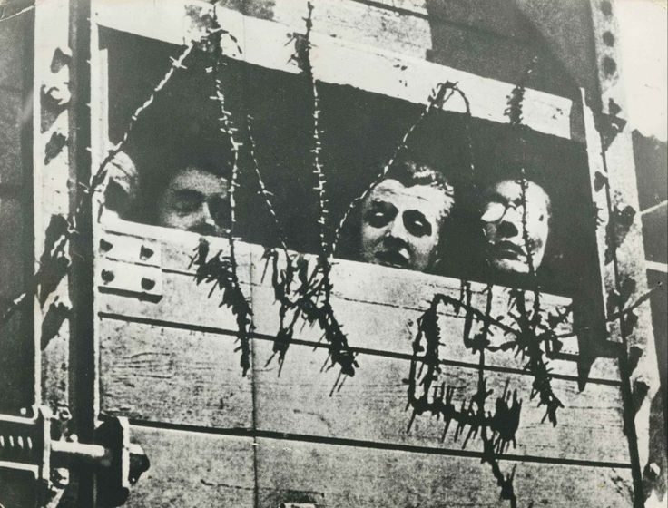
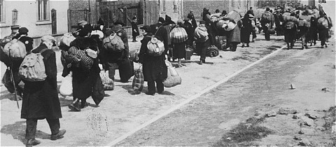
Deportation
Deportation – The forced removal of Jews in Nazi occupied lands to concentration camps.
Jews were forced to report to certain locations, usually near train stations, and put into crowded railway cars to be taken to the camps.
Deportations

Slide 14
The Final Stage
In early 1942, the Nazis were entering what they called the Final Stage of the Final Solution.
The Nazis held a conference in Wannsee, near Berlin, in Germany.
They goal of the conference was to come up with the plan for the mass killing of the Jewish populations that were in the camps and throughout Europe.
The ideas of mass killing included starvation, torture, and groups killings in gas chambers.

Slide 15
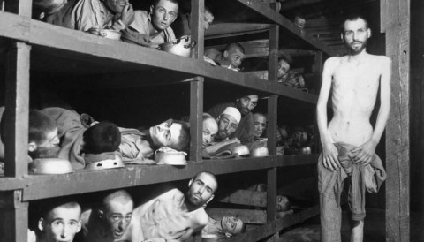
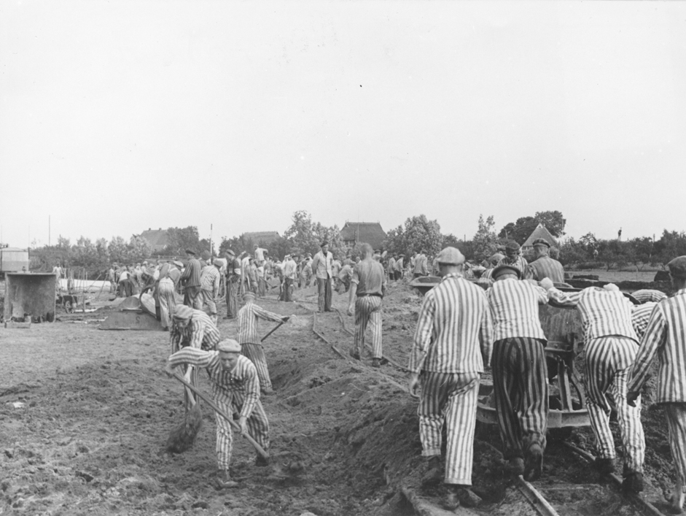
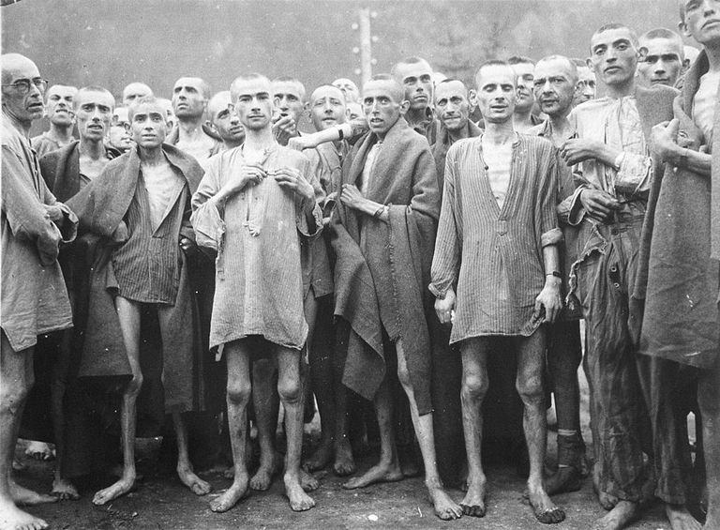
Concentration Camps
Concentration Camp – a prison camp operated by Nazi Germany in which Jews and other groups considered to be enemies of Adolf Hitler were starved and tortured while doing slave labor or were murdered.
Nazi Camps
Concentration Camps 1933-39
Concentration Camps 1942-1945

Slide 16
Auschwitz – Killing Center
Auschwitz was one of the largest
Nazi killing centers. It was located
in Poland.
Auschwitz was a complex of over 40 camps that included slave labor, human experiments, and killing centers such as gas chambers.
Of the 1.3 million people that were sent to Auschwitz, 1.1 million of the died there.

Slide 17
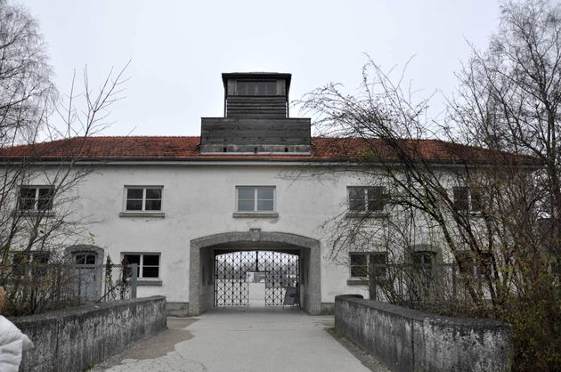
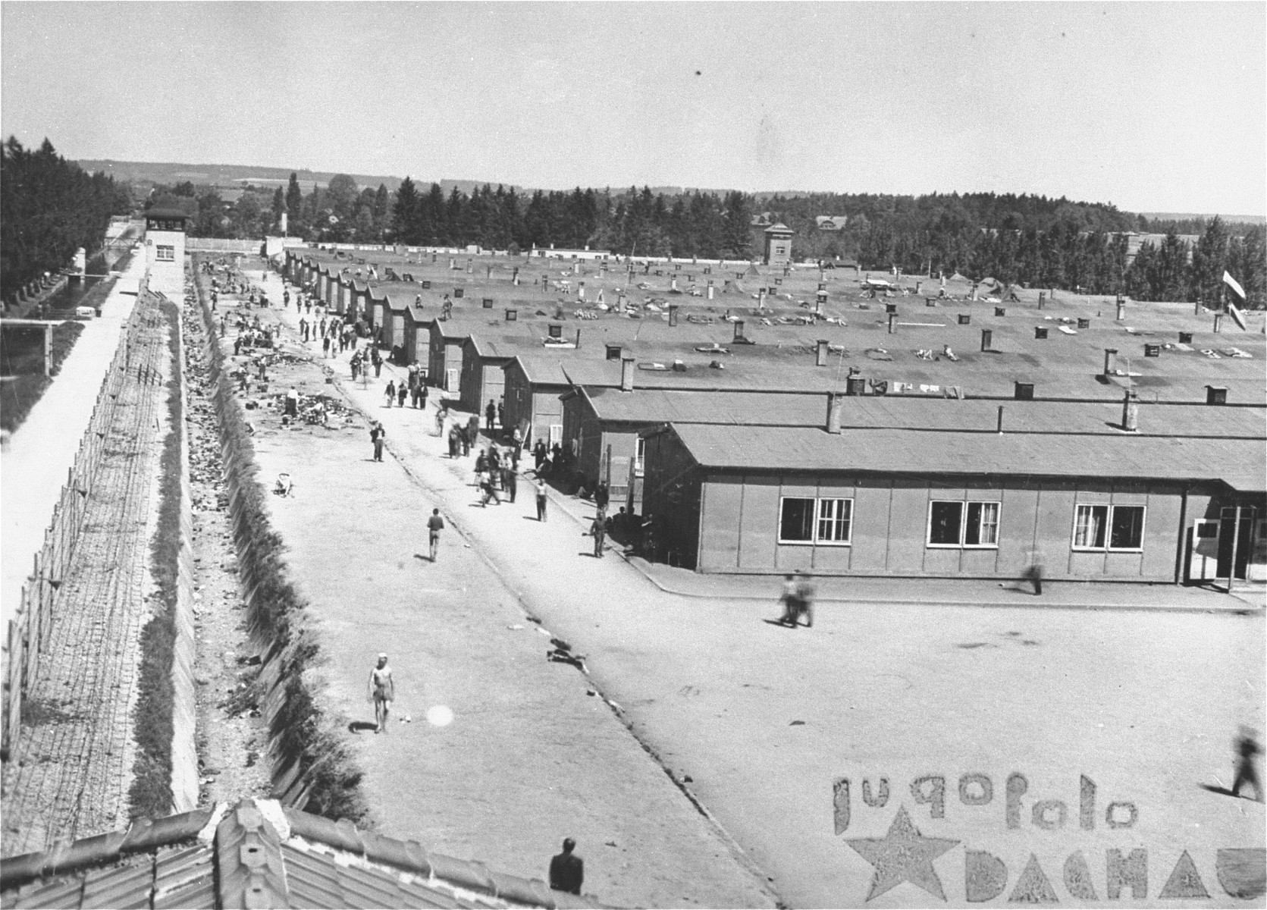
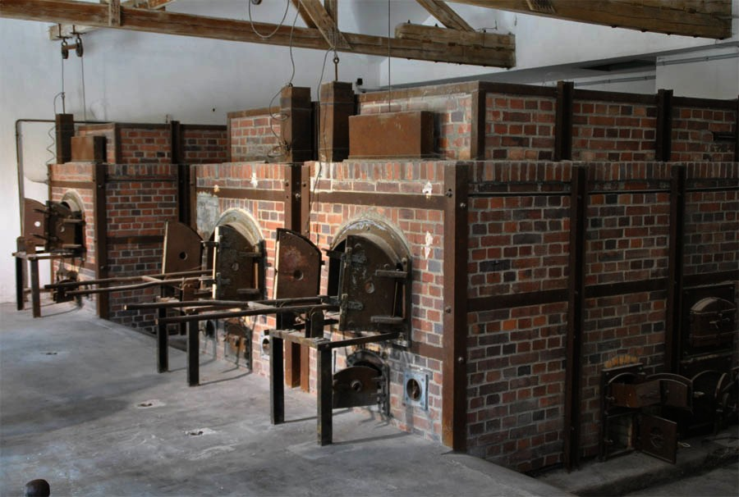
Dachau Concentration Camp
Dachau was a concentration camp that was located in southern Germany. It was originally started to hold political prisoners that opposed the rule of Hitler, but ended up housing many Jews as well.
Dachau was the 1st camp that was liberated by the United States in April 1945.
Dachau

