Slide 1
The Cold War Heats Up
Chapter 26 Section 2

Slide 2
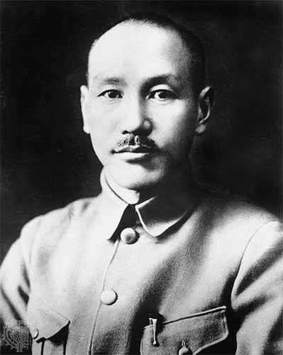
China Becomes A Communist Country
Chiang Kai-shek – The leader of the Nationalist government in
China.
The United States support Chiang as the best choice for leader of China and sent him $3 billion to try to gain power in China.
Yet, many U.S. government officials that knew him better thought that his government was inefficient and would never make it.
Some of Chiang’s policies would end up hurting the Chinese people.

Slide 3
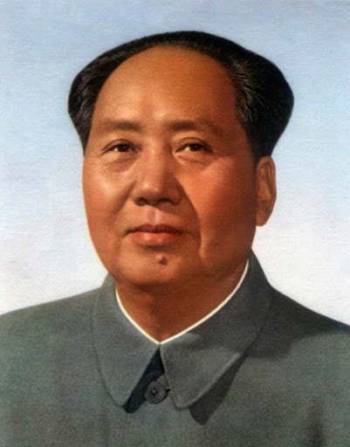
Mao Zedong – Leader of the Communist Party trying to
take control of China.
In many areas of China, the Communists were trying to win peasant support, which was the majority of the population of China.
They encouraged peasants to learn to read and tried to improve food production throughout the country.
This led many people to join the Communist Red Army and by 1945, much of northern China was under Communist control.

Slide 4
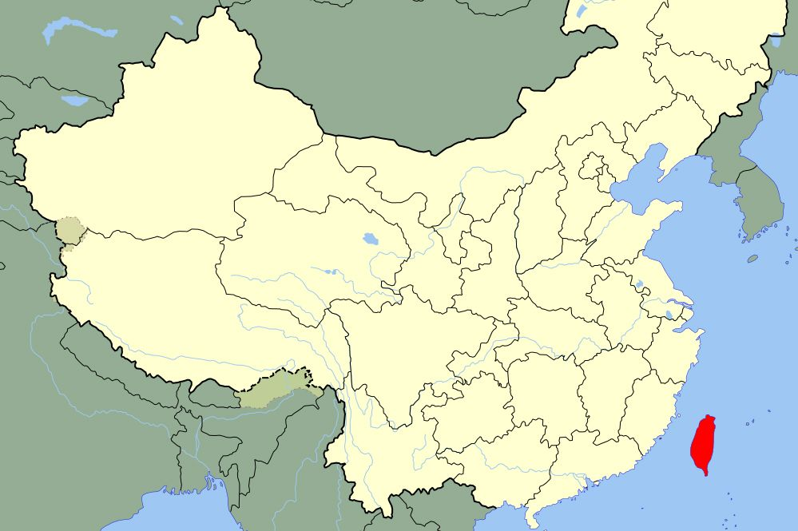
Civil War In China
As soon as the Japanese were defeated in World War II and the Chinese were not trying to defend against Japan, the two political parties, Nationalist and Communist started fighting each other for control of China.
U.S. money to support Chiang’s Nationalist government was not enough to make up for the weak military leadership of Chiang and his abusive practices led more and more people to go over to the side of the Communist Party led by Mao.
In May 1949, The Chiang government had to run to hide in Taiwan, an island off of the Southeast coast of China.
The Communists took power over China and called it the People’s Republic of China.
For years, the United States refuse to see the Communist government as the real government of China, but eventually had to accept it.

Slide 5
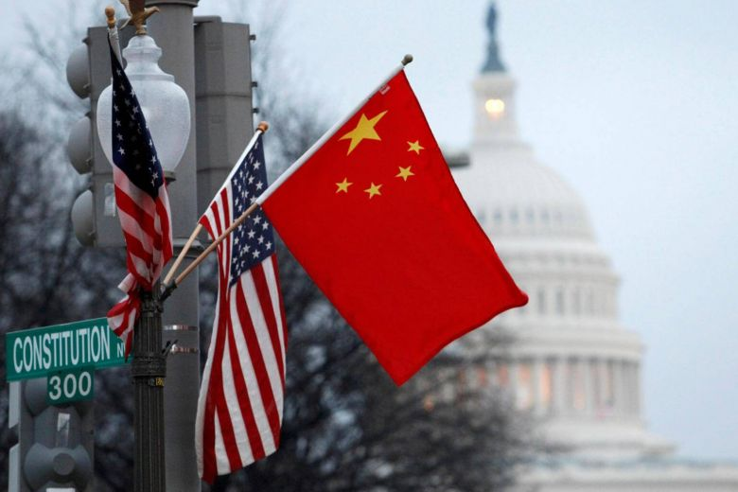
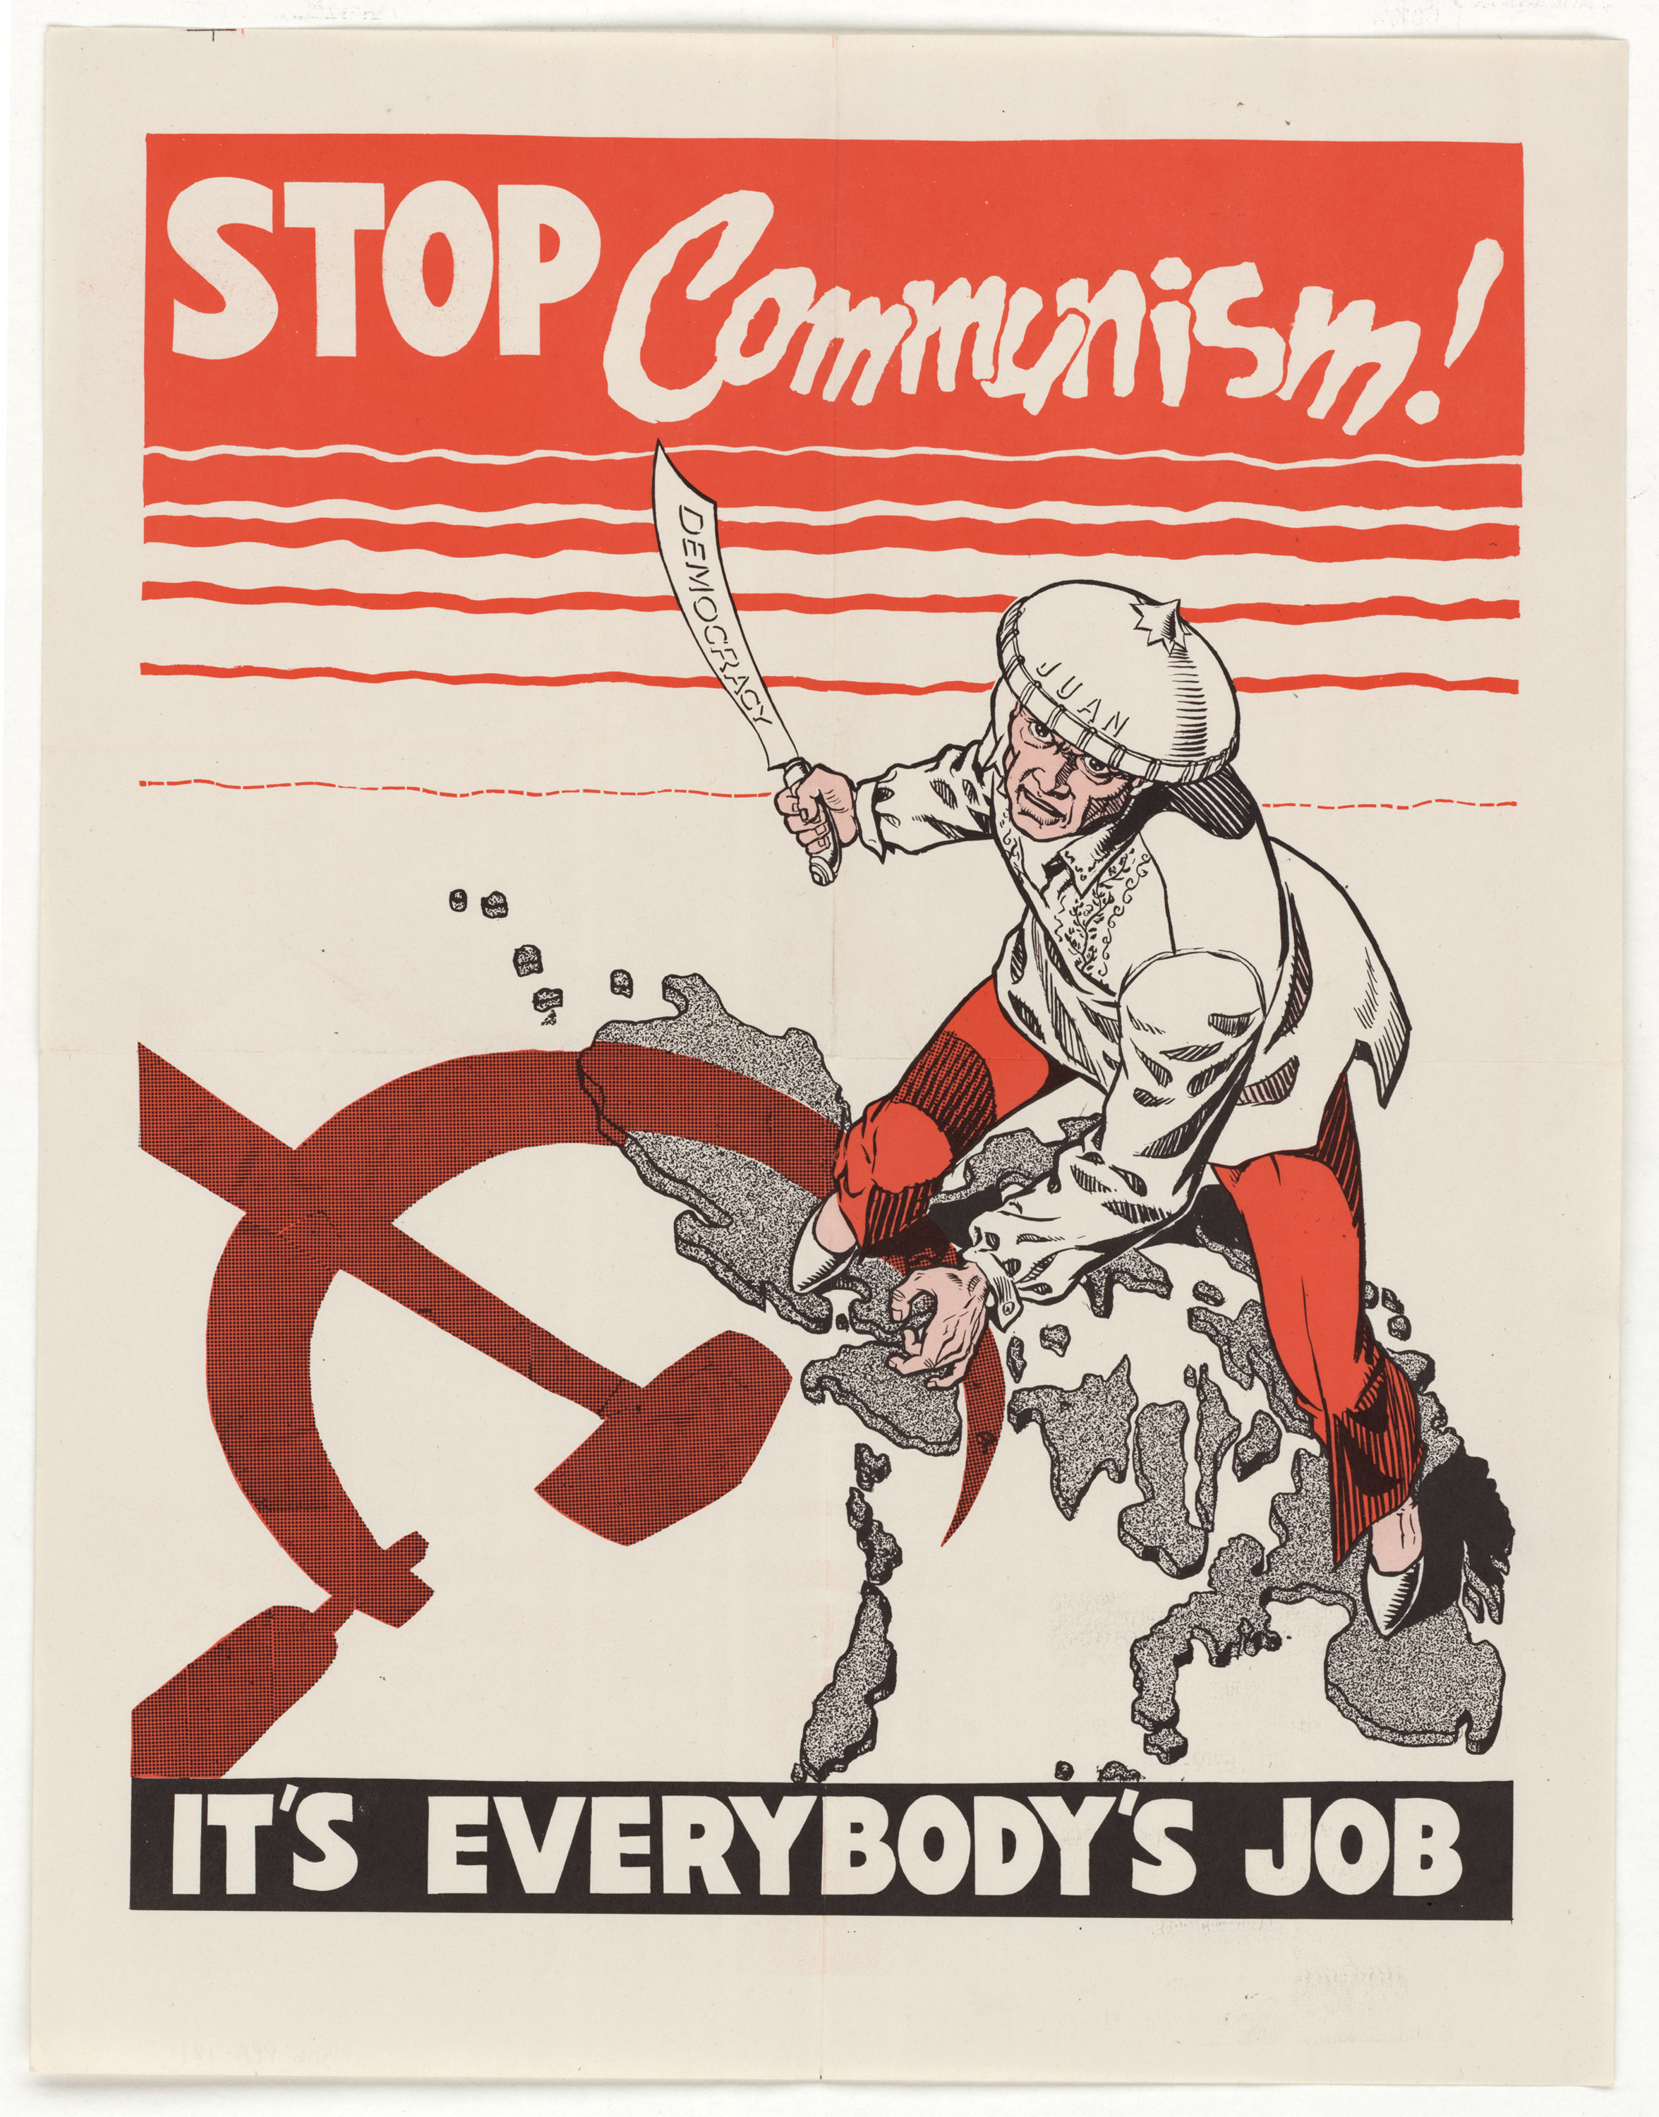
America Reacts to Communist Takeover
Many Americans thought that the U.S. did not do enough to make sure that China did not fall to Communism.
The U.S. government claimed that it was due to issues inside China and trying to force the people against Communism any more would have led to a war in Asia, which the U.S. was not willing to do.
Some U.S. Congressmen saw this as an excuse and thought that their may be Communist spies within the U.S. government.

Slide 6
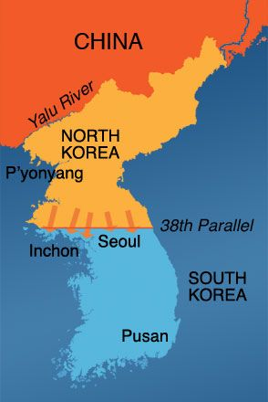
The Korean War
Korea was another area that had been taken over by Japan during World War II, especially the area above the 38th Parallel, which is the 38th line of north latitude on a map. It runs about halfway through the country that was Korea.
When WWII ended, the Japanese troops in the northern half of Korea, that area above the 38th parallel, surrendered to the Soviet Union, trading being controlled by one country to being controlled by another.
The Japanese troops in the southern half of Korea surrendered to the United States.
Just like it happened in Germany, the country of Korea ended up divided between the two sides, democratic U.S. and Communist Soviet Union.

Slide 7
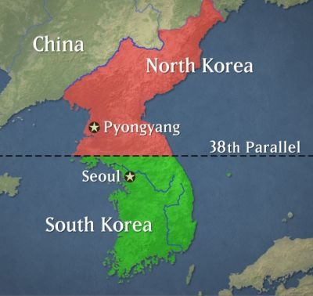
In 1948, South Korea, officially the Republic of Korea, was established by the United States and supported as a democratic country with the capital city in Seoul.
The Soviet Union created North Korea, officially the Democratic People’s Republic of Korea, with Kim Il Sung as its leader, with a capital city of P’yongyang.

Slide 8
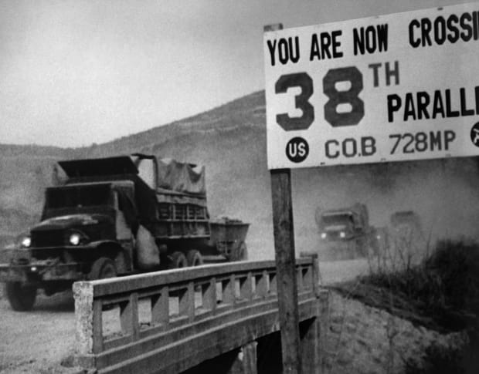
After World War II, the U.S. only had about 500 troops left in South Korea, and the Soviet Union thought that it was not enough to defend South Korea from the Soviet army, so they planned to attack and try to take control of all of Korea.
On June 25, 1950, the Communist army in North Korea that was supported by the Soviet Union came across the 38th Parallel in a surprise attack on South Korea.
For the next 3 years, the fighting over control of Korea became the Korean War.

Slide 9
On June 27, President Truman ordered troops into South Korea to defend against the Soviet, as well as an American navy fleet into the waters between Taiwan and China in case tension started there as well.
Eventually, 16 nations sent troops to help South Korea, most of them from the United States.
General Douglas MacArthur, hero of WWII in the Pacific, was put in charge of the combined army defending South Korea.

Slide 10
China Joins the Fighting
Fighting went back and forth across the 38th Parallel for the next three years, with neither side actually winning territory and keeping control of it.
In late 1950, when it seemed like the Americans might be starting to win, the Chinese sent 300,000 troops to support the North Koreans.
The Chinese wanted North Korea to remain communist so that there was a buffer zone, an area between China and the United States’ backed South Korea.

Slide 11
MacArthur Recommends Attacking China
MacArthur wanted to end the war quickly by using nuclear weapons against China, trying to force them to give up their support of North Korea.
President Truman did not agree with MacArthur, claiming that attacking China, which would then bring in the Soviet Union also, could start World War III.
Instead, Truman ordered MacArthur to keep attacking by land and by 1951, the war seemed to be at the same place that it started.

Slide 12
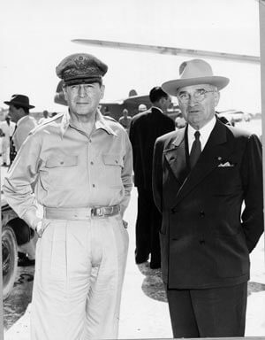
MacArthur Goes Public With His Idea
MacArthur was not satisfied with just keeping the Communists out of South Korea. He wanted to beat them and get them out of North Korea as well.
MacArthur told his ideas to the newspapers, trying to force Truman to act.
Despite several warnings to follow orders, MacArthur continued to speak out against the President.
Truman saw that he had no choice and ended up firing MacArthur for trying to go against the President’s policy.

Slide 13
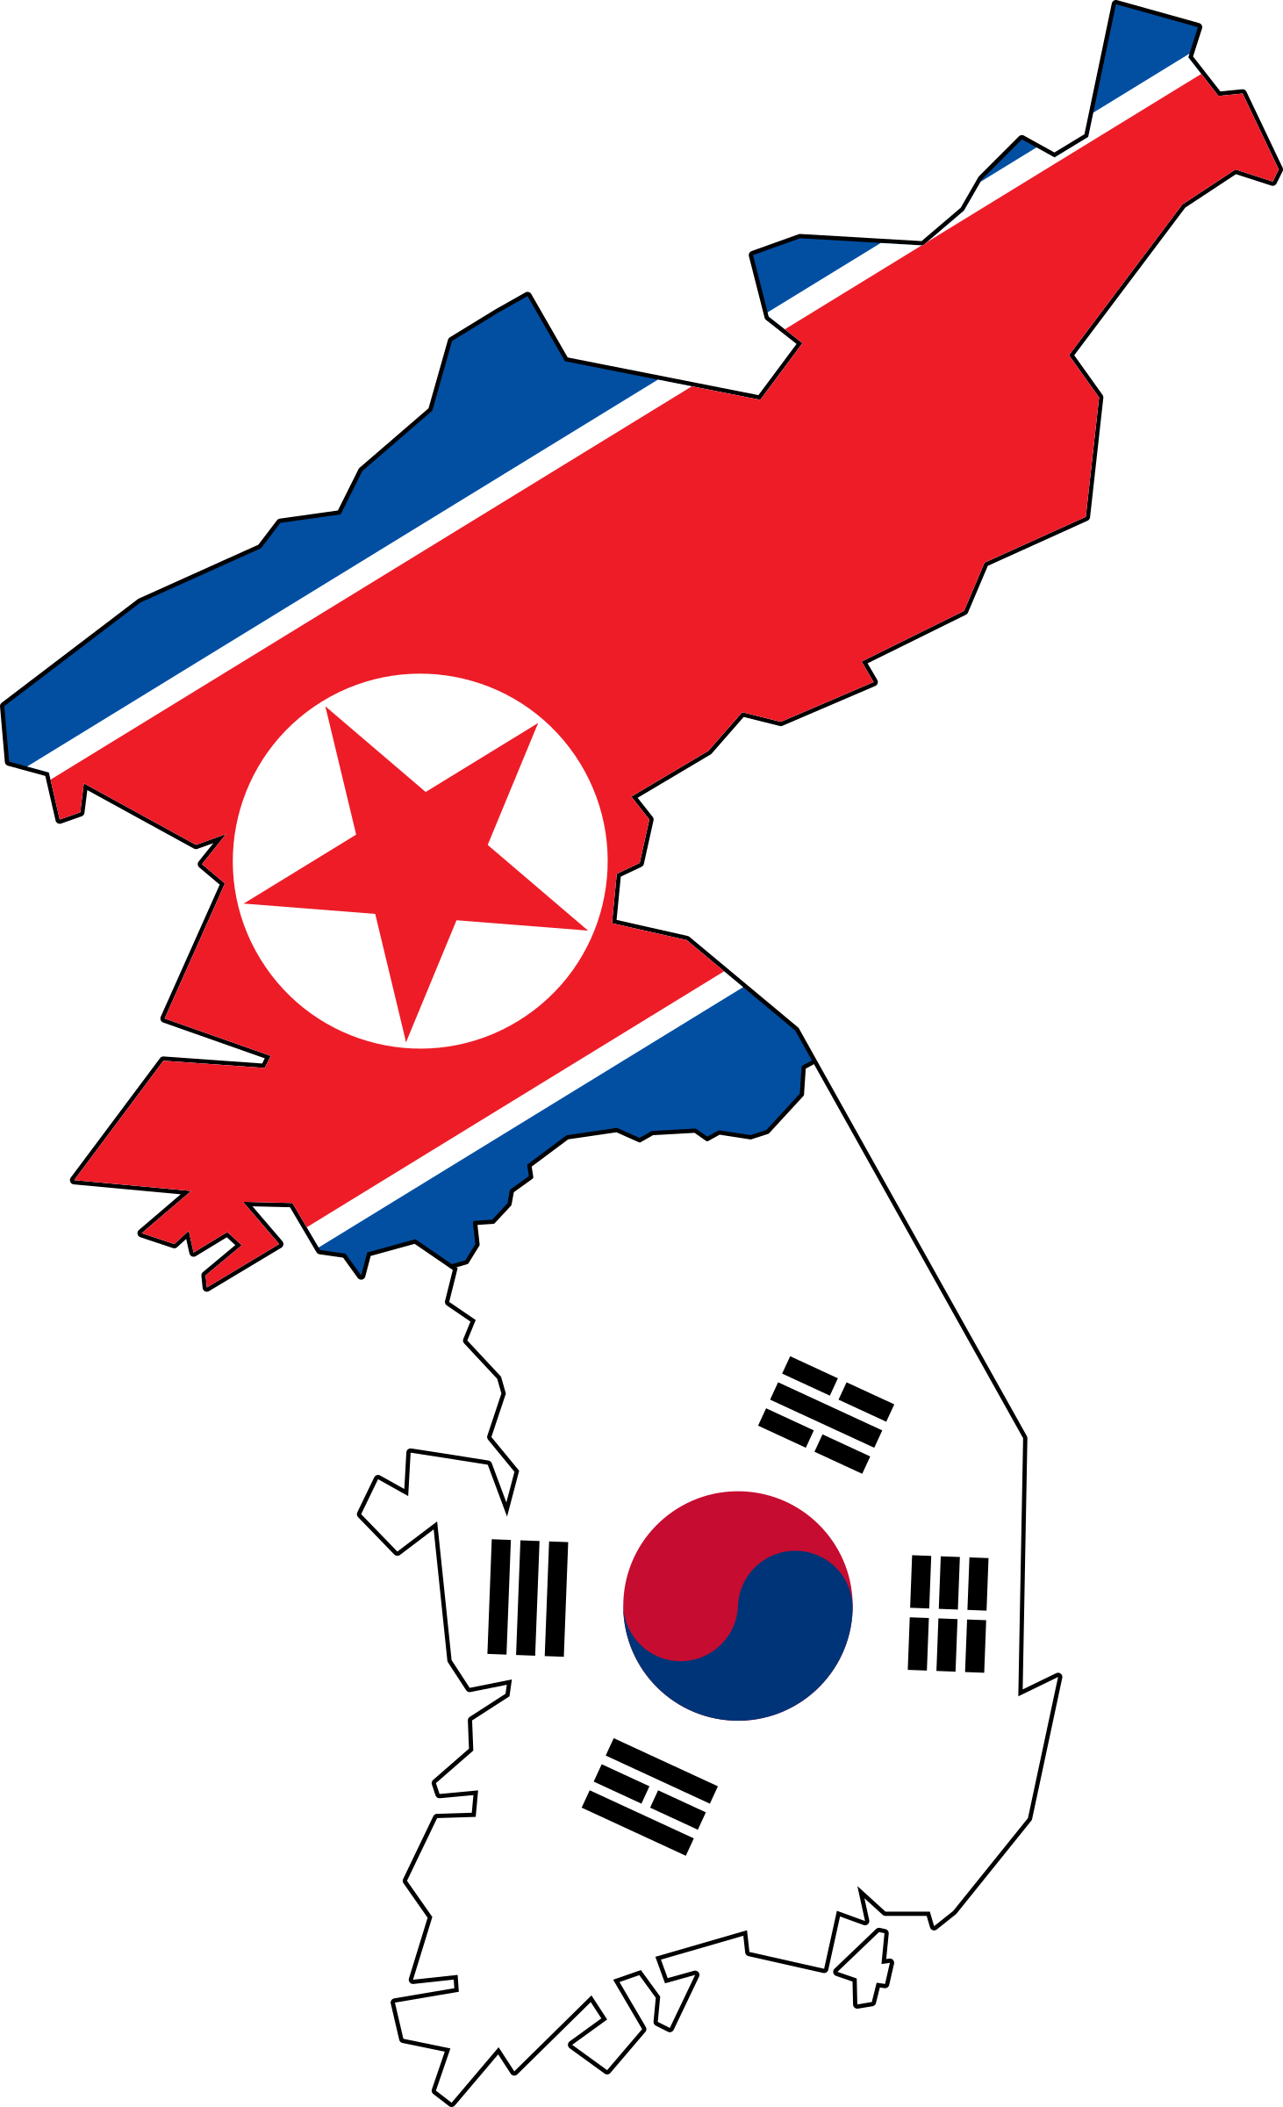
The Stalemate
Stalemate – a stop to fighting because no side was going to win.
The Korean War came to an end as a stalemate.
A cease-fire was declared, but no peace treaty was signed at the time.
Korea would continue to be divided into two countries up until today.
In 2018, the two Koreas finally signed an agreement to officially put an end to the Korean War, but the two countries still remain in disagreement with each other in many ways.

