Slide 1
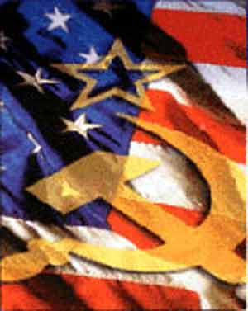
The Cold War At Home
Chapter 26 Section 3

Slide 2
Fear of Communist Influence

Slide 3
Loyalty Review Board

Slide 4
House Un-American Activities Committee

Slide 5
The Hollywood Ten

Slide 6
The McCarran Act

Slide 7
Spy Cases Shock the Nation

Slide 9
Joseph McCarthy and his “Witch Hunt”

