Slide 1
Origins of the Cold War
Chapter 26 Section 1

Slide 2
United States vs. Soviet Union
United States
Capitalism – private citizens control almost all economic activity, with little government interference
Voting – done by American citizens who chose their representatives
Soviet Union
Communism – all property and economic activity is controlled by the government
The Communist Political Party established a totalitarian government with no other political parties and the citizens do not vote for anything.

Slide 3
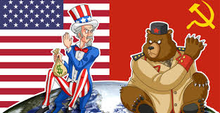
Suspicions Grew During World War II
The United States did not like that the Soviet Union had supported Hitler until Germany invaded the Soviet Union, and then they switched sides to join the Allies.
Stalin of the Soviet Union was upset that the Western Allies, especially the U.S., delayed in attacking the Germans in Europe. They thought the U.S. should have gotten into the war earlier.
Stalin was also angry that the U.S. kept the development of the atomic bomb a secret.

Slide 4
The United Nations
On April 25, 1945, representatives from 50 countries met in San Francisco, California to create the United Nations.
The United Nations was created as a peacekeeping organization that was started to promote peace and prevent wars.
The world had hope for peace at the end of World War II, even with the tensions that were still there.
The United Nations became a symbol of that hope.
The headquarters for the United Nations
is in New York City.

Slide 6
The allies (including Stalin) agreed to allow the people to create democratic institutions of their own choice and to choose the form of government under which they will live.
The allies also promised free elections of government responsive to the will of the people.

Slide 7
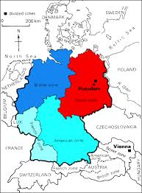
Division of Germany
As determined at the Yalta Conference, Germany and Berlin were divided into 4 zones (despite Berlin being located in the USSR zone).
Each zone was controlled by one of the Allies:
-USA
-Great Britian
-France
-USSR

Slide 9
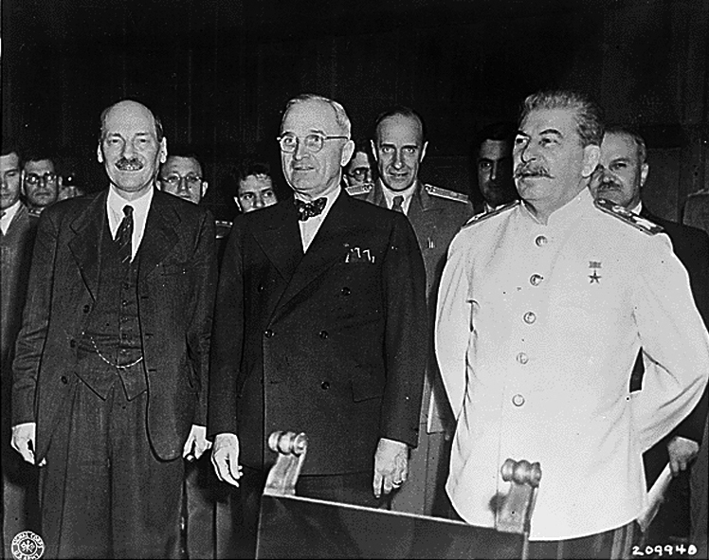
The Potsdam Conference
At the conference in Potsdam Germany, leaders of the “Big Three,” the U.S., Soviet Union, and Great Britain, met to discuss the actions agreed upon at the conference in Yalta.
By the time the leaders met in Potsdam, it became obvious that Stalin would not keep his promise of allowing free elections in Soviet controlled areas of eastern Europe.
Instead, he prevented elections and banned democratic political parties.

Slide 10
United States Expectations
World War II had made the United States into the leading economic superpower in the world.
The U.S. wanted to spread democracy to the countries that had their governments destroyed in the war.
They also wanted to be able to buy raw materials from Eastern Europe and to trade with those countries.

Slide 11
Soviet Union Expectations
The Soviet Union also gain great economic power because of World War II, but they had suffered a lot a destruction and loss in the war.
Because of their suffering in the war, the Soviet Union felt that they deserved their claim on Eastern Europe.
They thought by controlling the countries of Eastern Europe, they could stop any future invasion from countries in Western Europe.

Slide 12
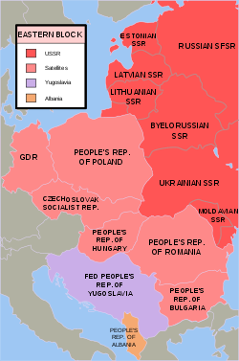
Satellite Nations – the countries dominated by the Soviet Union.
They included: Albania, Bulgaria, Czechoslovakia, Hungary, Romania, and Poland.

Slide 13
Policy of Containment
In February 1946, George Kennan, an American diplomat and expert on the politics of the Soviet Union that was stationed in Moscow, the capital of the Soviet Union, proposed the policy of containment.
Containment – the American policy that’s goal was to prevent communist rule from spreading to other countries.
This policy of containment became the main idea that guided President Truman’s foreign policy.
Foreign Policy – the plan of how a country would deal with events and interactions with other countries.

Slide 14
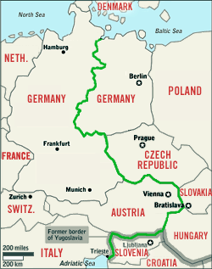
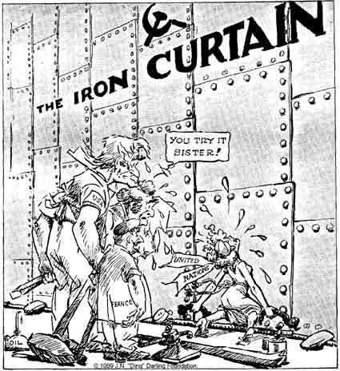
The Iron Curtain
Europe was now divided into two political sides, democratic western Europe and communist eastern Europe.
Iron Curtain – the term that became used to describe the two opposing sides of Europe, implying that since iron is strong, the divide in views between democratic and communist sides is not breakable or able to come to a compromise.

Slide 15
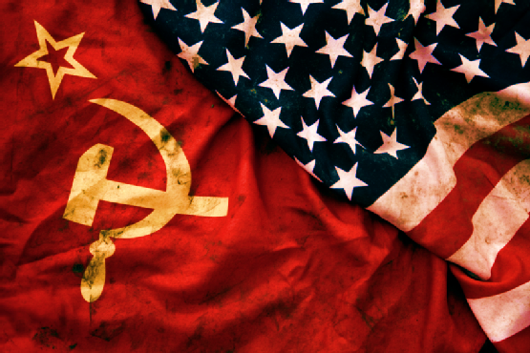
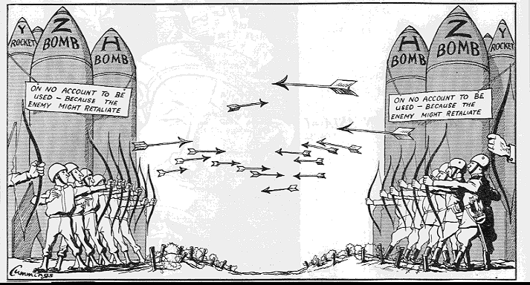
What was the Cold War?
The Cold War 1945-1991
After being Allies during WWII, the U.S. and U.S.S.R. soon viewed each other with increasing suspicion.
Their political differences created a climate of icy tension that plunged the two countries into an era of bitter rivalry known as the Cold War
The Cold War would dominate global affairs from 1945 until the breakup of the USSR in 1991.

Slide 16
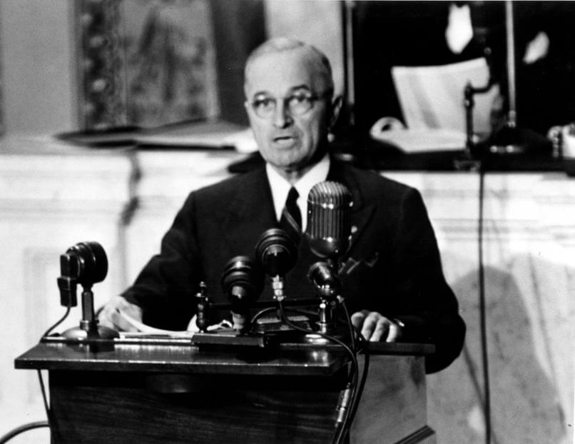
Truman Doctrine
Doctrine – a statement of government policy, mainly used for military reasons or policies towards how to act in dealing with other countries.
Truman Doctrine – a policy set by President Truman that stated that the U.S. would provide financial and military aid to any country being threatened by outside governments.
This policy was created mainly to help countries that were being threatened by the communist Soviet Union.

Slide 17
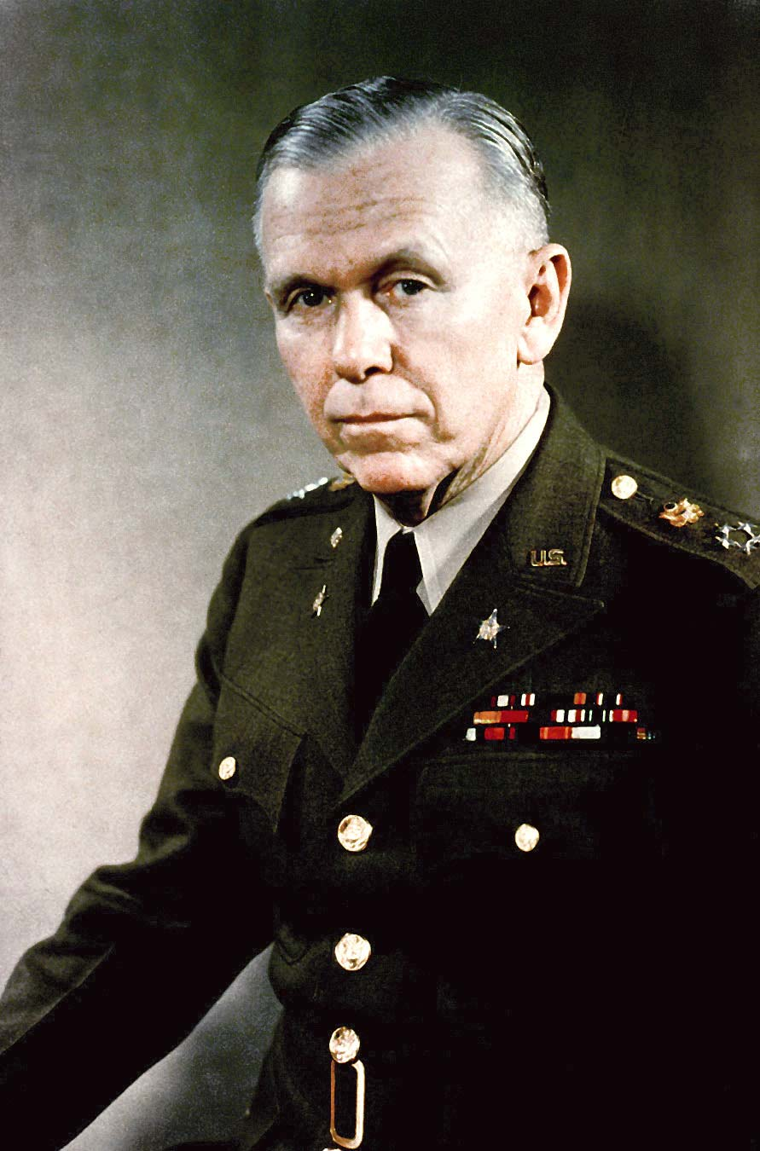
Marshall Plan
In 1947, two years after the end of the war in Europe, the countries involved in the war were struggling greatly.
Secretary of State, George Marshall, proposed the idea that if the United States would give aid in the form of money to all European countries, it would makes those countries more able to keep the ideas of democracy, and not fall to the idea of communism out of desperation.
The Marshall Plan was to divide $13 billion to 16 countries to help rebuild after the war and hopefully not make those countries become desperate enough to believe that communism was the best way to rebuild.
The Secretary of State is the
Person in the United States
Government that is in charge
Of dealing with issues
Involving other countries.

Slide 19
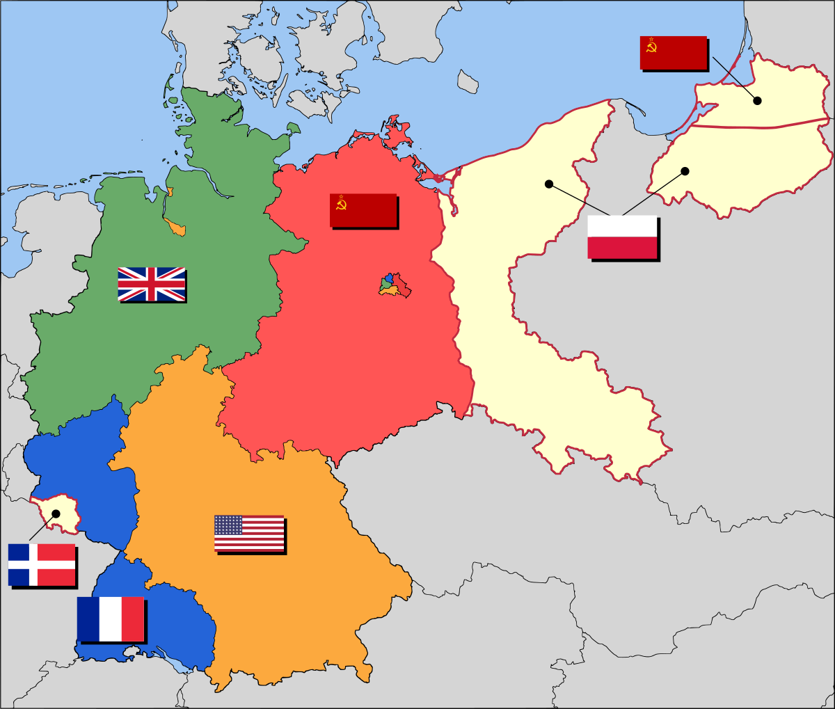
Superpowers Struggle Over Germany
The United States did not agree with the Soviet Union on the future of reunifying Germany.
Reunify – to make as one part again.
Since the end of World War II, the agreement was that Germany was divided into 4 zones, each controlled by one of the Allies Power from World War II.

Slide 20
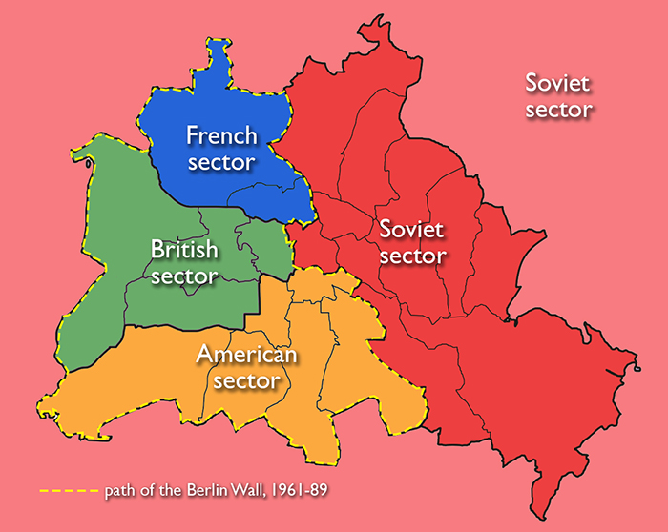
The agreement between the Allied Powers following World War II was that the 4 countries would divide control of Germany and then allow free elections in Germany at a later time.
The Soviet Union controlled the eastern side of Germany, and the other three Allies would each take a section in western Germany.
The capital city of Berlin would be divided in the same way.
The entire city of Berlin was surrounded by the Soviet Union’s territory in the east.

Slide 21
The Berlin Airlift
The Soviet Union saw that since its territory of Germany surrounded Berlin, it could keep the western democratic countries from easily accessing their area of Berlin.
The Soviets hoped that the western countries would just give up control of their areas of Berlin.
In June 1948, Stalin closed all highways and railroads going into Berlin, which meant no food or fuel could get in.
As a way of getting around the blockade, the U.S. started flying in supplies to the western part of Berlin.
Almost a year of flying in supplies to Berlin resulted in the Soviet Union realizing that the blockade was pointless and stopped the blockade.

Slide 22
Germany Becomes Two Countries
In 1949, Germany was officially split into two countries.
West Germany officially became the Federal Republic of Germany.
East Germany officially became the German Democratic Republic.

Slide 23
The NATO Alliance
The Berlin blockade increased Western democratic Europe’s fear of the Soviet’s aggression.
In response to the Soviet’s force, countries of Western Europe and North America grouped together to form the North Atlantic Treaty Organization (NATO).
The 12 members of NATO agreed to give military support to one another in the case that any member was attacked.
Simply put, if any country attacked one member, it would be the same as attacking them all at once.

