Slide 1
Mobilizing for Defense
Chapter 25 Section 1

Slide 2
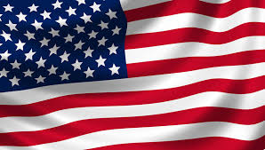
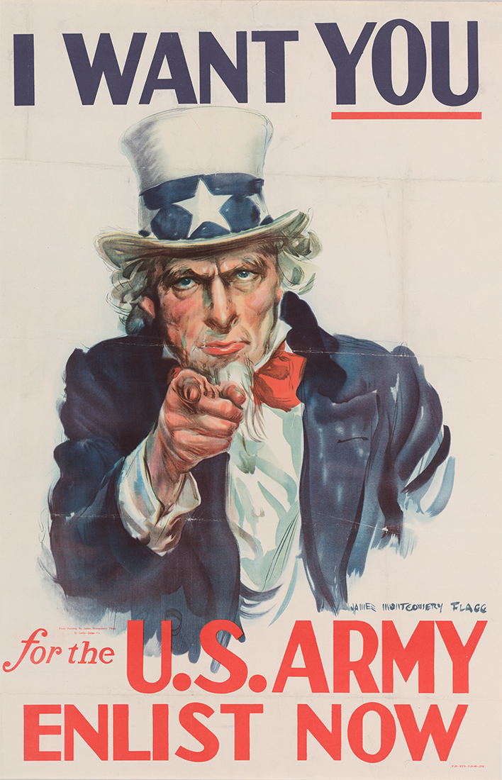
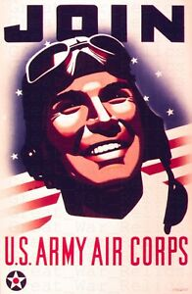
Americans Join the War Effort
Because of the attack on Pearl Harbor, many Americans changed their mind about whether the United States should get involved in the war.
Many wanted payback for the attack and feared that if the United States did not retaliate, it would bring more attacks to our country.
Over 5 million Americans signed up for the military following the attack, but even more would be needed.
Another 10 million soldiers were drafted into the armed forces through the Selective Service Act.

Slide 3
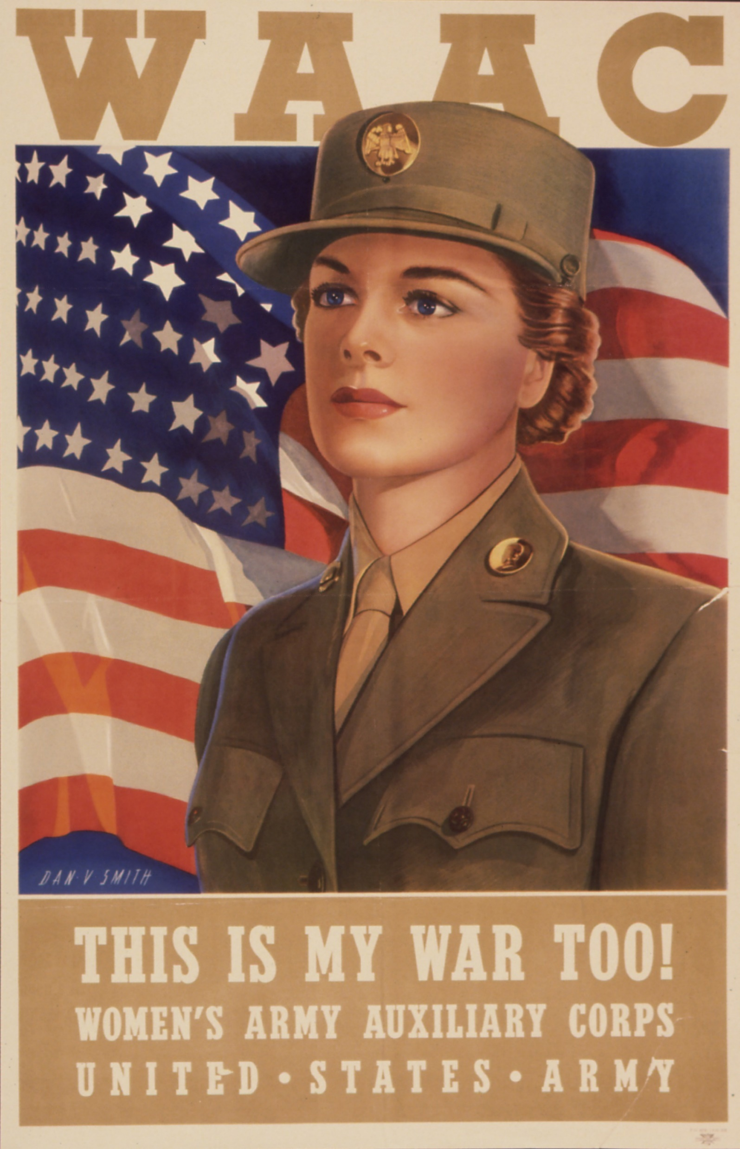
Expanding the Military
Women’s Army Corp (WAC) – a U.S. army unit created during World War II to enable women to serve in noncombat positions.
Positions:
-nurses
-ambulance drivers
-radio operators
-electricians
-pilots (thought not in combat)

Slide 4
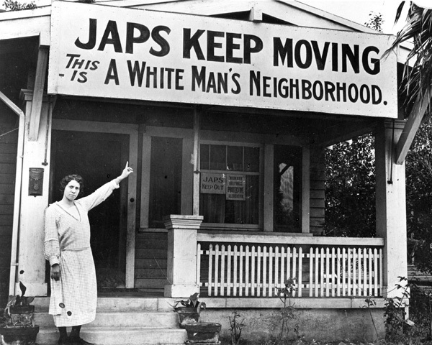
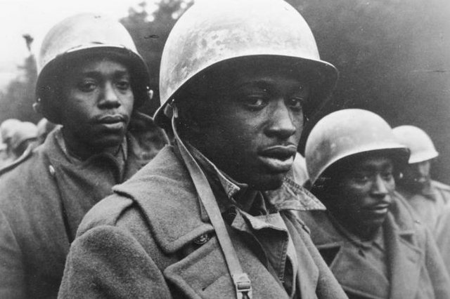
Discrimination in the Military
Many minority Americans found it hard to accept being drafted to fight for their country when their country did not give them equal rights as citizens.
Still, many minority group members joined the military during World War II, even though they were not allowed to fight in the same positions as whites. They were placed in separate units and were not allowed in combat until 1943.
In addition to fighting in the military, many minority members would work in factories making war supplies, where before the war, many of the same factories would not hire minority workers.

Slide 5
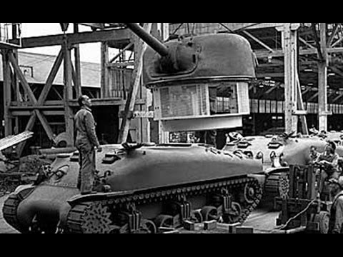
Production During the War
To help with the war effort, many factories stopped producing everyday products and changed their factories to produce war supplies such as tanks, planes, and other military vehicles.
Factories also changed to product things like parachutes, bombs, and uniforms.

Slide 6
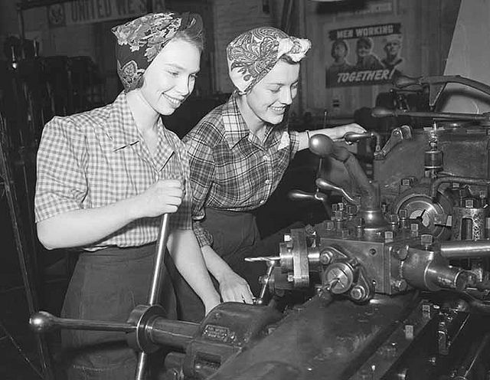
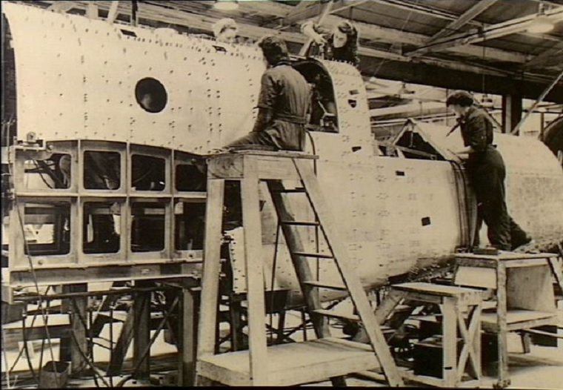
Women in the Workforce
Over 6 million women joined the workforce during WWII, mostly in factories.
Since a large amount of men who would normally be working the factory jobs were fighting in the military instead, society became much more accepting of women working in factories, saying that they were doing their duty for their country.

Slide 7
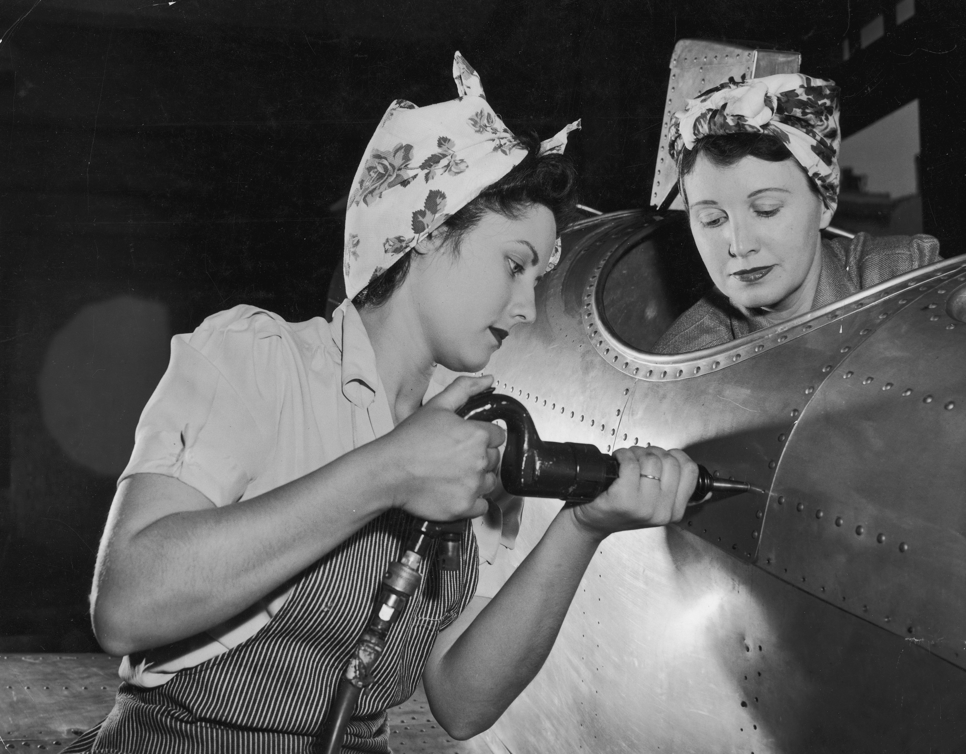
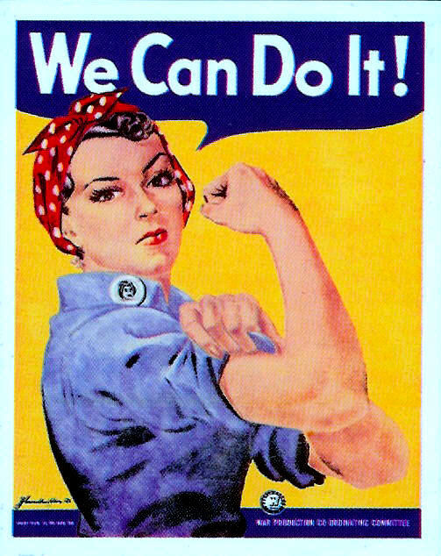
Rosie The Riveter
Because the U.S. needed women to take the place of the many men who left their jobs in factories to join the military, the government started an advertising campaign that was directed at getting women to feel that it was their duty to join the factory workforce.
It made it acceptable to society for women to work outside the home because they were doing it to support their country.
Rosie the Riveter was a
character that was the
focus of the advertisements
to get women to work in
factories during World War II.
She was based on a women
who worked at the Selfridge
Air Base in Ypsilanti, MI.

Slide 8
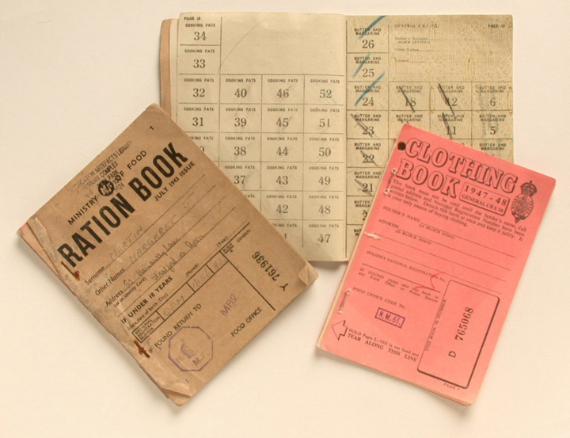
Federal Government Controls Business
Office of Price Administration – a government department created by Congress during WWII to control prices on everyday products that were in low supply.
War Production Board – government department made to coordinate the production of supplies for the military
Rationing - limiting the amount of a product that the public can buy so that the supply does not run out because many factories were making war supplies instead.

