Slide 1
Kennedy and the Cold War
Chapter 28 Section 1

Slide 2
Fears About the Cold War
By 1960, several Soviet accomplishments such as the launch of Sputnik I, which was a satellite put into space, and the Soviets development of long-range missiles, made many Americans feel that the American military was falling behind the Soviets.
An American spy plane had also been captured by the Soviet Union and the Soviets had created a partnership with the country of Cuba, which is just south of the United States.
These issues together made some Americans fear that we were losing the Cold War to the Soviet Union.

Slide 3
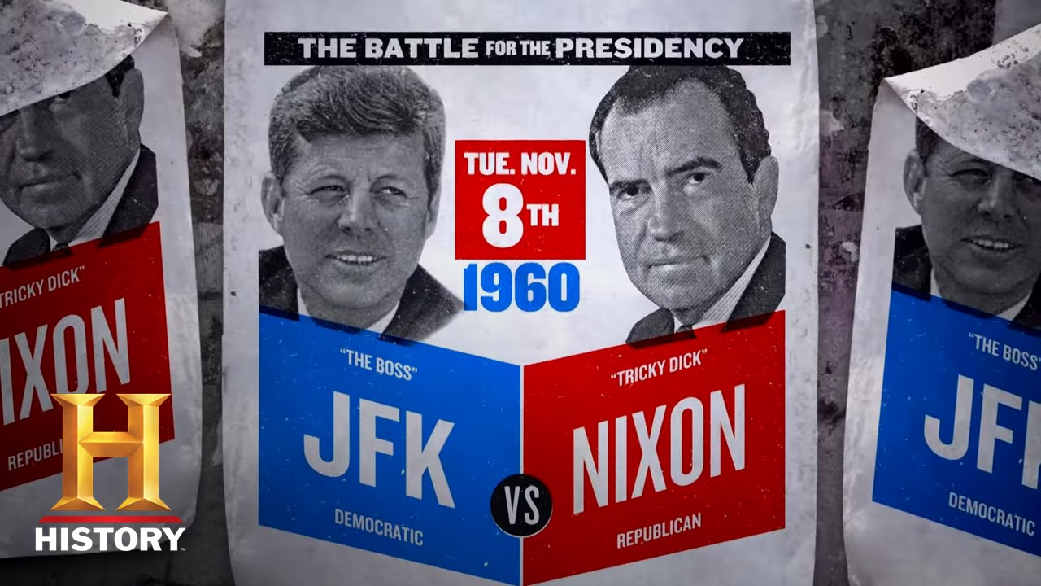
The Presidential Election of 1960
The election of 1960 was between Vice President Richard Nixon, and Democratic Senator John F. Kennedy.
Nixon was hoping to win election because the was the Vice President to President Eisenhower, who was very popular and well liked among the public.
Kennedy was a new, young man that made the promise of a very active leadership.
Two factors would help Kennedy win the 1960 election, television and his activities in the issue of civil rights.

Slide 4
Fears About Kennedy
There were two things about John Kennedy that worried some Americans:
1. He was very young and inexperienced in politics. His family had been very active in politics and he grew up in a political family, but he was only 43 at the time of the election, and had only been in the senate for one term.
2. He was Roman Catholic, and some people feared that he would make decision based too much on his religious beliefs.

Slide 5
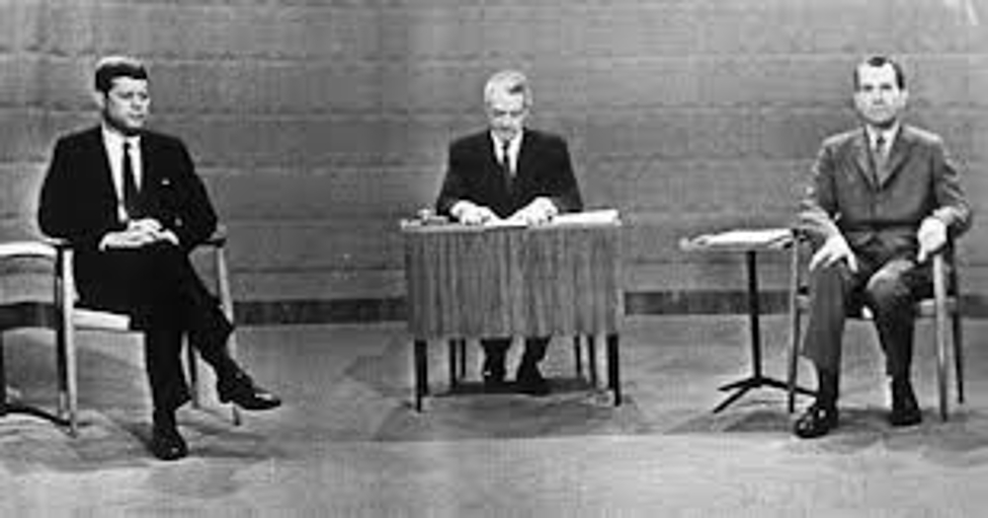
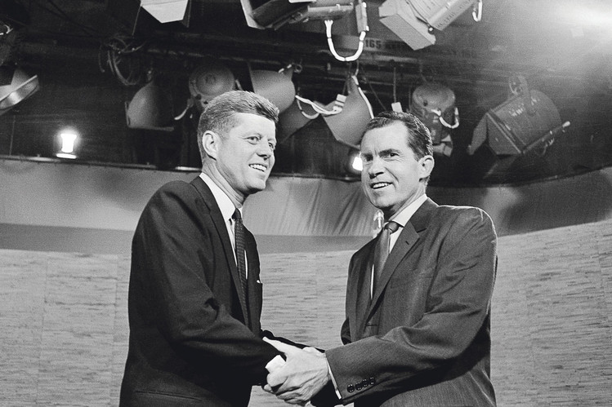
How Television Affected the Election
For the 1st time, the debates leading up to a presidential election were able to be shown on television, instead of listened to on the radio or just put in a newspaper.
Even though Nixon had more political experience, Kennedy was a better public speaker and was much younger and healthier looking than Nixon.
Because the look of the candidates made an impression on the viewers, Kennedy’s debate performance was considered a success and a factor in him eventually winning the election.

Slide 6
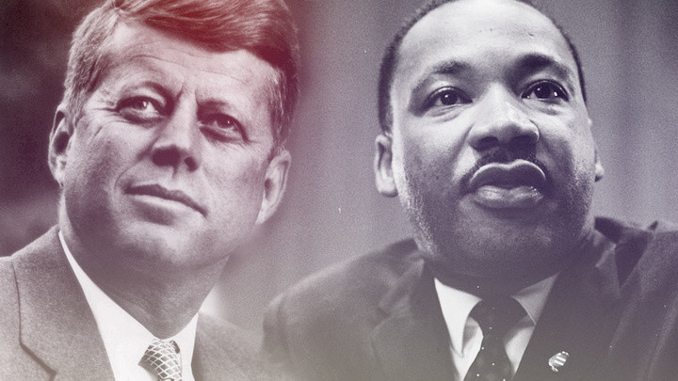
Kennedy and Civil Rights
Civil Rights – The rights that each individual is suppose to have just by being a citizen of the U.S., no matter what group they belong to.
In October 1960, Martin Luther King Jr. and many other African-American protestors were arrested for sitting at a lunch counter that was suppose to be all white diners.
MLK was imprisoned for a small traffic violation as an excuse and the President Eisenhower did nothing about it, making many in the African-American communities upset.
Kennedy was the only politician to express support for MLK, and even called his wife to show support. Kennedy and his brother Robert Kennedy convinced the judge to release MLK on bail, which got the attention of African Americans and brought many of them to support Kennedy for President.

Slide 7
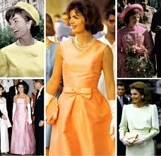
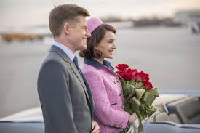
The Camelot Years
The Kennedy’s were viewed as the new style of first family in the White House.
They were young, stylish, and known for having many celebrities and artists as guests at the White House.
John Kennedy and his wife Jackie appeared on television often and the press loved their look and public style.
Many people around the country started to make the Kennedys lifestyle into a new culture of the American people, by trying to imitate how they dressed and acted.
The years of the Kennedy Presidency became known as the Camelot Years, referring to the old stories of the King and Queen of Camelot being adored by the whole royal court.

Slide 8
A New Military Policy With Kennedy
Over the years before Kennedy became President, the Soviet Union had gained partners in countries that were struggling economically, especially in the third world countries in Asia, Africa, and Latin America.
Kennedy believed that one of his top military concerns should be to increase the U.S. nuclear abilities.
He started the military strategy called flexible response.
Flexible Response – a military strategy that involved preparing for a variety of military responses to international crisis instead of focusing on just the use of nuclear weapons.

Slide 9
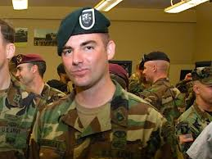
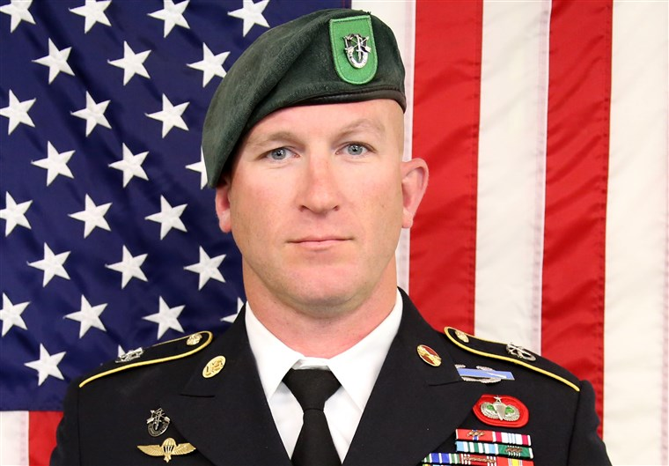
To make sure that the country was prepared for different types of military issues, President Kennedy increased spending for the defense department, which would include more conventional military forces and weapons.
Conventional Weapons – traditional military weapons such as guns, planes, boats, and tanks.
Kennedy also created an elite branch of the army called the Special Forces, also known as Green Berets because of the hat that went with their uniform to make their military branch recognizable.
President Kennedy also tripled the nuclear weapons that the U.S. held so that they could compete with the Soviet Union in that way as well.

Slide 10
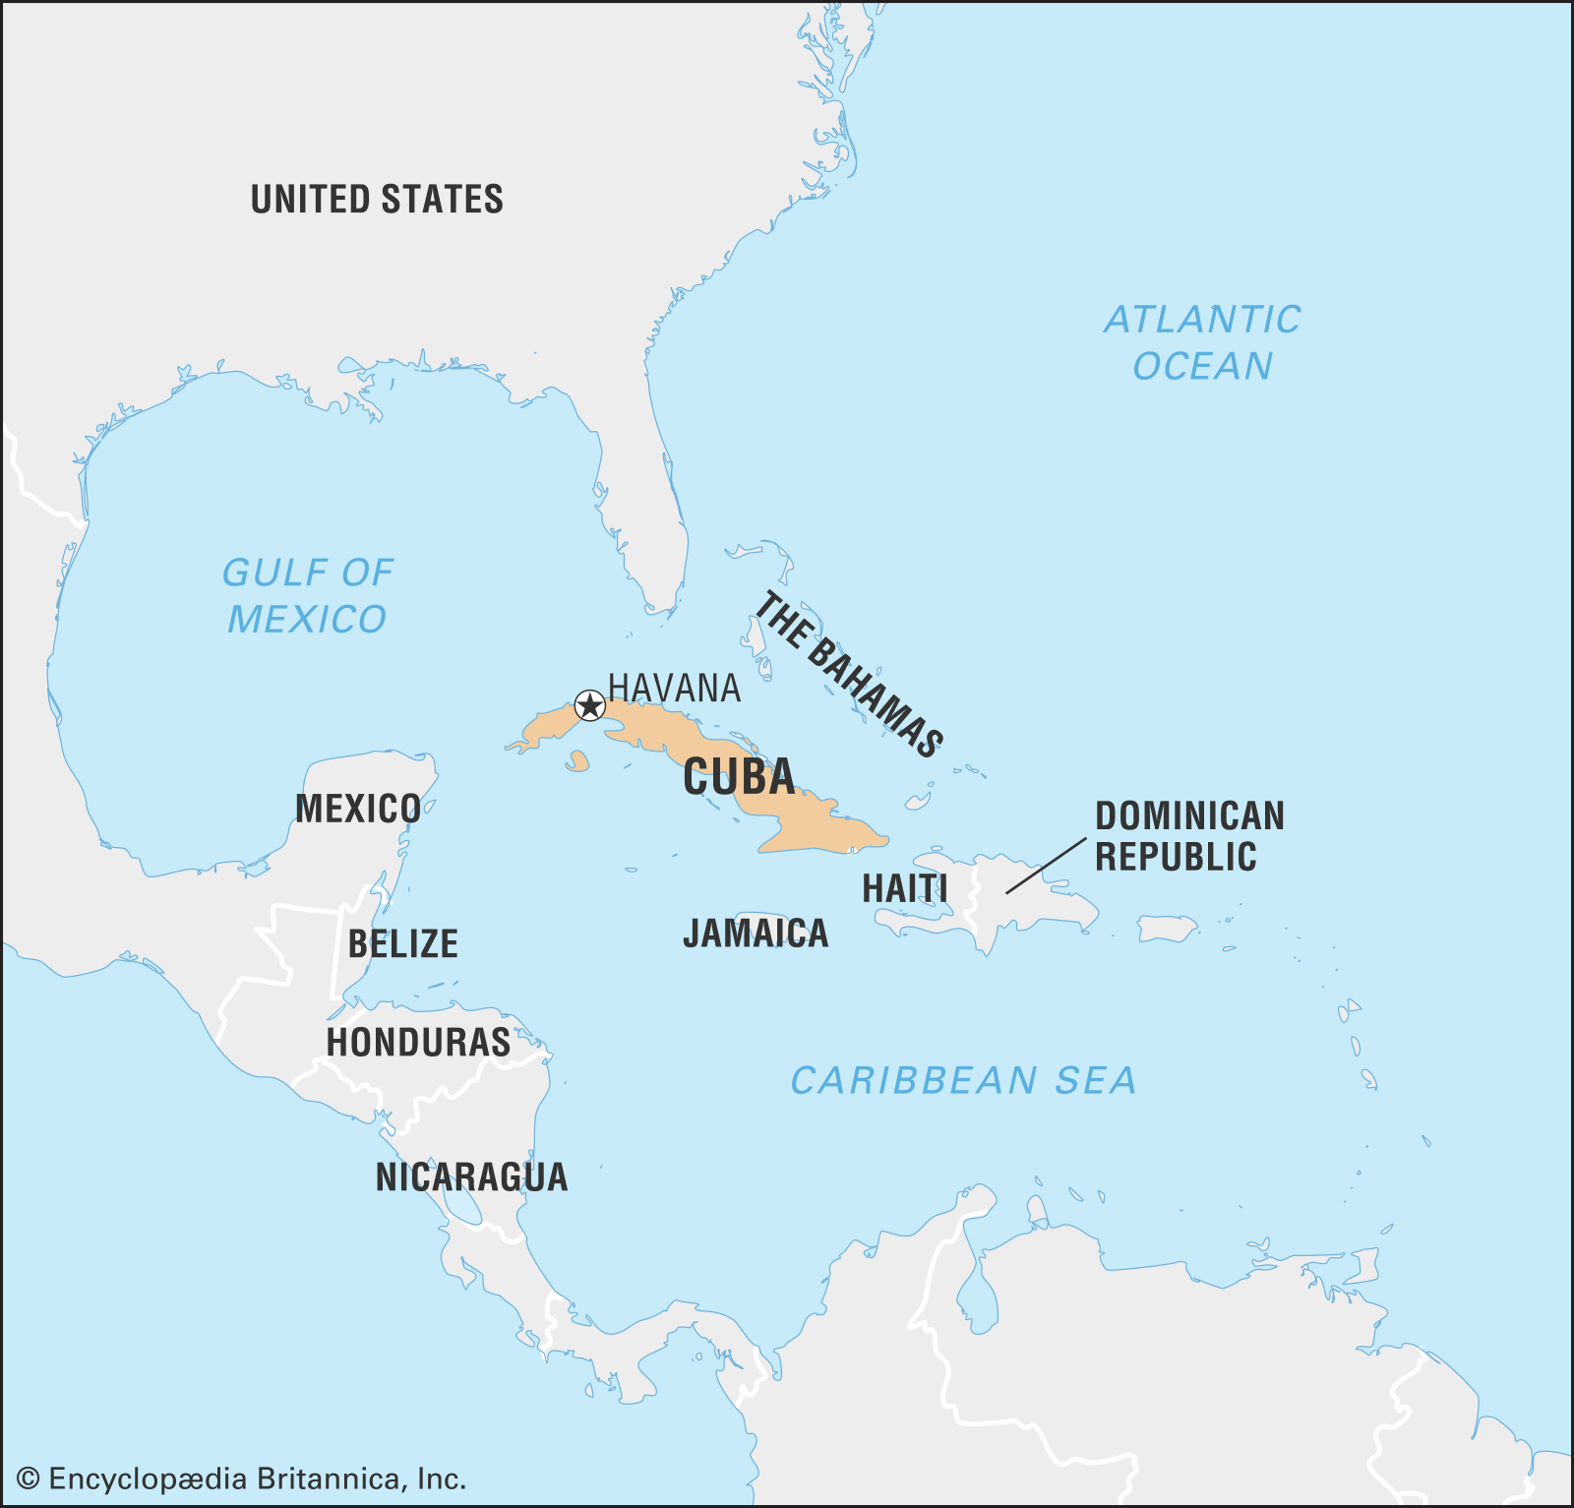
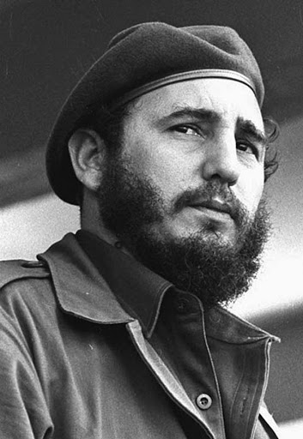
Crises Over Cuba
Cuba is an island country that is just 90 miles off the southern coast of Florida.
Fidel Castro gained power of Cuba in 1959 by fighting a revolution against dictator Fulgencio Batista and promising the people a democratic society. He promise to get rid of poverty, inequality, and dictatorship in Cuba.
Just before Kennedy became president, Fidel Castro declared himself the leader of Cuba after a revolution in Cuba. He claimed to be Communist and created a accepted help from the Soviet Union, creating another communist partnership.

Slide 11
When Castro took control of three American and British oil refineries in Cuba, relations between the U.S. and Cuba started to get worse.
Castro took commercial farms, farms that were privately owned by companies, and turned them into communes that were owned by the Cuban government and would be worked by peasants that had been without land.
American sugar companies, which controlled about 75% of the farmland in Cuba, asked the U.S. government for help.
The U.S. Congress put up trade barriers against Cuban sugar. That means that the Cuban government could not sell the sugar they grew in the U.S. as a way of getting back at Cuba for taking land owned by the U.S. companies.

Slide 12
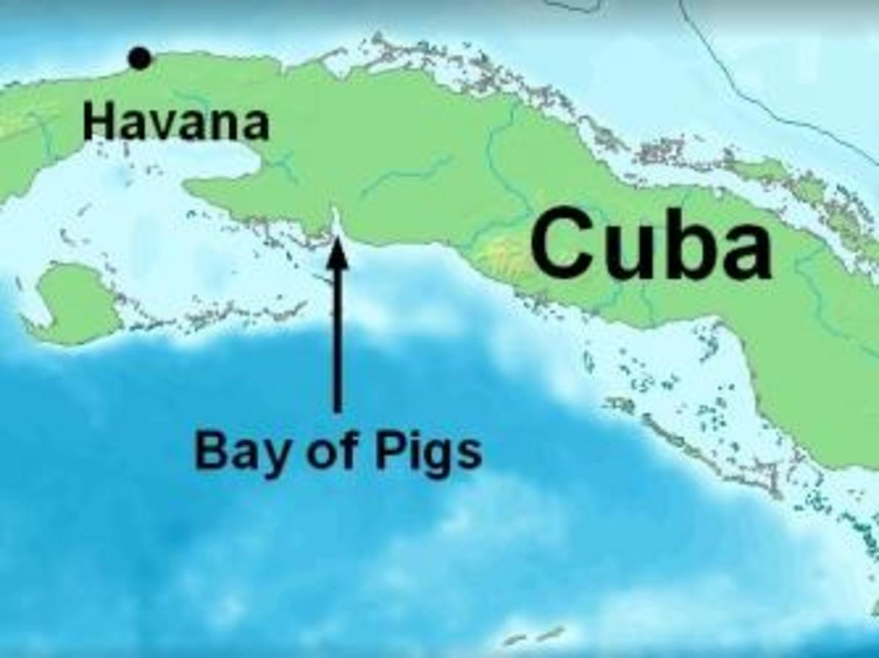
Bay of Pigs Invasion
In 1960, President Eisenhower had given the CIA (Central Intelligence Agency) permission to secretly train exiles from Cuba to invade Cuba.
The CIA and the exiles hoped it would start an uprising in Cuba that would lead to the overthrow of Castro.
President Kennedy learned of the plan 9 days after he was elected the new president.
On April 17, 1961, about 1,500 Cuban exiles that were supported by the U.S. military landed on Cuba’s southern coast in an area known as the Bay of Pigs.

Slide 13
The Bay of Pigs invasion was a total failure.
-The air strike failed to take out the Cuban air force, but the CIA reported it had succeeded, which was wrong.
-A small advance group that was sent to distract Castro’s soldiers never made it to shore.
-When the main group of exiles reached land, it had no Americans air support and faced 25,000 Cuban soldiers that had tanks and jets that had been supplied by the Soviet Union.

Slide 14
Many of the invading exiles were killed, the others sent to prison in Cuba.
The defeat at the Bay of Pigs was an embarrassment for President Kennedy.
Kennedy negotiated with Castro for the release of the surviving invaders, and paid $53 million in food and medical supplies to Cuba to get them released.

Slide 15
The Cuban Missile Crisis
Soviet Premier, Nikita Khrushchev, promised to defend Cuba with Soviet weapons.
During the summer of 1962, the Soviet Union was giving Cuba many military weapons, including nuclear weapons.
President Kennedy responded by warning Cuba that the United States would not just allow the Soviet Union to put offensive nuclear weapons in Cuba.

Slide 16
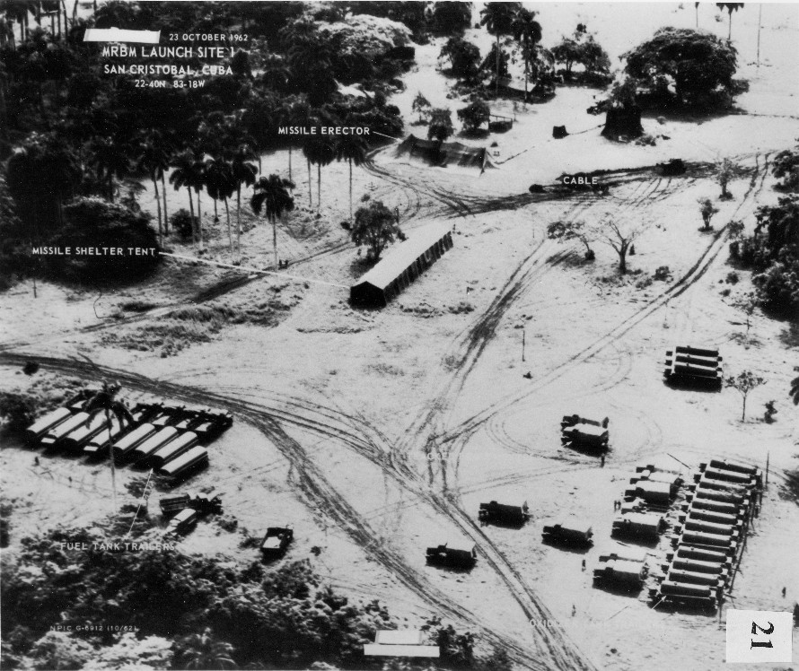
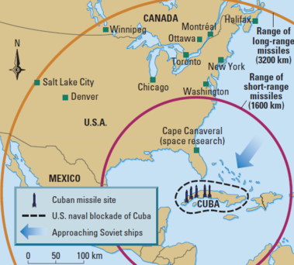
On October 14, photographs taken by U.S. planes flying over Cuba showed missile bases being built by the Soviet Union in Cuba.
The missiles in Cuba would be able to reach U.S. cities within minutes of being launched.
On October 22, Kennedy announced the existence of the Soviet missiles in Cuba to the American people. He also announced a plan to remove them.
Kennedy said that any attack from Cuba would force a U.S. attack on the Soviet Union.

Slide 17
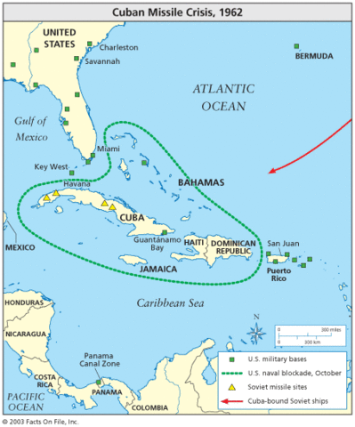
For 6 days, the world faced the fear of a possible nuclear war.
Soviet ships, that were assumed to be carrying more missiles, were heading to Cuba.
The U.S. Navy was ordered to set up a blockade in front of Cuba, and not let the Soviet ships to reach Cuba.
The Soviet ships continued towards Cuba and stopped just before coming up on the U.S. Navy ships.

Slide 18
A few days later, Khrushchev of the Soviet Union offered to remove the missiles in return for America promising not to invade Cuba.
The U.S. also agreed to remove our missiles from Turkey, which were there as a threat to the Soviet Union.
The blockade had worked and the missiles never made it to Cuba.

Slide 19
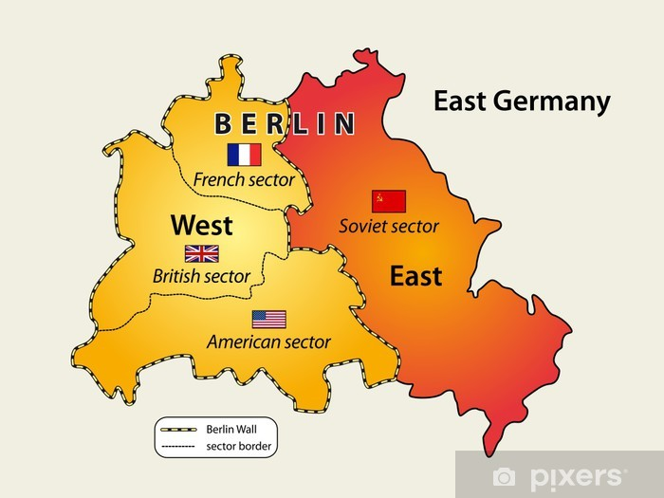
Troubles In Berlin
Kennedy was determined to prove to Khrushchev that he was going to fight to contain communism from spreading to even more areas of the world.
In 1961, the city of Berlin was struggling. Many citizens from East Berlin fled to West Berlin because the west was free of Communism.
These refugees spoke out against the failures to the East Germany Communist government, and the loss of a portion of East Germany’s population hurt the economy of East Germany too.

Slide 20
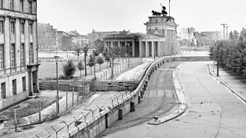
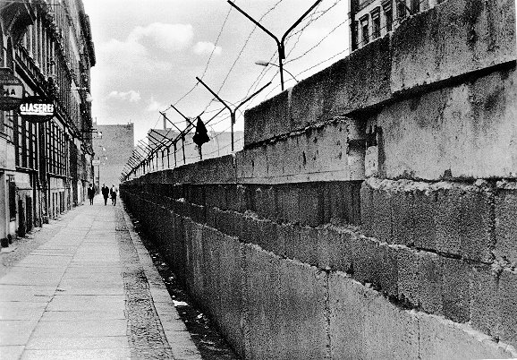
The Berlin Wall
In order to stop more residents of East Berlin from fleeing to the west, the Soviet Union built a wall around the area of East Berlin, trapping residents inside.
Within just a few days, the Berlin Wall was installed. It contained a concrete wall topped with barbed wire and armed guards to stop residents of East Berlin from leaving the communist side of the city.
The Berlin Wall became an ugly symbol of the hardships caused by the Soviet Union’s Communist control.

Slide 21
Searching for Ways to Ease the Tension
The Hot Line – a direct phone line between President Kennedy in the White House with Premier Khrushchev at the Kremlin in the Soviet Union.
The direct phone line would allow the two leaders to speak quickly and in secret if another problem between the two countries occurred.
Kremlin – the capital government building in the Soviet Union.
The Limited Test Ban Treaty – the agreement between the U.S. and the Soviet Union to stop testing nuclear weapons in the atmosphere.
The Limited Test Ban Treaty was another show of compromise between the two leaders.

