Slide 1
Dictators Threaten World Peace
Chapter 24 Section 1

Slide 2
The Treaty of Versailles, which ended WWI, had caused anger and resentment instead of peace.
Germany felt especially angry because they were blamed for the war and lost a lot of territories in the treaty.

Slide 3
The Weimar Republic was the democratic government that was set up in Germany after WWI.
Many of the democratic governments that began in Europe after WWI were not successful, and so those country’s people would turn to authoritarian leaders.

Slide 4
5 Types of Governments
1. Authoritarian Government – Style of government that has a strong central power and limited political freedom for the people. There is not any standard law.
2. Communist - the type of government in which the government is controlled by a single person or a small group that also has control over the economy

Slide 5
3. Fascist – a political system that promotes a strong central, nationalistic government led by a powerful dictator. This government stresses the good of the country over the good of its individual people.
4. Totalitarian – a political system in which the government exercises complete control over its citizens.
5. Democratic – a government that gives the public a say in decisions and a choice in who the leaders are.

Slide 6
Joseph Stalin Transforms the Soviet Union
Vladimir Lenin died in 1922, and Joseph Stalin took over control of the Soviet Union by 1924.
Stalin made agricultural ( which means farming) growth and industrial growth his two main economic goals for the Soviet Union.
Stalin took all privately owned farms and made them into collectives. Each collective was work on by hundreds of families.
Collective – government owned and operated farms.

Slide 7
Stalin also pushed to make the Soviet Union a major industrial country.
All economic activity, which means land, materials, and industry, was placed under government control.
Stalin eliminated any opponents to his rule. This was done by either sending them to prison camps or even as harsh as having them executed.

Slide 8
The Rise of Fascism in Italy
In Italy, unemployment and inflation were causing strikes among the workers.
Inflation – the cost of buying things goes up more than the amount of money people make.
Strikes – workers stop working to try to force their employers to make changes
Because of these problems, the middle and upper classes were pushing for a stronger government leader.

Slide 9
Benito Mussolini took advantage of the situation by claiming that he would be the strong leader that the people of Italy had been wanting and that he would solve their economic problems.
Mussolini started the Fascist Party. This was a political party that pushed for nationalism and said that the good of the nation was more important than the rights of the individual person.

Slide 10
Mussolini gained the support of the police and many important government officials.
He then used that support to force Italy’s king to appoint him the new leader of Italy.
Once Mussolini had control of the government, he force the former king to leave Italy, but before the king could get out, Mussolini had him captured and executed.

Slide 11
Nazis Take Over Germany
In 1919, Hitler joined the National Socialist German Worker’s Party, or Nazis.
Hitler was a powerful public speaker and organizer. He quickly became the party’s leader.

Slide 12
Hitler’s 3 Goals
Hitler wrote a book, Mein Kampf, which means “My Struggle” as a plan for uniting all German-speaking people under one large German empire. This became the goal of the Nazi Party.
Hitler also wanted to force racial purification in Germany. His master race of Aryans, pure Germans, became a main focus of the Nazi Party’s beliefs.
Hitler’s third goal for Nazi Germany was national expansionism. He believed that German were the superior race and deserved more living space, and they would take it from cultures or races.

Slide 13
The Role of the Great Depression
The Great Depression, which was the economic collapse that effected the whole world, helped the Nazis come to power in Germany.
Germany’s economy was destroyed by both World War I and then the Great Depression.
The people of Germany were desperate and Hitler told them that he would fix the government and bring Germany back to the power it once had. He said exactly what people wanted to hear.

Slide 14
Hitler is elected Chancellor, leader of Germany
In 1933, Hitler was given the title of Chancellor of Germany, which is the same as a prime minister or a president.
Hitler took apart Germany active government, the Weimar Republic, and replaced it with his Third Reich, which means the Third German Empire.

Slide 15
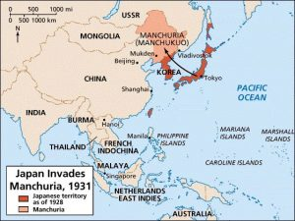
Militarists Gain Control in Japan
Military Nationalists wanted to expand the area of Japan, similar to what Hitler wanted for Germany.
The Military Nationalists took control of the Japanese government.
Soon after taking control, they attacked the area of Manchuria in China, which is an area of land in China that is known for good soil and many mineral resources.

Slide 16
The League of Nations, the organization which was formed after World War I to try to prevent future wars, watched Japan’s attack on China, but did nothing to stop it.

Slide 17
Aggression in Europe and Africa
The dictator’s in Europe took the fact that the League of Nations did nothing to stop Japan as a sign that the organization would also do nothing if they attacked other countries too.
In 1935, Hitler began to build up Germany’s military, which went against the Versailles Treaty that ended World War I.

Slide 18
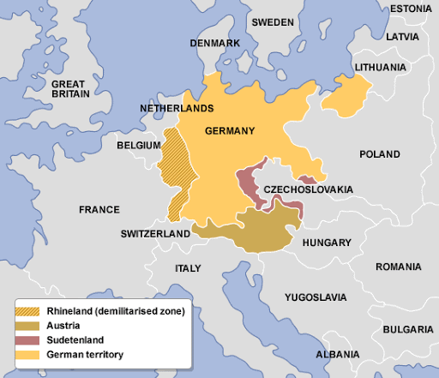
In 1936, Hitler sent that army to attack the Rhineland, which is a German region along the border with France and Belgium.
As Hitler predicted, the League of Nations did nothing to stop it.

Slide 19
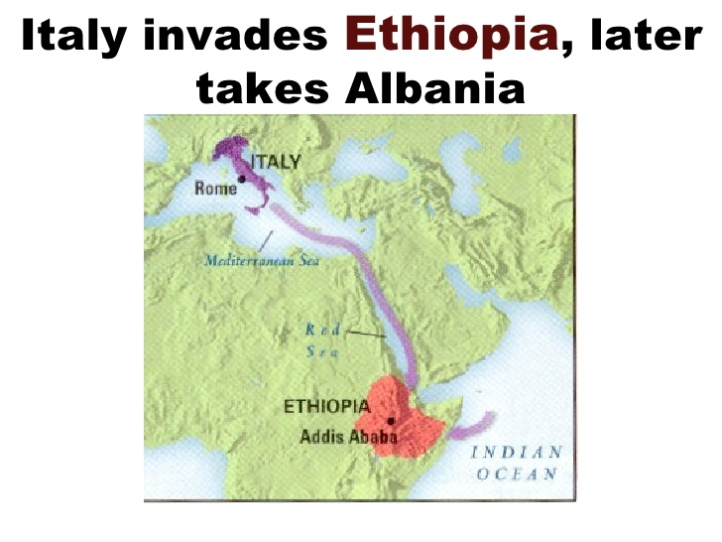
Mussolini also began building his empire for Italy.
He invaded Ethiopia, which was one of Africa’s last remaining independent countries.

Slide 20
Civil War in Spain
In 1936, a group of Spanish army officers led by General Francisco Franco, rebelled against the Spanish republic government.
Some Americans went to help Spain fight back against the army officers and the Fascist government that they wanted to start in Spain.
Due to very little help from other western democratic countries, Fascism spread through Spain.
Hitler and Mussolini both supported the Fascist ideas of Franco by sending troops and weapons to help the Spanish army officer’s take over of the government.
The partnership of Hitler and Mussolini in helping Spain turned into the signing of a formal alliance called the Rome-Berlin Axis. Hitler and Mussolini would remain partners through the beginning of World War II.
Spain became a fascist country with Francisco Franco the totalitarian dictator of the country.

Slide 21
The United States Tries to Remain Neutral
Neutral – means not choosing a side
Through the early 1930s, America was claiming to remain neutral in the conflicts happening in Europe.
In 1935, Congress passed a law known as the Neutrality Acts. This law had three parts.
1. The U.S. would not sell weapons to nations at war.
2. The U.S. would not give loans to any nations at war.
3. The U.S. could not sell weapons or supplies to nations in a civil war, such as Spain.

Slide 22
President Roosevelt Ignores the Neutrality Acts
Roosevelt claimed that since Japan had never formally declared war on China, the Neutrality Acts were not in effect.
The U.S. continued to send weapons and supplies to China.
Roosevelt spoke out against the idea of isolationism until protests against the possibility of the U.S. getting involved in conflicts changed that idea.
Isolationism – the idea that a country will not get involved in the problems of other countries.

