Slide 1
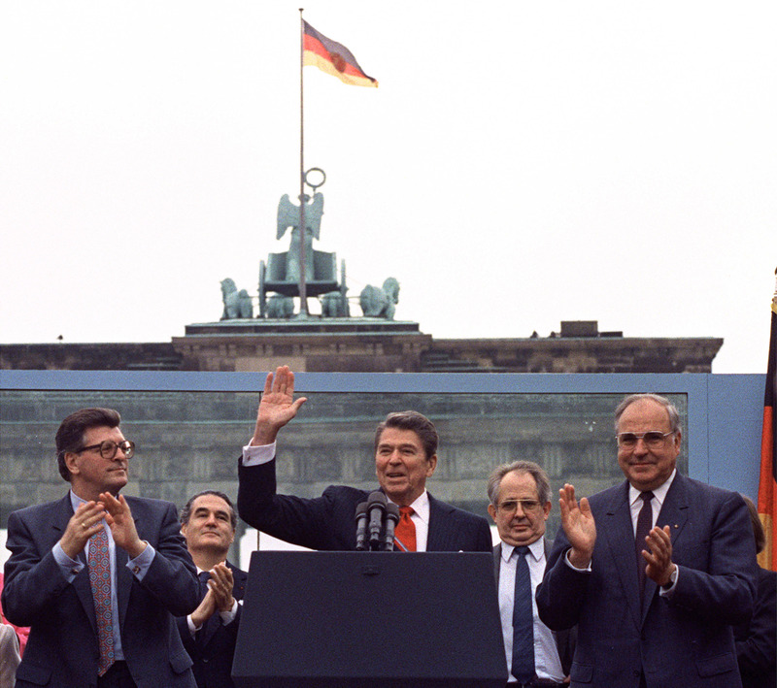

Slide 2
Thank you so much for purchasing this product for your classroom! I very much appreciate your support and business. Please, however, do not post this resource to any webpage, blog, Weebly page or Youtube. This is a violation of our Terms of Use.
Thank you!
Click below for Guided Outline Notes:
https://www.dropbox.com/s/jvu4006hbrri6ea/Detente%20End%20of%20Cold%20War%20Notes%20Page.docx?dl=0
“Flipped Classroom” Youtube Video:
https://youtu.be/yBwOMyULy_Y
Google Slides Version:
https://docs.google.com/presentation/d/15hCDg2IY9jLUoTgSBeOip-bOCczhIMbOrjgmajY4TDE/copy

Slide 3
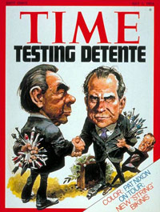
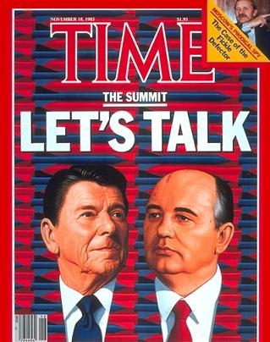
Détente
Cooling off period of the 1970’s
Presidents Nixon & Carter
Strategic Arms Limitation Treaties (SALT I & II) limit the number of nuclear missiles

Slide 4
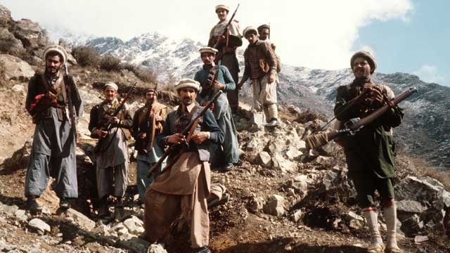
The End of Détente
Soviets invade Afghanistan in 1979
America helps Afghan forces
War lasts until 1989
Pres. Reagan returns to more competitive policy

Slide 5
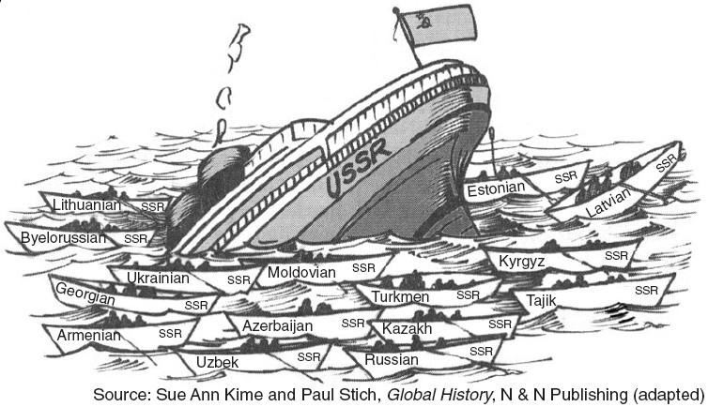
Internal Problems of the Soviet Union
Increasing military expenses to compete with USA
Rising nationalism in Soviet republics
Economic inefficiency

Slide 6
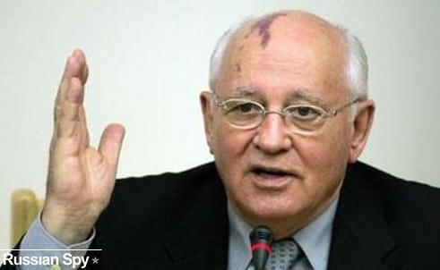
Soviet Reforms
New Soviet leader Mikhail Gorbachev makes reforms to save the country:
Glasnost – more openness
Perestroika – Free market economic restructuring)

Slide 7
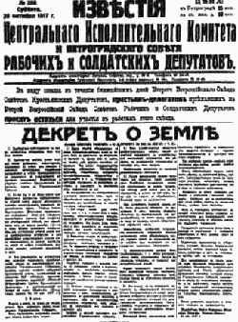
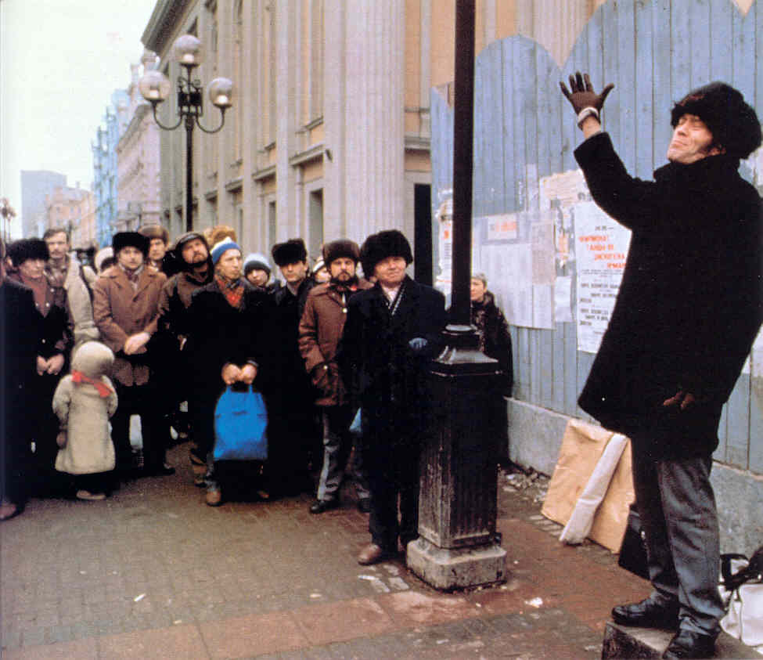
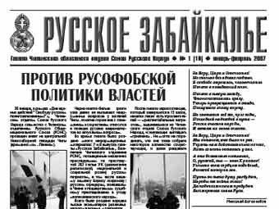
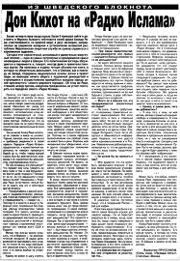
Glasnost
More freedom of speech, press, & religion

Slide 8
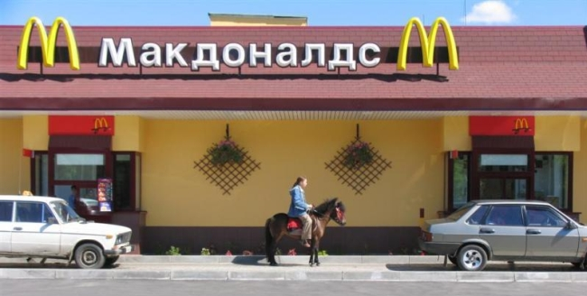
Perestroika
More free market, private businesses

Slide 9
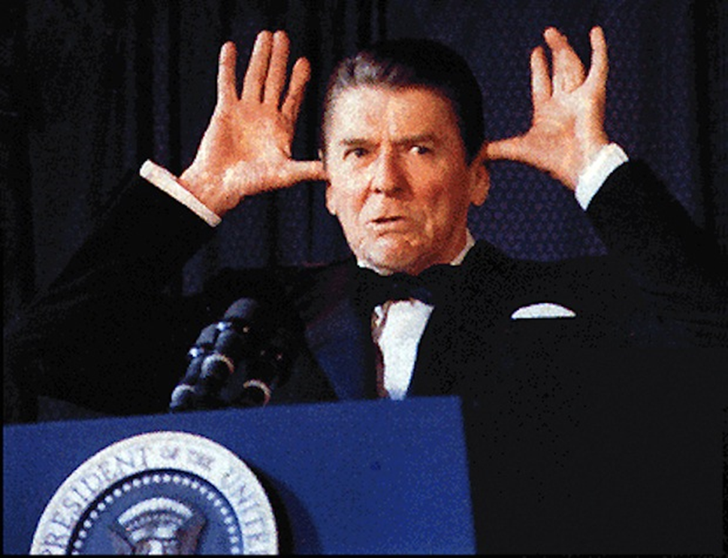
President Reagan
Loves to poke fun at the Soviet Union

Slide 10
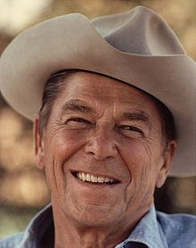
President Reagan
Conservative Republican president 1980-1988
Increases military spending
Tax cuts & reducing government
Transferring more responsibilities to state governments

Slide 11
Brandenburg Gate Speech
“Mr. Gorbachev tear down this wall!”
Challenges the morals of the Soviet Union
Puts pressure on Soviets to allow freedom

Slide 12
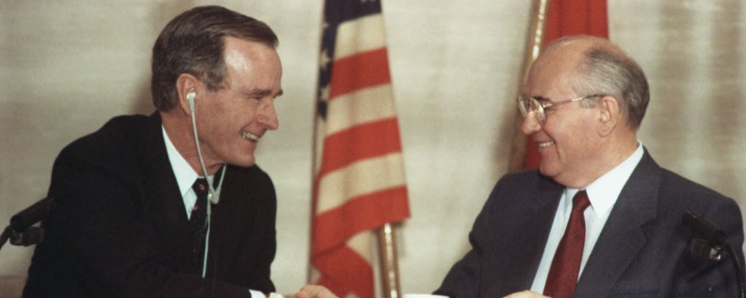
Collapse of the Soviet Union
George Bush elected US president in 1988
Gorbachev loosens control on Soviet satellite nations
These then break away & declare independence

Slide 13
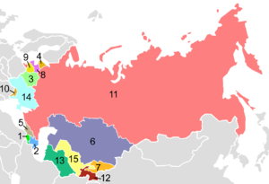
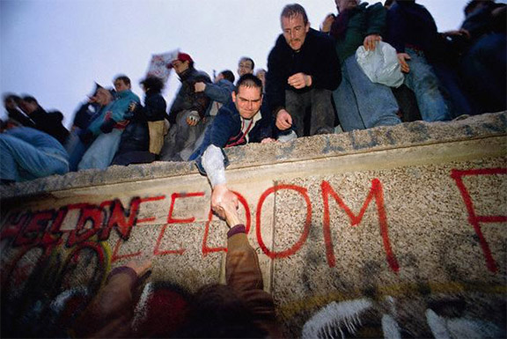
Results
Berlin Wall town down & Germany reunited
Communist rule overthrown across Eastern Europe
America wins the Cold War and is the only remaining superpower

