Slide 1
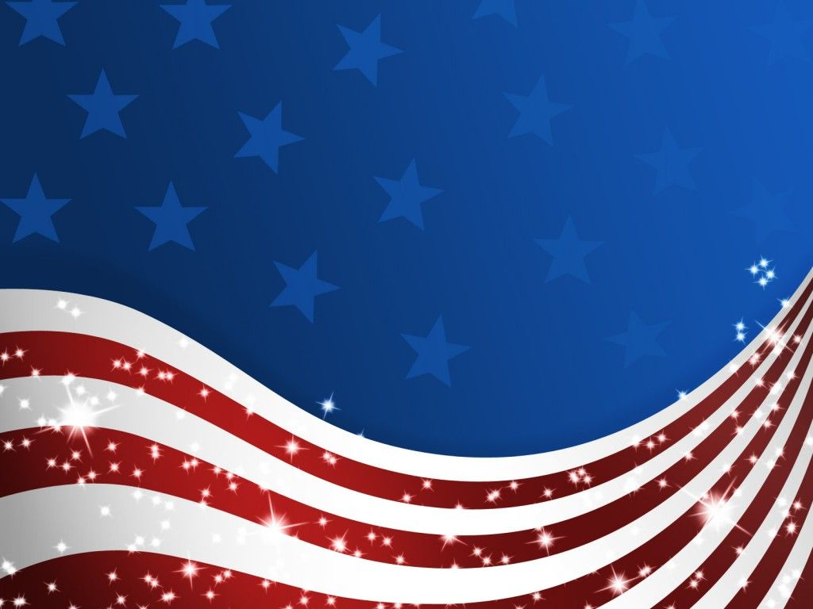
America Moves Towards War
Chapter 24 Section 4

Slide 2
Moving Cautiously Away From Neutrality
Cash-and-Carry - allowed warring nations to buy U.S. weapons as long as they paid cash and transported them in their own ships.
Roosevelt hoped that this would help France and Great Britain to defeat Hitler. That way the United States would not have to enter the war.
The cash-and-carry policy went into effect as part of the Neutrality Acts of 1939.

Slide 3
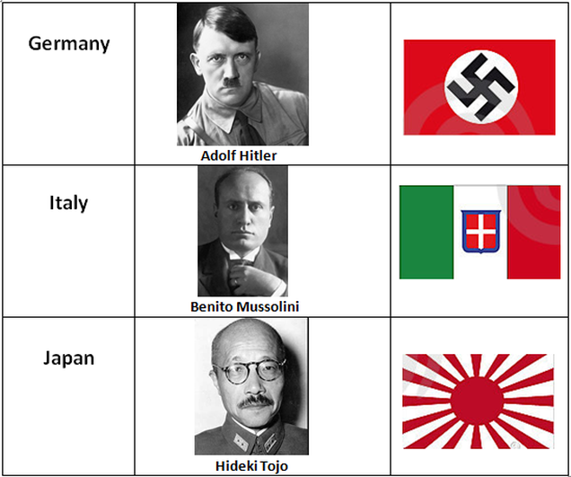
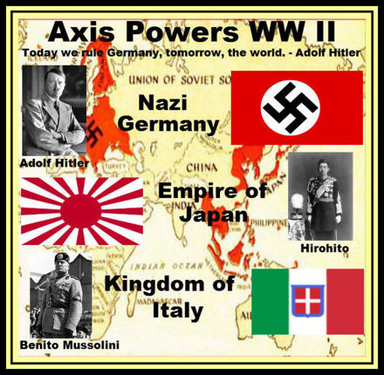
The Axis Threat
On September 27, 1940, Americans found out that Germany, Italy, and Japan had signed a defense treaty known as the Tripartite Pact. The three nations officially became known as the Axis Powers.
The Tripartite Pact was aimed at
keeping the United States out of the
war.
If the U.S. would declare war on any one
of the Axis Powers, it would be the same as
declaring war on all of them.
The U.S. would end up fighting a war with its army
split between two oceans.

Slide 4
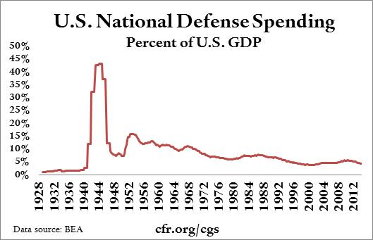
Building U.S. Defenses
Roosevelt, realizing that the United States might eventually be forced to enter the war anyway, asked Congress to increase spending for national defense.
Because the Nazi had so many big wins in 1940, defeating areas of Europe, Congress stopped believing that the United States would never have to get involved in the problems of Europe and they put more money into the defense department (the military).

Slide 5
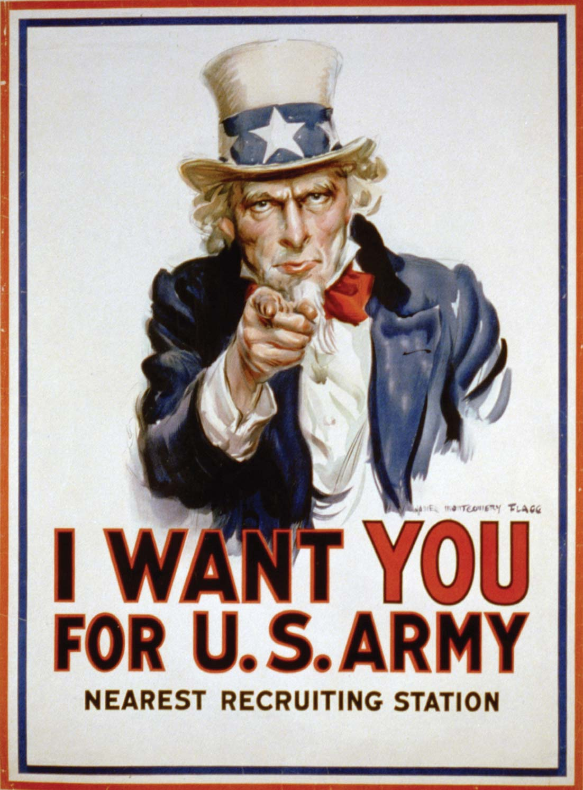
Selective Training and Service Act
Congress also passed the first peace time military draft, the Selective Service and Training Act.
This draft was to increase the amount of military men in the United States’ armed forces so that they would already be trained and ready in the case that we would enter the war.

Slide 6
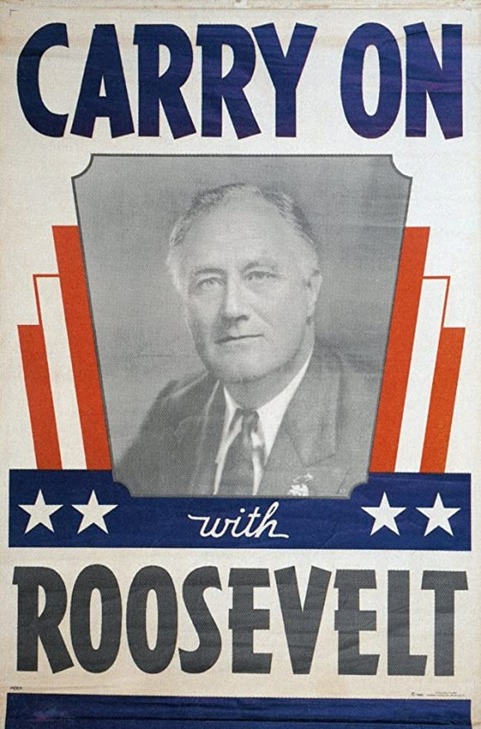
Roosevelt Runs for a Third Term
Roosevelt decided to go against tradition of American presidents only running for two terms.
Both Roosevelt and his opponent, Wendell Wilkie, used the promise of keeping American out of the war in their campaign.
Roosevelt was very well known and trusted by the public, and this help him win a third term as President.
This was a tradition started by George Washington, who refused to try for a third term in office, claiming that he did not thinks any one person should ever hold that much power.
This was never actually written into the Constitution as a law, it was just a tradition that had been followed ever since.

Slide 7
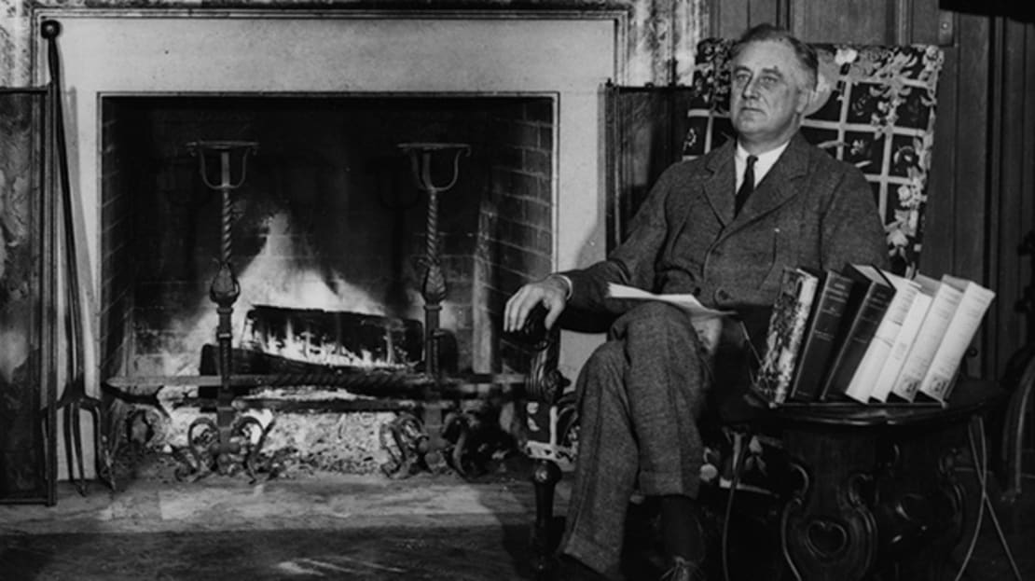
The Great Arsenal of Democracy
After Roosevelt was elected to his third term as President, he discussed the future of America in the war in one of his fireside chats.
Fireside Chats – speeches that President Roosevelt would give over the radio from the White House, but in the speeches he would explain things that were important to Americans in a way that everyone could understand and relate to.
Roosevelt’s fireside chats made regular Americans feel more in touch with our government and brought trust in the President.
Roosevelt made it clear that if Hitler defeated Great Britain, there would be no one left to stop him from conquering other parts of the world, so the United States had to help Great Britain.

Slide 8
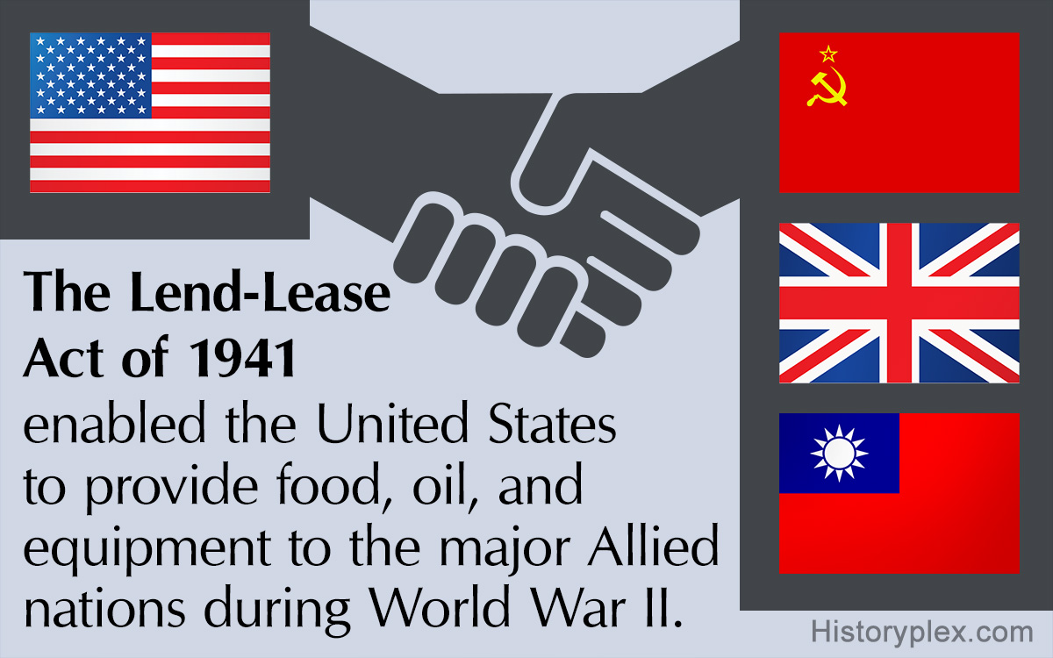
Lend –Lease Plan
By 1940, Great Britain had no money left to buy war supplies, so Roosevelt came up with the Lend-Lease Plan.
According to the plan, the President would approve the lending or leasing of military supplies to any country whose defense was considered vital to the United States. Simply put, since we needed Great Britain to stop Hitler’s German army, it would benefit the U.S. to make sure that they had the supplies that they needed.
Congress passed the Lend-Lease Act in March 1941.

Slide 9
The Soviet Union Switches Sides
In 1941, Hitler broke the agreement that he had made with Stalin in the Soviet Union and sent his armies to invade the Soviet Union.
That invasion made Stalin see Hitler as an enemy and the Soviet Union officially joined the side of the Allied Forces.
Because Stalin’s Soviet Union was now on the Allied side, Roosevelt approved supplies to be sent to the Soviet Union through the Lend-Lease Act.

Slide 10
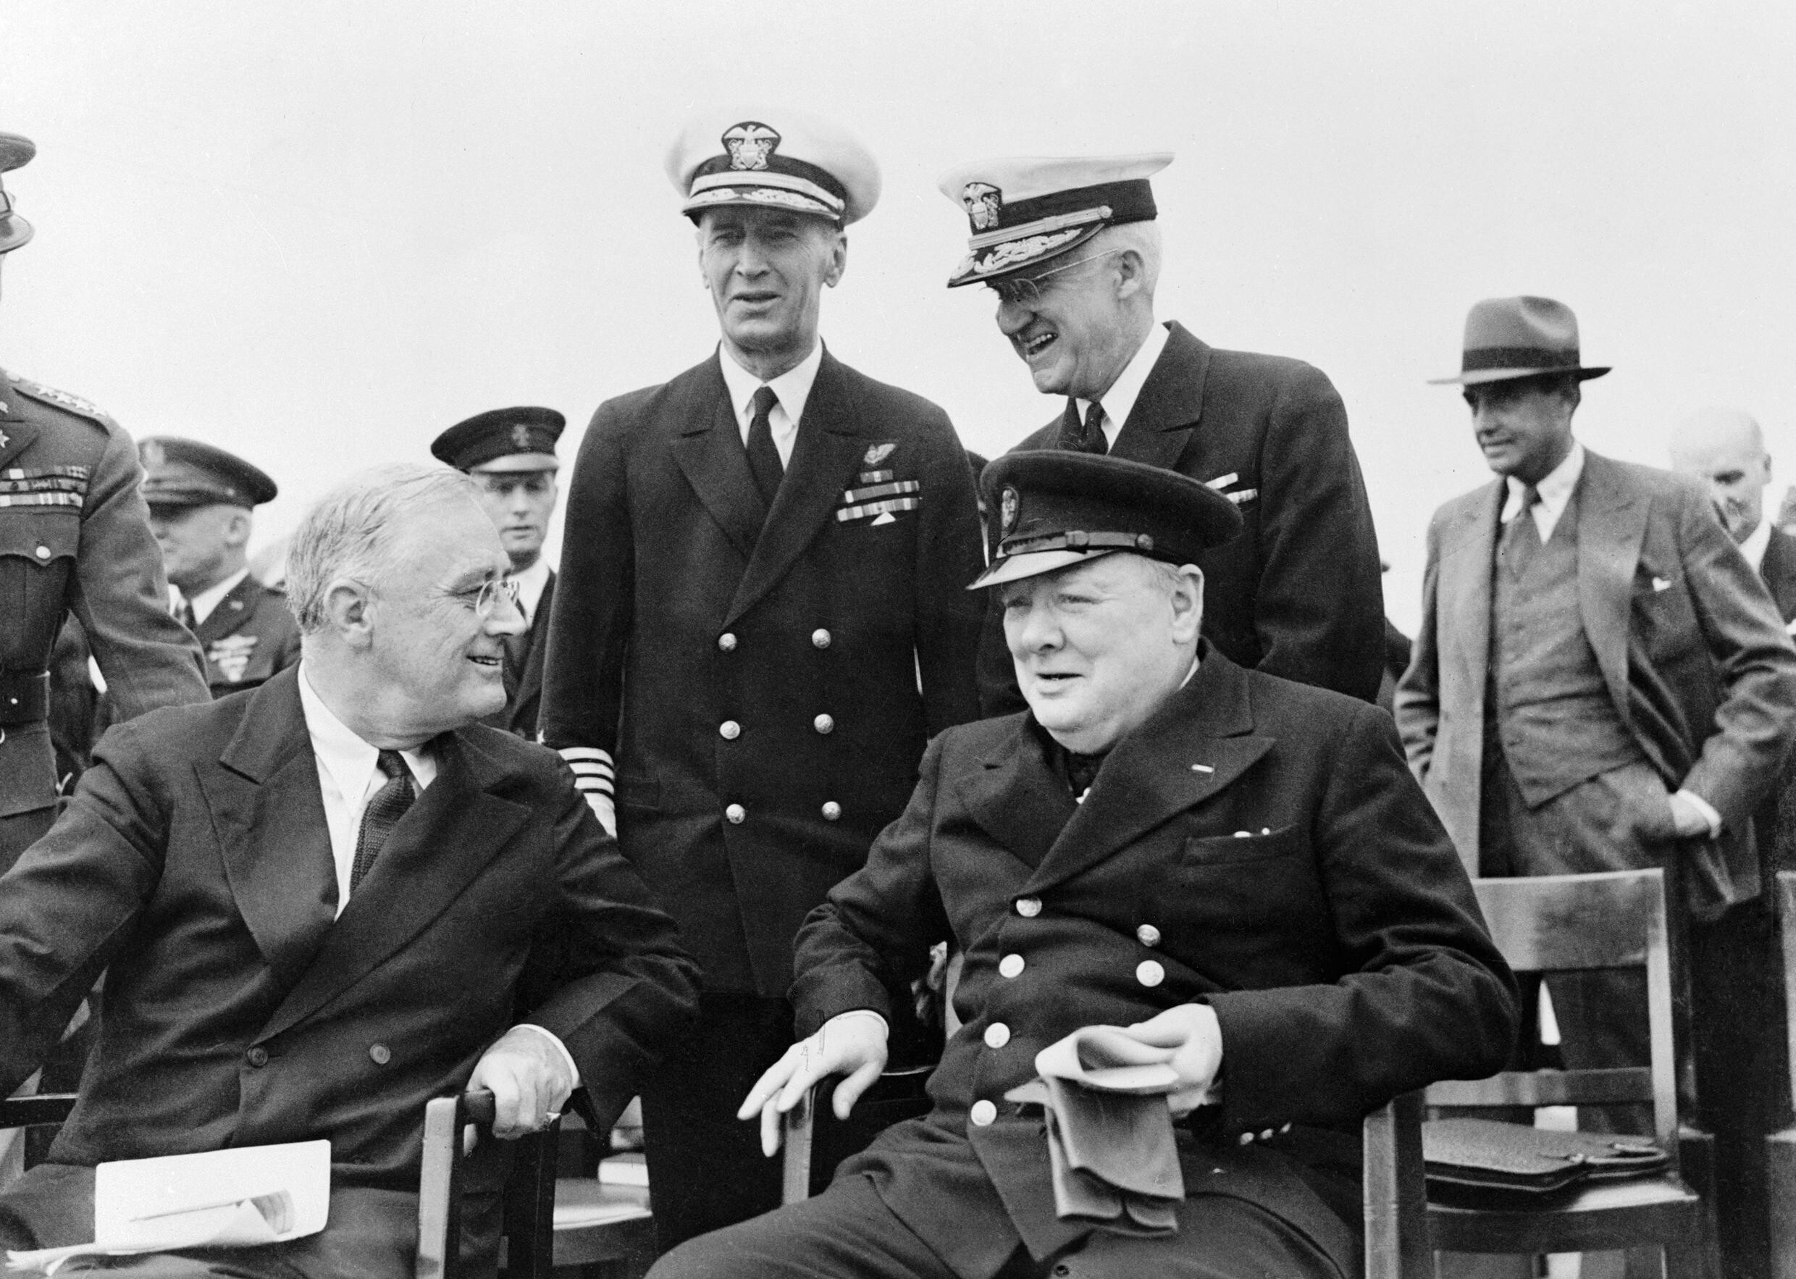
The Atlantic Charter
Atlantic Charter – an agreement between President Roosevelt and Prime Minister Winston Churchill of Great Britain that set goals for opposing the Axis Powers in World War II.
Both Countries Pledged (promised):
1. Collective Security – both countries would help to defend each other
2. Disarmament – Force Germany to give up its military
3. Self-determination – After the war, countries would decided on what government they wanted for themselves
4. Economic Cooperation – both countries would help each other financially
5. Freedom of the Seas – countries would be able to trade overseas without other countries stopping them

Slide 11
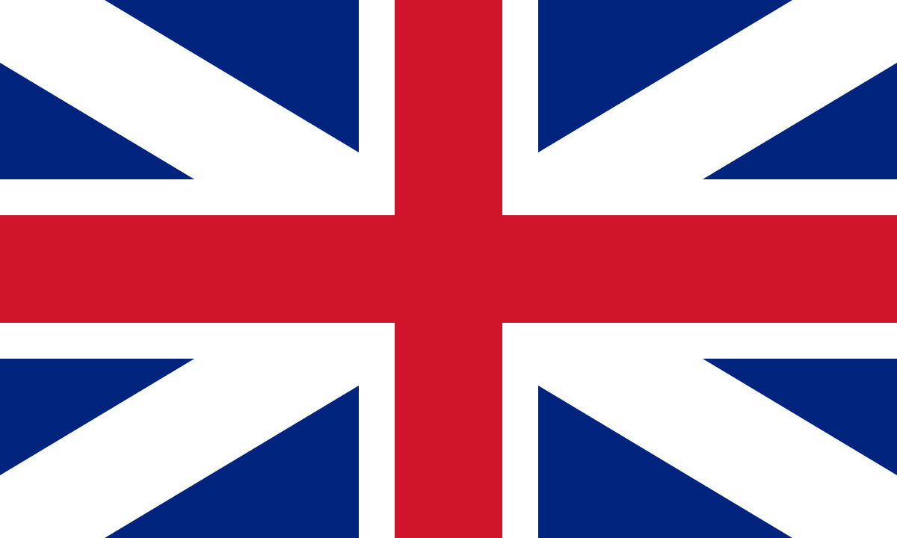
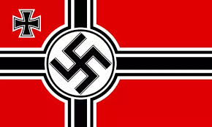
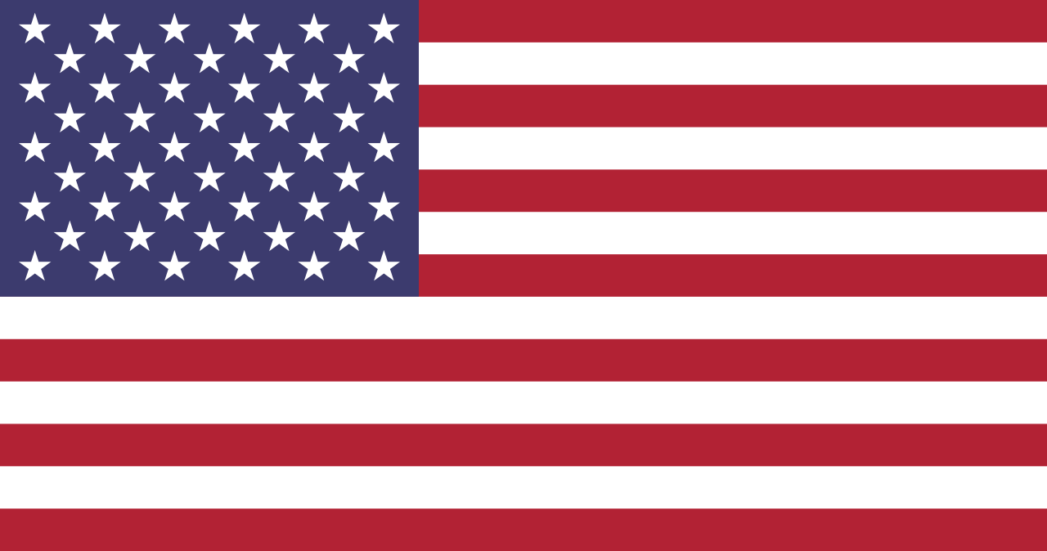
2 Sides of the War By 1941
Allied Power
Axis Powers
Great Britain
France
Soviet Union
The United States (by December 1941)
Germany
Italy
Japan

Slide 12
Japan Attacks the United States
Hideki Tojo – the chief of staff of the Kwantung Army of Japan
Since European colonies were not protected by their European owners due to the fighting in WWII, Japan took that as an opportunity to take those colonies under Japanese control.
The U.S. showed disapproval of the Japanese invasions of other colonies by stopping trade with Japan, especially materials that would be needed for Japan to keep fighting like oil.
Japan felt that they either needed the U.S. to trade with them again, or it would lead to Japan going to war with the U.S.

Slide 13
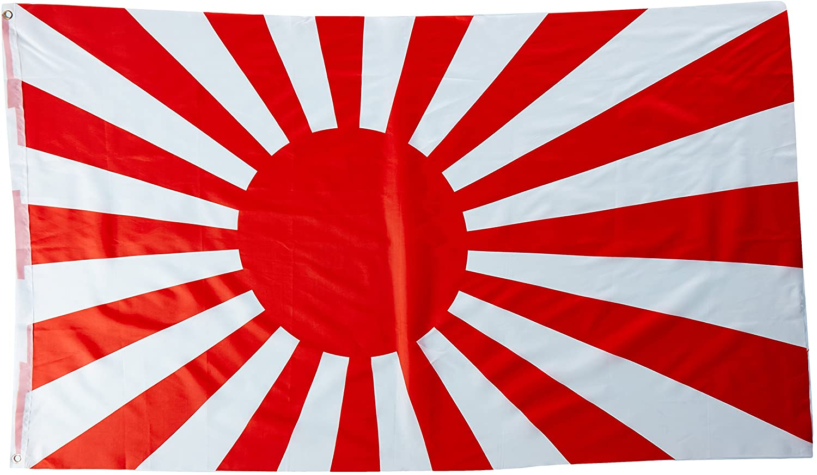
Peace Talks With Japan In Question
When Hideki Tojo became the Prime Minister of Japan, he met with the Emperor (like a king).
Tojo promised to try to keep peace with the U.S., but at the same time he was preparing the Japanese Navy for war with the U.S.
The U.S. military had broken the Japanese communication codes and learned that Japan was planning an attack on the U.S. They just did not know when or where.
Roosevelt sent a message to U.S. military based around the Pacific Ocean, warning them, but also saying that he wanted to wait for Japan to make the first move.
The U.S. was involved in peace talks for a month. On December 6, 1941, Roosevelt received a coded message that instructed Japan to destroy all documents and coding machines, A sign that they were not trying to make peace for the U.S. anymore.

Slide 14
Attack on Pearl Harbor, Hawaii
Early on Sunday morning, December 7, 1941, over 180 Japanese warplanes and bomber planes flew to Pearl Harbor, Japan where the U.S. Navy base was located.
Pearl Harbor had most of the navy’s ships that were in the Pacific Ocean all based there.
Pearl Harbor also had a large airfield that held many of the planes for the military in that area of the country.
In less than 2 hours, the U.S. Navy had suffered more damage than in all of World War I.

Slide 15
Reaction to Pearl Harbor
The day after the Pearl Harbor attack, President Roosevelt gave a speech to Congress, in the end ask Congress to vote to declare war on Japan.
Three days later, Germany and Italy declared war on the United States.
The United States was officially involved in World War II, fighting in both Europe and Asia at the same time.

